Slide 1
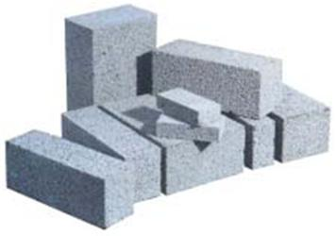
Some Assembly
…
required
Building Successful R&D Partnerships
Kathie L. Olsen, PhD
Founder & Managing Director
Scienceworks, LLC
May 1, 2015

Slide 2
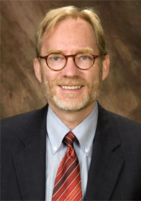
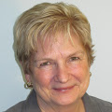
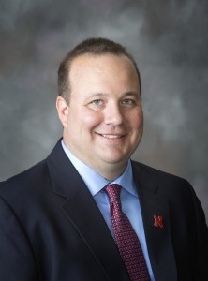
Thank you
David Stone, Associate VP for Research, Northern Illinois University (President)
Anne Geronimo,
Director for Research,
University of Maryland
(Conference Planning Committee)
Nathan L. Meier, Director of Research Strategy, University of Nebraska, Lincoln (Friend!)

Slide 3
Kathie L. Olsen, Ph.D.
Former Associate Director
for Science,
OSTP, EOP
Former NASA
Chief Scientist
Former Vice President, International Programs
Association for Public and Land-grant Universities
Former NASA
Act. Assoc. Adm. For
Biological & Physical
Research
Former Deputy Director
and COO of the
National Science Foundation
And Now-------
Founder, Managing Director
ScienceWorks
Former NSF Employee
(at least five different positions)
Former Adj. Assoc.Prof.
George Wash. Med.School
Former Postdoctoral Fellow- Harvard Med. Sch
Former Brookings Fellow
In Senator’s Office
Former Asst. Prof. SUNY-Stony Brook
Former Graduate Student- UC-Irvine

Slide 4


2015 Meeting:
Building R&D Partnerships
Committee Meetings:
  Enhancing Research Collaborations
Sessions
Breakout and Roundtable
  The Collaboration Continuum: An R&D Perspective on Building Teams
  Strategies to Support Multi-Institutional, Cross Conference Research Collaborations
  Building Partnerships to Enhance Global Research
  Gender and Team Science: Improving Collaborative Effectiveness of Research Teams
  Grand Challenge Research Initiatives and the “Grand Challenge” of Building Partnerships Within and Outside the University
  The Role of Creativity in Research Development
Idea Showcase
  The Steam Factory: Fostering Interdisciplinary Collaboration and Innovation in an Academic Environment
Notes:
Took out “focus on” – that’s understood and too busy for the title. Changed “RD perspective” to “R&D perspective.” I think that’s what you meant? Deleted next slide, same as this one but without the image --abc

Slide 5
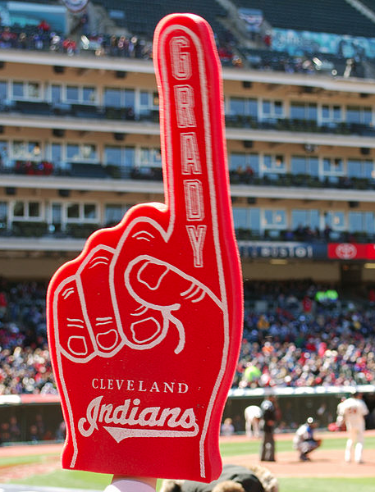
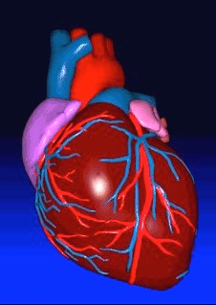





Diversity --
Who Needs It?
2!
1
AVIS
We Try Harder!
Crash Test Dummies
Human Heart
i ??
Voice
Recognition
"Grady Sizemore Foam Finger" by Chris Metcalf, with additions Licensed under CC BY 2.0 via Wikimedia
Notes:
Paula Green, who created the campaign, said it was true of her life as a female executive, we try harder! (we have to)

Slide 6
Diversity, Who Needs It?
WE DO!
“To fuel discovery, science needs a diversity of minds, perspectives, and voices. Research has shown that diverse teams make for better science and lead to better results.”—SfN Website
More perspectives are taken into account and fewer things taken for granted
  Improved understanding of the marketplace or for universities –understanding of the goals requested….
  Enhanced creativity and problem-solving abilities in teams
  Better use of talent
  Diversity of Teams = Better and more successful outcomes
Notes:
Reformatted -- abc

Slide 7
Diversity, Who Needs It?
WE DO!
Diversity is across dimensions: From an University Perspective
  Research, Teaching and Administrative Expertise
  Fields of Science and Engineering
  Institutional Positions: Faculty , Staff, Students
  Personality: Extrovert to Introvert
Diversity is more than male/female/under-represented groups
Research also shows that we all – regardless of the
social groups we belong to – perceive and treat people differently based on their social groups (race/ethnicity, gender, sexual orientation, disability, etc.)
Ely & Thomas (2001). Administrative Science Quarterly, 46(2), 229-273.
Page (2007). Princeton University Press, 6-20.
  Sommers (2006). J Personality and Social Psychology, 90(4), 597-612.
  Temm (2008). In Schiebinger (Ed.), Gendered Innovation in Science and Engineering (pp. 131-149). Stanford, CA: Stanford University Press.
Valian (1998) Why So Slow? The Advancement of Women. Cambridge: MIT Press, p. 280.
Rigoglioso www.gsb.Stanford.edu Aug. 1, 2006
Notes:
Reformatted -- abc

Slide 8

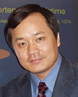


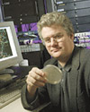

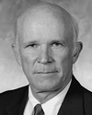
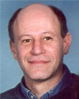
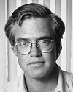
NIH 2004 Pioneer Award Recipients
Review panel: 61 men
4 women
Notes:
The second completion was ab out 50/50 for each..
What do you think? K

Slide 9
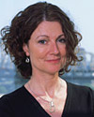
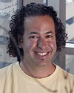
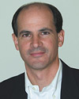


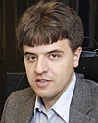

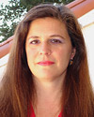
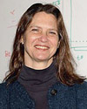
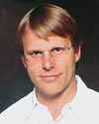
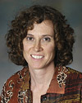

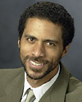
NIH 2005 Pioneer Award Recipients
Three phases of review:
Phase one= 47 men/17 women
Phase 2= 37/16
Phase 3=13/ 5
Notes:
Faces make the point better than names? All fron the NIH web site.

Slide 10
Stereotypes
Explicit and Implicit
Conscious,
intentional,
subject to logic.
Unconscious,
automatic,
logic irrelevant.
Overt Bias and discrimination have decreased globally, but UNCONSCIOUS BIAS is still a major challenge
Courtesy: Frederick L. Smyth, UVA, 2013, SfN IWIN
Notes:
Our implicit ones, on the other hand,
develop and influence us automatically,
are outside our consciousness,
and may be at odds with our explicit beliefs and values.
[click]

Slide 11
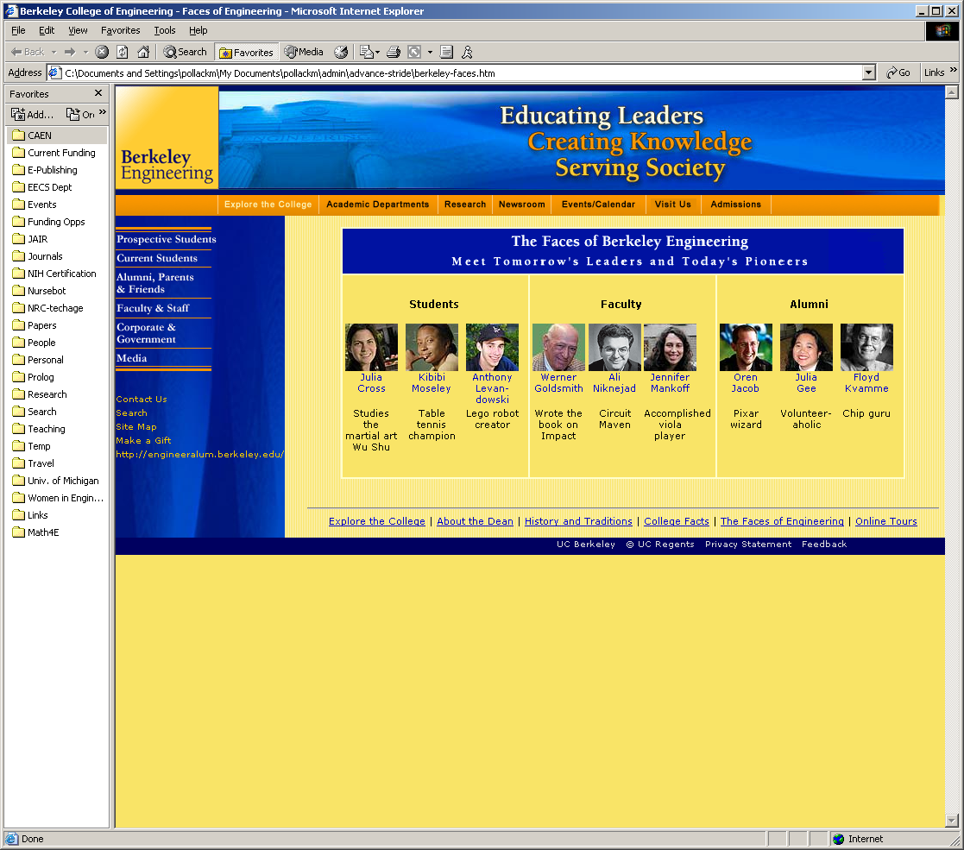
What is the effect on applicants -- aspiring students and potential faculty?
How is it that people committed to diversity made such a web page? It was clearly not done intentionally, meaning that there was an unconscious element.
Slide provided: STRIDE: University of Michigan ADVANCE
Notes:
I would use this one.

Slide 12

I was arguing with my girlfriend about women
not inventing anything useful.
In an attempt to prove me wrong
she Googled “She invented” only to have it ask,
“Did you mean ‘He invented’?”
-- submitted by Tom Boutcher to digg.com: May 6, 2007
Me: “She discovered.” Google: “Did you mean ‘He discovered’?”
Me: “She calculated.” Google: “Did you mean ‘He calculated’?”
Me: “She analyzed.” Google: “Did you mean ‘He analyzed’?”
Me: “She led.” Google: “Did you mean ‘He led’?”
Me: “She CRIED!” Google: _____
Unconscious Bias: Even on Google!
Notes:
Also works with “discovered,” “calculated,” “analyzed,” and even “led.” However, if you type in something like “she cried,” it does NOT ask if you meant “he cried.”
I would not use this one for this talk – like the Verizon campaign one better, and really, the “faces of Berkeley” one makes the point. Delete at least one, if not both this one and the Verizon campaign.

Slide 13

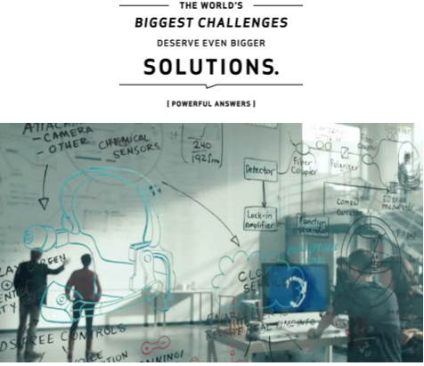
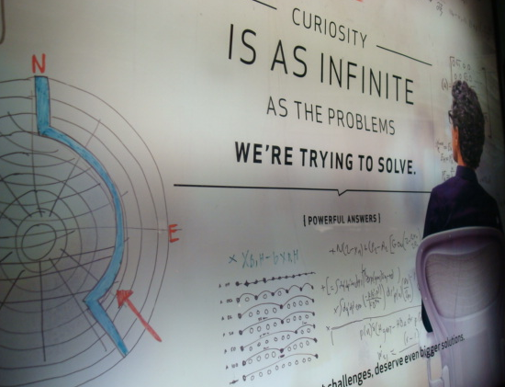
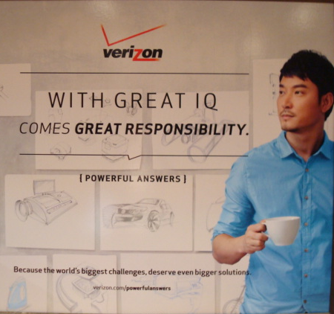

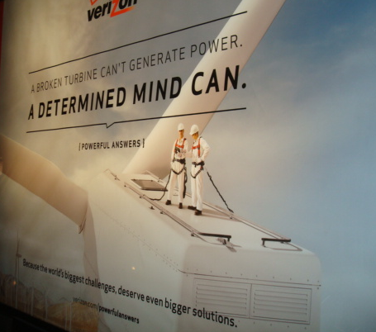
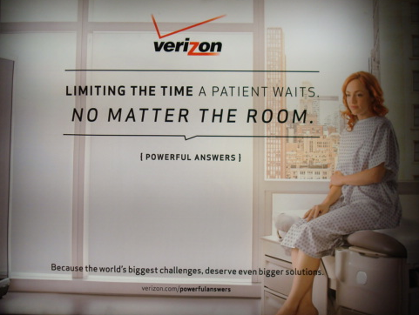

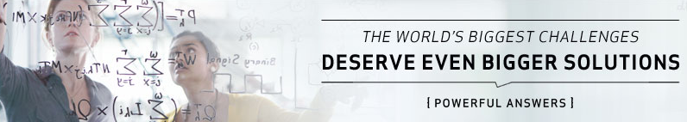
Consider the recent VERIZON “Powerful Answers” campaign!

Slide 14
Evaluation of Identical CVs: Gender
When evaluating identical application packages, male and female University psychology professors preferred 2:1 to hire “Brian” over “Karen” as an assistant professor.
When evaluating a more experienced record (at the point of promotion to tenure), reservations were expressed four times more often when the name was female.
Karen
Brian
Steinpreis, Anders, & Ritzke (1999) Sex Roles, 41, 509.
Slide provided: STRIDE: University of Michigan ADVANCE & SfN IWIN

Slide 15
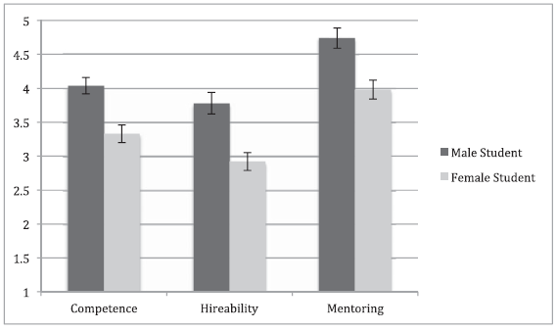
STEM Faculty’s judgments of lab manager applicant
Rating
Competence Hireability Mentoring
Moss-Racusin et al., 2012
Notes:
Finally, just last year, researchers demonstrated the effect of implicit gender bias on judgments made by current STEM faculty at research-intensive universities.
[click]

Slide 16
STEM Faculty’s judgments of lab manager applicant
Applicant Name
Male
Female
Rating
Competence Hireability Mentoring
Moss-Racusin et al., 2012
Notes:
The professors evaluated the credentials of someone they believed was actually seeking employment as a science lab manager. Just like the crying baby experiment, the only difference in the credentials was the gender implied by the name.
[click]

Slide 17
STEM Faculty’s judgments of lab manager applicant
Applicant Name
Male
Female
Rating
Competence Hireability Mentoring
Moss-Racusin et al., 2012
Notes:
The male candidate was favored on nearly every dimension:
[click]

Slide 18
STEM Faculty’s judgments of lab manager applicant
Applicant Name
Male
Female
Rating
Competence Hireability Mentoring
Moss-Racusin et al., 2012
Notes:
More competent,
[click]

Slide 19
STEM Faculty’s judgments of lab manager applicant
Applicant Name
Male
Female
Rating
Competence Hireability
Moss-Racusin et al., 2012
Notes:
More hireable,
[click]

Slide 20
STEM Faculty’s judgments of lab manager applicant
Applicant Name
Male
Female
Rating
Competence Hireability
Moss-Racusin et al., 2012
Notes:
More hireable,
[click]

Slide 21
STEM Faculty’s judgments of lab manager applicant
Applicant Name
Male
Female
Rating
Competence Hireability Mentoring
Moss-Racusin et al., 2012
Notes:
More hireable,
[click]

Slide 22
STEM Faculty’s judgments of lab manager applicant
Applicant Name
Male
Female
Rating
Competence Hireability Mentoring
Moss-Racusin et al., 2012
Notes:
And more worthy of mentoring.
[click]

Slide 23
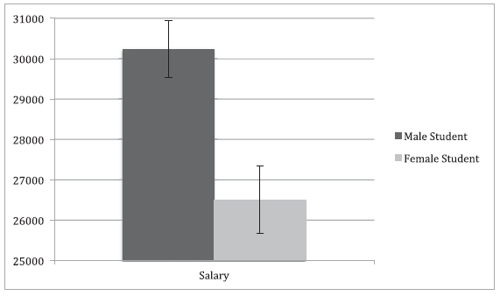
Salary Offered
Salary Offered
Male Female
Applicant Gender
Moss-Racusin et al., 2012
Notes:
And also worthy of 14% more salary!
[click]

Slide 24
Salary Offered
But women
more “likeable”!
(what is in a name?)
* Are all we: Karma!
Salary Offered
Male Female
Applicant Gender
PNAS: Moss-Racusin et al., 2012
Courtesy: STRIDE: University of Michigan ADVANCE & SfN IWIN, 2013
Notes:
Interestingly, though a female name on the portfolio was a liability on every competence-related outcome, it was a plus for ratings of likeability.
[click]

Slide 25
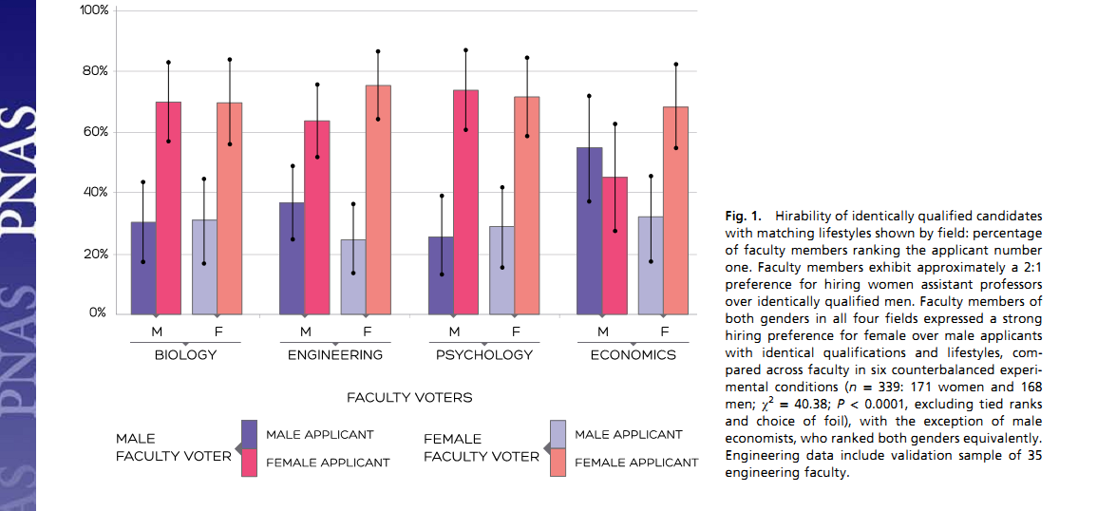
National hiring experiments reveal 2:1 faculty preference for women on STEM tenure track
Wendy M. Williams¹ and Stephen J. Ceci
PNAS April 13, 2015

Slide 26
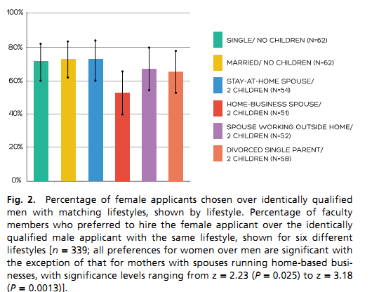
National hiring experiments reveal 2:1 faculty
preference for women on STEM tenure track
Wendy M. Williams¹ and Stephen J. Ceci
PNAS April 13, 2015

Slide 27
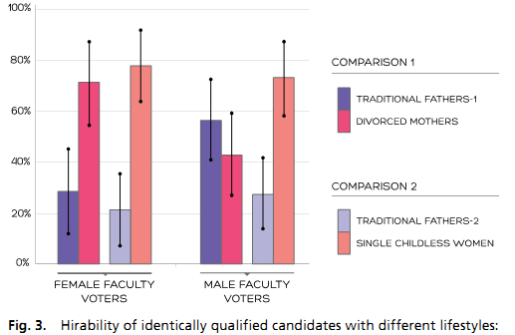
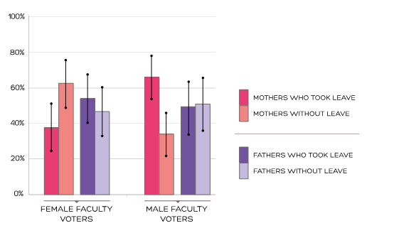
National hiring experiments reveal 2:1 faculty preference for women on STEM tenure track
Wendy M. Williams¹ and
Stephen J. Ceci
PNAS April 13, 2015

Slide 28
Unconscious Bias:
Impact of Blind Auditions
Based on audition records of 14,000 individuals & rosters from symphony orchestras: 1970-1996:
The audition data show the use of a screen
  increases the probability that a woman will advance from preliminary rounds by 50%
The roster data show the switch to blind auditions
  accounts for 30% of the increase in the proportion of women among new hires
Goldin & Rouse (2000) The American Economic Review, 90, 4, 715-741.
Notes:
reformatted

Slide 29
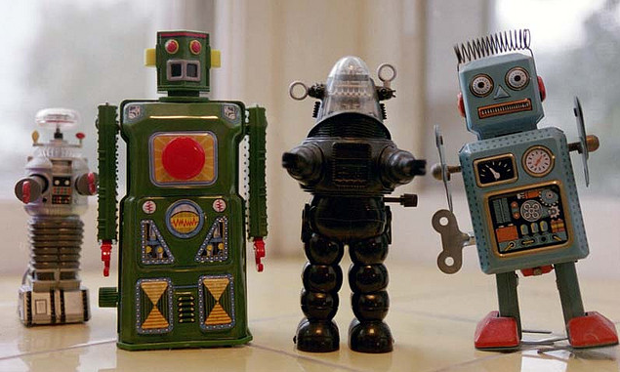
Unconscious Bias:
(Its impact on Fostering a Creative, Innovative, Center-Type Team)
Adapt new Strategies from successful NSF Advance Grants/ SfN WIN Grant/website
Brainstorming Sessions for New Ideas and Vision
  Invite all (Open Recruitment!)
  Topic can be broad (Too narrow limits participation)
Building Teams
  The POWER of More than One!
    Visible diversity can have negative effects on group, but ONLY INITIALLY (M. Neale)
  Increase conscious awareness of bias and how bias blinds us to new ideas
  Foster cooperation and an atmosphere for dissenting views to be freely shared
  Is the climate for discussion inclusive to listening/appreciative of all ideas?
How are Decision Made
  If too rapid, criteria unclear, information is ambiguous or incomplete….
Implicit bias affects STEM outcomes
We each have unique strengths
and perspectives
Image: flickr, courtesy Creative Commons license

Slide 30
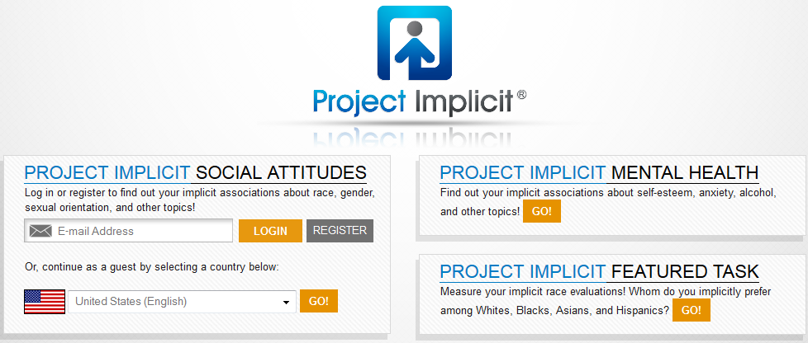
implicit.harvard.edu/implicit/
Notes:
Though we haven’t systematically tested a UVa vs. Tech IAT beyond UVa’s hallowed grounds, this is the basic methodology and theory behind the IAT.
Hundreds of other implicit associations have been studied through Project Implicit via the Internet. It was founded by Tony Greenwald at University of Washington, Mahzarin Banaji at Harvard, and my UVa colleague Brian Nosek, and now about 20,000 visitors each week complete a variety of IATs.
[click]

Slide 31
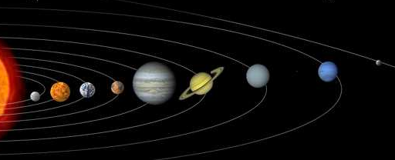
You are here
Coordinating Science and Technology Inside the Federal Government

Slide 32
How are U.S. S&T Priorities and Budgets Set?

Slide 33
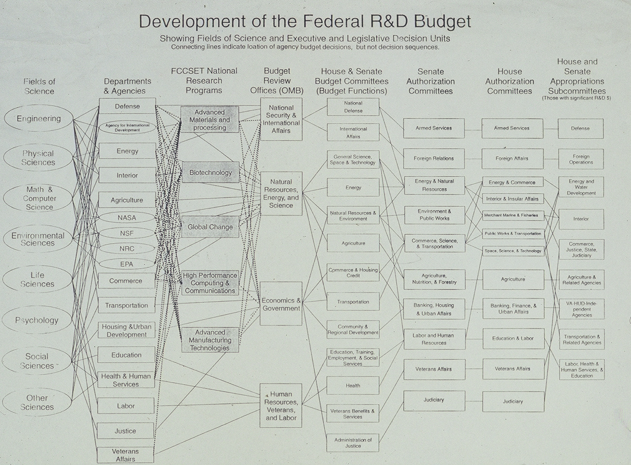

Slide 34
S&T Priorities and Budgets
The National Science and Technology Council (NSTC)
President’s Council of Advisors on Science & Technology (PCAST)
A Cabinet-level council of advisers to the President on Science and Technology
Principal means to coordinate science and technology matters within the Federal research and development enterprise
Means to establish clear national goals for Federal science and technology investment.
PCAST is an advisory group to the President and his Executive Office and consists of the nation’s leading scientists and engineers
PCAST assists the National Science and Technology Council (NSTC) in securing private sector involvement in its activities
PCAST is administered by the Office of Science and Technology Policy (OSTP).
OSTP / OMB Guidance Memorandum
for FY S&T Priorities

Slide 35
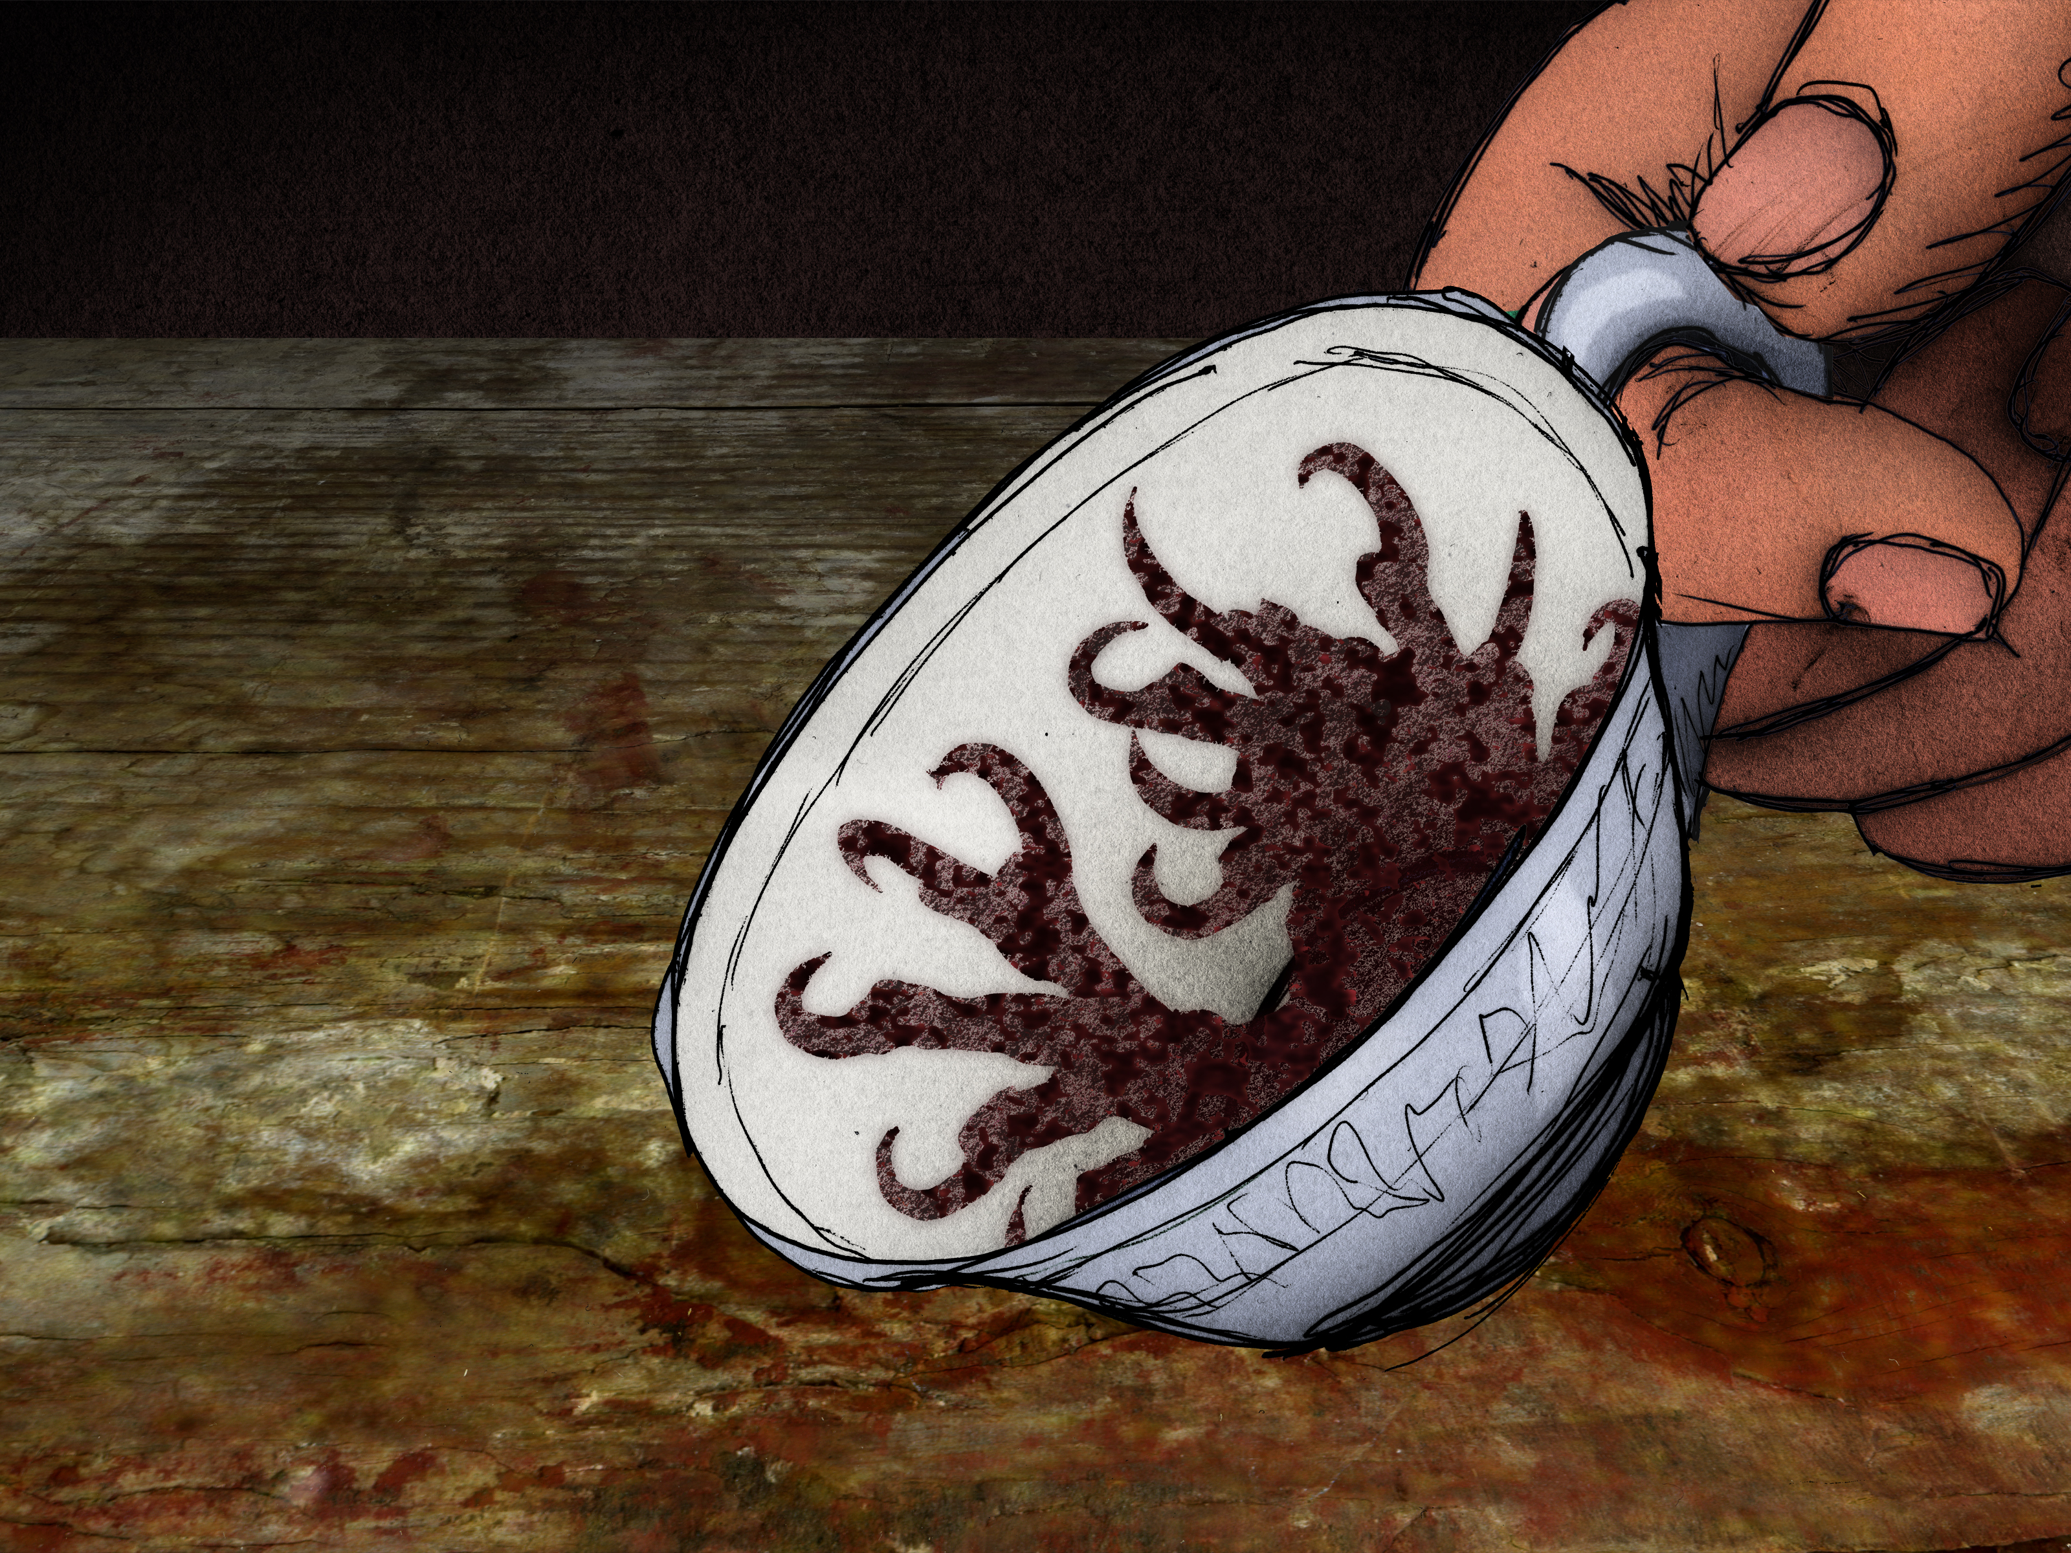
How To Read the Tea Leaves?
Predicting the Future of…
NSTC
Report
Report
OSTP/OMB
memo
Report
Report
Federal Funding
Report
PCAST
Report
Image: Gunnar Creutz, Falbygdens museum
Wikimedia Commons

Slide 36

National Science and Technology Council (NSTC)
Established by Executive Order of President Clinton on November 23, 1993.
Operates by Committees, Subcommittees and Working Groups to coordinate R&D.
Used it to organize and convene large stake-holders meetings
  Resulted in Reports, Priorities and Action
  PECASE
Notes:
reformatted

Slide 37
Current NSTC
Structure
Oct. 2003
National Science and Technology Council
Director, OSTP
Committee on
Environment &
Natural Resources
Committee on
Science
Committee on
Technology
Committee on
Homeland and
National Security
WH: Olsen
NSF: Colwell
NIH: Zerhouni
WH: Olsen
DOC: Lautenbacher
EPA: Gilman
WH: Russell
DOC: Bond
WH: Dale
DOD: Wynne
DHS: McQueary
Research Business Models
Education & Workforce Dev.
Technology Dev.
Global Change Research
National Security R&D
Air Quality Research
Large Scale Science
Networking Information
& Technology
Radiological/Nuclear
Countermeasures
Aquaculture
Disaster Reduction
Nanoscale Science, Eng.
& Technology
International
Human Subjects Research
Ecosystems
IWG Physics of the Universe
WMD Medical
Countermeasures
Toxics & Risks
Aerospace
IWG Plant Genome
Standards
Water Availability & Quality
IWG Dom. Animal Genomics
IWG Earth Observations
R&D Investment Criteria
Research Misconduct Policy
Infrastructure
IWG on Dioxin
Biotechnology
Legend
Oceans
Informal
Social, Behavioral & Econ.
Under development
Health and the Environment.

Slide 38
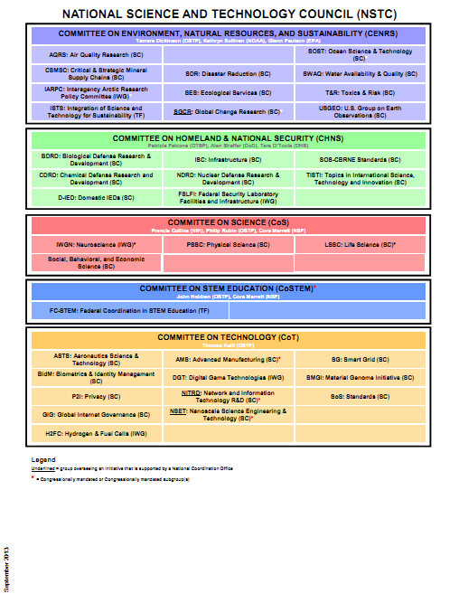
Current
Notes:
I’m not stopping here, but if I did, you can already take these messages away:
implicit bias is consequential for STEM gender disparities
and no one is immune, not even people like us, who are well-aware of the possibility.
[click]
Note: lots more acronyms, arguably less science. --abc

Slide 39
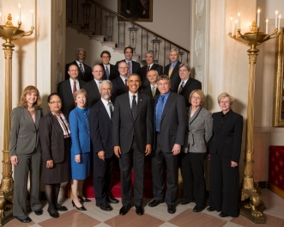
President’s Council of Advisors on Science & Technology (PCAST)
  Makes policy/priority recommendations
Meetings and Meeting Agendas
  Almost Bimonthly
  Agendas reflect priorities and to be priorities
  Meet with the President
Reports
  Accelerating U.S. Advanced Manufacturing
  National Nanotechnology Initiative*
  Education Technology- Higher Ed & Skills & Jobs
  Antibiotic Resistance
  Systems Engineering in Healthcare
  Big Data and Privacy
  Cybersecurity
  Climate Change
  Networking & Information Technology*
  Innovation in Drug Discovery, Dev. & Evaluation
  Etc…..

Slide 40

Critical to Understand That, in the Federal Government…
What Goes Around
Comes Around

Slide 41
Current Activities of the
President’s Council of Advisors on
Science & Technology and the
National Science & Technology Council
Déjà Vu!
And on the same day too…
Kathie Olsen, OSTP & Connie Atwell, NIH
at the Federal Demonstration Partnership
May 1, 2003

Slide 42
My first talk about our NEW NSTC…
Subcommittee on
Research Business Models
Goals
Facilitate a coordinated effort across Federal agencies to identify and address important policy implications arising from the changing nature of scientific research
Examine the concomitant impacts these changes have had or should have on business models and business practices for the conduct of scientific research sponsored by the Federal government and carried out by academic, industrial, and government entities
Notes:
The first meeting of the Subcommittee was held on Friday, February 21 –very well attended by the research agencies
OSTP is interested in the topic of earmarks and the resulting impact on the research enterprise
Dr. Zerhouni would like the subcommittee to explore the “human capital” area of research funding, and review how the mix of investigators supported is influenced by changing business models and practices.

Slide 43
Research Business Models:
Workgroups
Common Practices Among Agencies
Alignment of Funding Mechanisms with Scientific Opportunities
Appropriate Costs of Research Enterprise: Determination, Recovery, Accountability
Notes:
Regulatory issues may be most relevant to RBM efforts

Slide 44
Research Business Models Workgroup:
Common Practices Among Agencies
Policies and procedures among agencies
Streamlining & unifying grants administration practices
Impact of regulatory and administrative burden
Agency treatment of indirect costs: common and uncommon practices

Slide 45
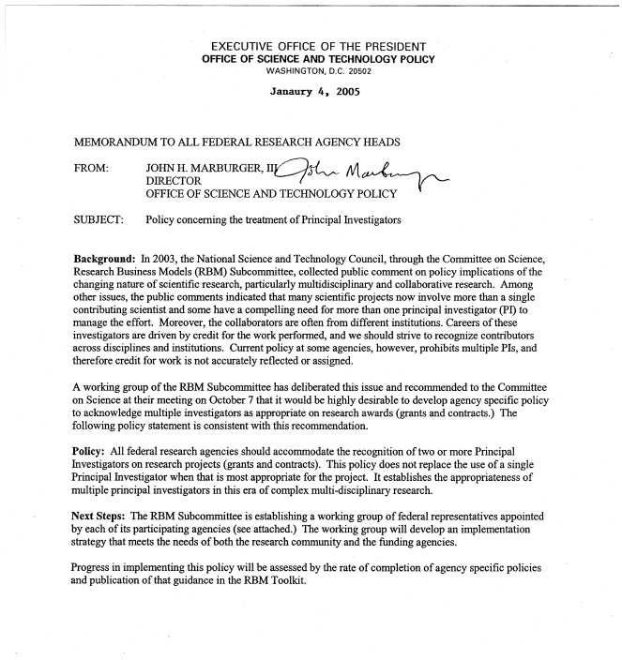
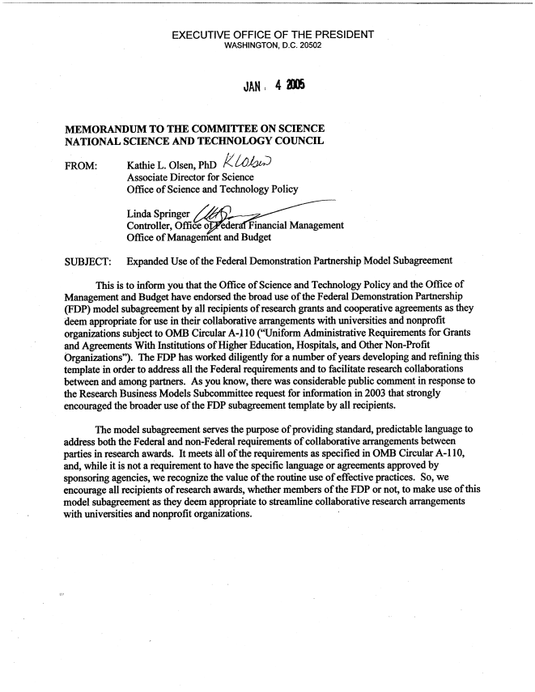
NSTC Subcommittee on Research Business Models
And by May 2005…
• Recommend that all federal research agencies should recognize two or more Principal Investigators on research projects
Endorsed the broad use of the Federal Demonstration Partnership model subagreement
• Issued proposed streamlined research grant award terms and conditions

Slide 46

Other Activities
National Science Board
Institute of Medicine/National Research Council
Chair: Arthur Bienenstock, Stanford
Recommendation is to establish a permanent high-level inter-agency, inter-sector committee with OMB/Office of Information and Regulatory Affairs (OIRA)
Committee on Federal Research Regulations and Reporting Requirements: A New Framework for Research Universities in the 21st Century
Ad hoc committee under Committee on Science, Technology and Law (CSTL) and the Board of Higher Education and Workforce (BHEW)
Geoffrey E. Grant, President Research Advocates
Town Meetings across the Country
  San Francisco in May
  DC in July

Slide 47
Reauthorization of the
America COMPETES Act
“Sense of Congress”
  High burdens/costs in federal research admin, ie: higher ed, are eroding basic research funds
  Progress has been made, but post-award admin costs & reporting requirements continue to grow
  Estimated 30% of federally invested funds are consumed by paperwork
  These processes must be streamlined so more money goes to research activities
Therefore, the OSTP Director shall…
  Est. a working group for reviewing federal regulations affecting research/research universities, & make recommendations on how to:
    Streamline regulations & reporting requirements
    Min. burdens on higher education institutions while maintaining accountability
    Identify/update regulations to refocus on performance-based goals while still meeting desired outcomes

Slide 48
NEW Working Group for
Reviewing Federal Regulations
  The working group will take recommendations from:
    Federally and non-federally funded researchers
    Institutions of higher education
    Scientific Societies & Associations
    Nonprofit Research Institutions
    Industry
    Federally funded R&D centers
    Etc.
  OSTP Director will report annually on steps taken to carry out working group recommendations to:
    House Committee on Science, Space, and Technology
    Senate Committee on Commerce, Science, and Transportation.

Slide 49

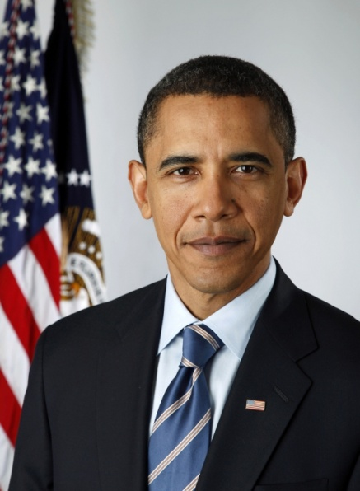
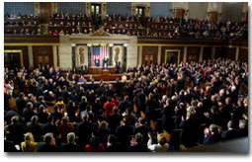
Congress Disposes
The President
Proposes
_._._._._._._._._._

Slide 50
How To Read the Tea Leaves?
Predicting the Future of…
Statements
Authorization
Studies
CONGRESS
Federal Funding
Appropriations
Questions
Reports
Image: Gunnar Creutz, Falbygdens museum
Wikimedia Commons

Slide 51
Critical to Understand That, in the Federal Government…
What Goes Around
Comes Around

Slide 52


Decade of the Brain
  BRAIN Initiative
  President Obama announced, April 2, 2013
  Brain Research through Advancing Innovative Neurotechnologies
$100M to Invest with NIH, NSF and DARPA & Private Sector Investments
Interagency Working Group
  Led Phil Ruben, OSTP (NIH/NSF)
NIH named Advisory Committee to Director--Reports
Congressional Champions
  Congressman Chaka Fattah (D-PA) APPROPRIATIONS
  Neuroscience Caucus
    Rep Earl Blumenaurer (D-OR)
    Rep Cathy Mc.Morris Rodgers (R-WA)
President George Bush designated the 1990’s as the Decade of the Brain
Interagency Committee
  NIH, NSF, DOD, NASA et al.co-led by Alan Leshner
  Reports
Congressional Champions
  Rep. Silvio O. Conte, (R-MA)
    Died 69, 1991
  Rep. William H. Natcher (D-KY)
    Died 1994
    NIH Natcher Building
NIH DOUBLING: Presidents’ Clinton and Bush; NIH Directors Varmas & Kirschstein
Rep. John Porter-R-IL & Senator Arlen Spector R-PA , Sen. Barbara Mikulski D-MD

Slide 53
REFLECTIONS
Every agency evolves with new leadership
  Priorities
Culture, Values, Missions remain
  Role/Power of the Program Directors
  Review Processes
  Bottoms up or Top down
Flat budgets have impacts more than lower success rates
  More bureaucratic/less flexibility/moral
Sustained Support for Research and Education is required to maintain our “American Dream”

Slide 54
Lessons Learned: U.S. Government
Never have a letter sent to you that you don’t want to answer—but with that letter you can MAKE changes
You learn more with conversation
Start at the bottom and move up, if needed
Never, EVER, put down an option—no matter how stupid—if can’t live with it (so contrary to science and grants)
Your BOSS is the President. During testimony-You always support the Budget…no matter how much more money you want for the Agency!
Always keep the high moral ground

Slide 55


Another Lesson:
We Do Reports—They Listen
And Learn

Slide 56
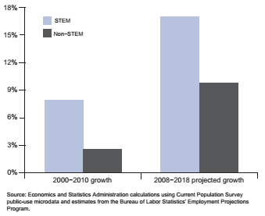
Recent and Projected Growth in STEM and Non-STEM Employment

Slide 57
Learn from the Lawyers
In 2010
  313.9 Million Lawyers
  805,500 US PHD in Science, Engineering & Health
1.27 M licensed by American Bar in 2012
Diversity of Training
  Expectations is that they are NOT all going to be law professors
    Favorite Line: “I didnt train you to go to the government!”

Slide 58
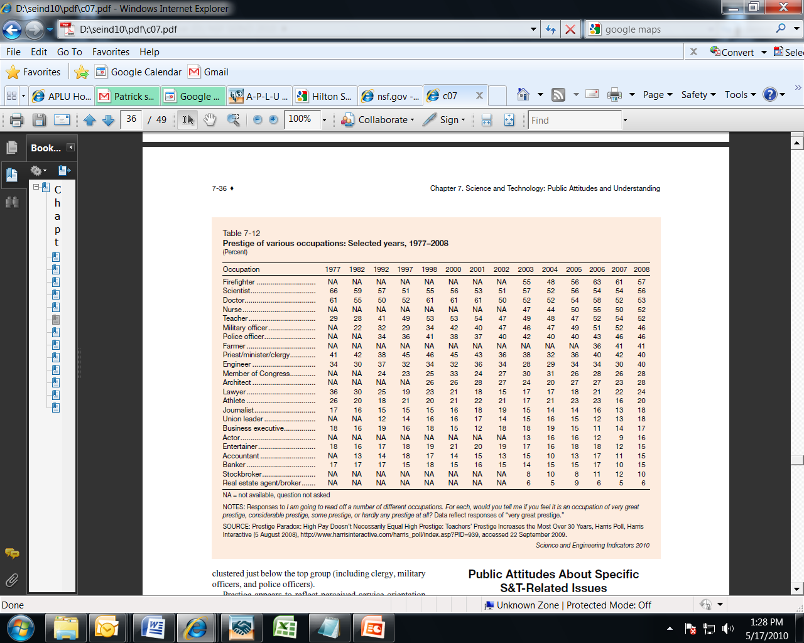
And WE have more Prestige
US
them

Slide 59


“The only way to discover the limits of the possible is to go beyond them
…into the impossible.”
THANK YOU NRODP!
Arthur C. Clarke
Notes:
Click for brain to appear in center of galaxy.

Slide 60
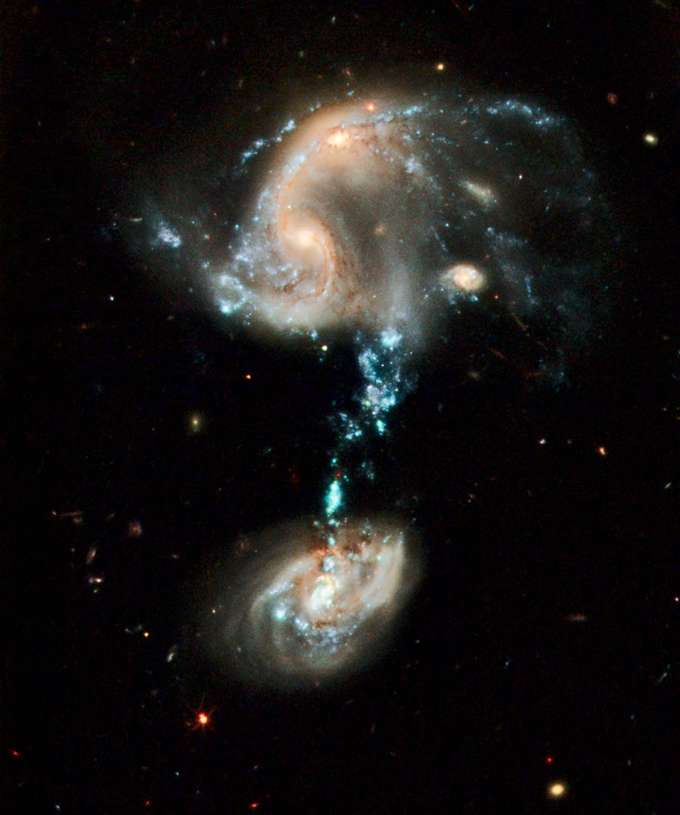
Are there any Questions?

Slide 61
Why Support University Research?
Primarily Basic/Fundamental Research
Integrates research with education
Researchers have flexibility
  Mobility among universities, types of institutions
  Capitalize on breakthroughs and emerging areas
  Collaborate across disciplines, institutions & countries
  Collaborate with industry
Cultivate interdisciplinary expertise in research and education to develop Centers of Excellence
Public service and education of community

Slide 62
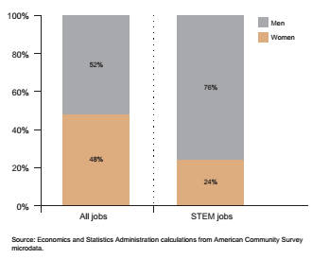
Gender Distribution Between STEM and All Employment, 2009

Slide 63
NIH Study: Data 2000-2006
Black applicants from 2000-2006 were 10 percentage points less likely than white applicants to be awarded research project grants from the NIH after controlling for factors that influence the likelihood of a grant award.
Low number of applications for NIH R01 grants. 40,069 individual applicants
  1.5 percent self-identified as black or African-American (598),
  3.3 percent as Hispanic (1,319),
  13.5 percent as Asian (5,402),
  71 percent as white (28,456), and
  11 percent as other/unknown.

Slide 64
Presidential Awards for Beginning Scientist and Engineers: from PYI to PECASE
Reagan: Started PYI only at NSF
  100 Engineers
    100 other—Eventually SBE and 4-Yr Colleges Eligible
    Nomination
Bush
  40 PYIs (20 Engineers and 20 other)
    NSF PYI started to increased number
  Nomination
Clinton
  Emphasis: National Science and Technology Council
  Presidential Early Career Awards for Scientists and Engineers (PECASE)
    NSF linked the award to CAREER Applications--
    NIH, VA, DOD, DOE, AG, NASA were also included
    Total of 50 to ensure prestige
Bush
  New selection component: Both outstanding science and service
  Added Education and increased numbers for agencies
Obama
  Increased the number to around 100 and added agencies including Interior, EPA, Intelligence Community, and Smithsonian
???

Slide 65
The Role of the Federal Government in Science & Technology
Improve Nation’s ability to:
  Innovate
  Enable Discoveries
  Sponsor development of critical and enabling technologies
  Coordinate across Federal agencies and with academia & industry
Ensure National Security
Strengthen the Economy
Improve Health & Well-being
Foster an Educated Society
Strengthen the Economy
NIH: Translational Focus

Slide 66
Why Does the Federal Government Support Research?
“Federal investments in basic research have a rate of return to the U.S. economy of between 25% and 4000% -- we know it is a good investment”.
        Former Congressman Vernon J. Ehlers
        House Science Committee, 2-16-2005
“Support of basic research offers a double-whammy of a solid payback
to the Treasury of between 30% and 60% per year (after a waiting
period of 5 and 10 years), as well as an array of new knowledge
and technologies that create wealth, add to human health & longevity,
and help fulfill human potential” Dr. Leon M. Lederman
Director Emeritus of Fermilab
1998 Nobel Laureate in Physics

Slide 67
Why Support University Research?
Primarily Basic/Fundamental Research
Integrates research with education
Researchers have flexibility
  Mobility among universities, types of institutions
  Capitalize on breakthroughs and emerging areas
  Collaborate across disciplines, institutions & countries
  Collaborate with industry
Cultivate interdisciplinary expertise in research and education to develop Centers of Excellence
Public service and education of community

