Slide 1
THE Impact Rankings, Sustainable Development Goals and SciVal 2020 NORDP Pacific Regional Meeting
Linda Galloway, MSLIS, AHIP – Elsevier Research Intelligence Consultant
https://www.elsevier.com/research-intelligence

Slide 2
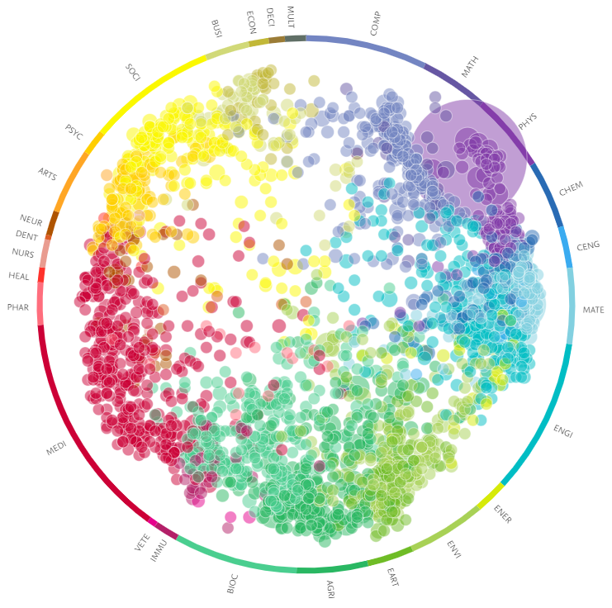
Transforming Research with SciVal
UN Sustainable Development Goals
Why this matters
Contributions impacting science
Sustainable Development Goals in SciVal
Exploring impact
Understanding global strengths
Academic-Corporate Collaborations
Where to get more information

Slide 3
SDG Resource Centre: https://sdgresources.relx.com/
Report: Mapping research to advance the SDGs: https://www.elsevier.com/connect/sdg-report

Slide 4
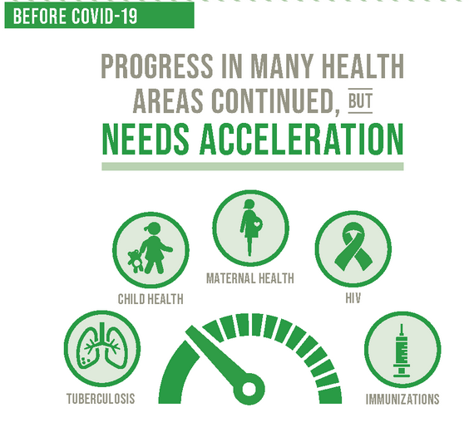
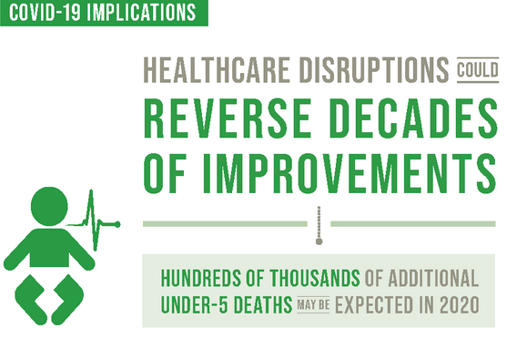
SDG3 – Good Health and Well-being

Slide 5
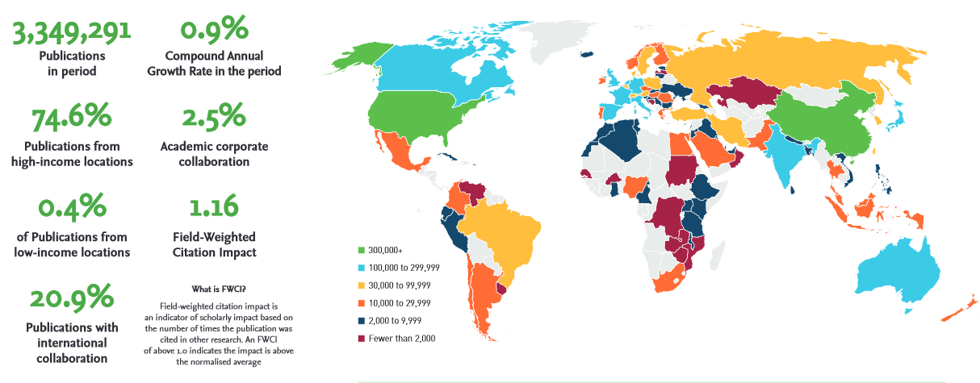
Sustainable Development Goal 3 – Good Health and Well-being
Mapping research to advance the SDGs: https://www.elsevier.com/connect/sdg-report
2015-2019
Notes:
E

Slide 6
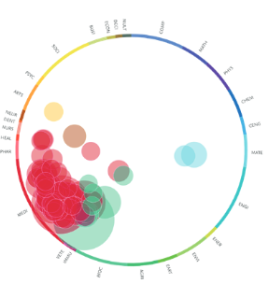
Sustainable Development Goal 3 – Good Health and Well-being
Top 10 Institutions
2015-2020
Notes:
Investigate, understand and analyse SDG research globally with SciVal Research Areas for the UN Sustainable Development Goals (SDGs).Research Areas queries can help researchers and institutions track and demonstrate progress towards the targets of the SDGs. The Topic Wheel presented here clusters publications 2010-2019 into global, unique research topics based on citation patterns. Research linked to SDG3 is most prominent within Medicine and Biochemistry. The 17 Perspective Abstract in the page before offers a complementary view, highlighting cross-sector programs that encompass Population, Health and the Environment – with the latter being too often neglected in SDG3 research.

Slide 7
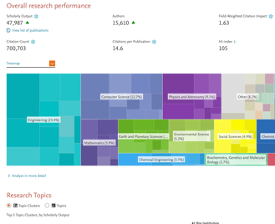
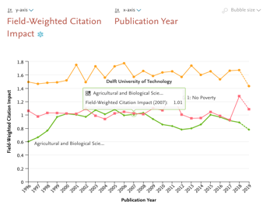
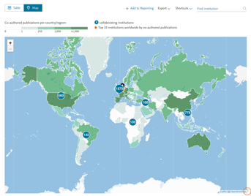
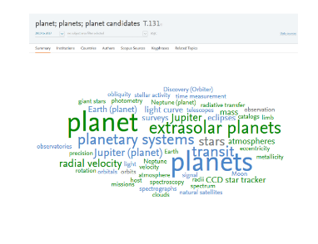
SciVal in a nutshell
SciVal provides access to the research performance of over ~19,000 research institutions from 231 nations worldwide
Visualize research performance
Benchmark your progress
Develop collaborative partnerships
Analyze research trends
Ready-made-at a glance snapshots of any selected entity
Flexibility to create and compare any research groups
Identify and analyze existing and potential collaboration opportunities
Analyze research trends to discover the top performers and rising stars
Analyze a variety of entities – individual researchers to entire countries – from a variety of perspectives to gain a deep understanding of research contributions and impact

Slide 8
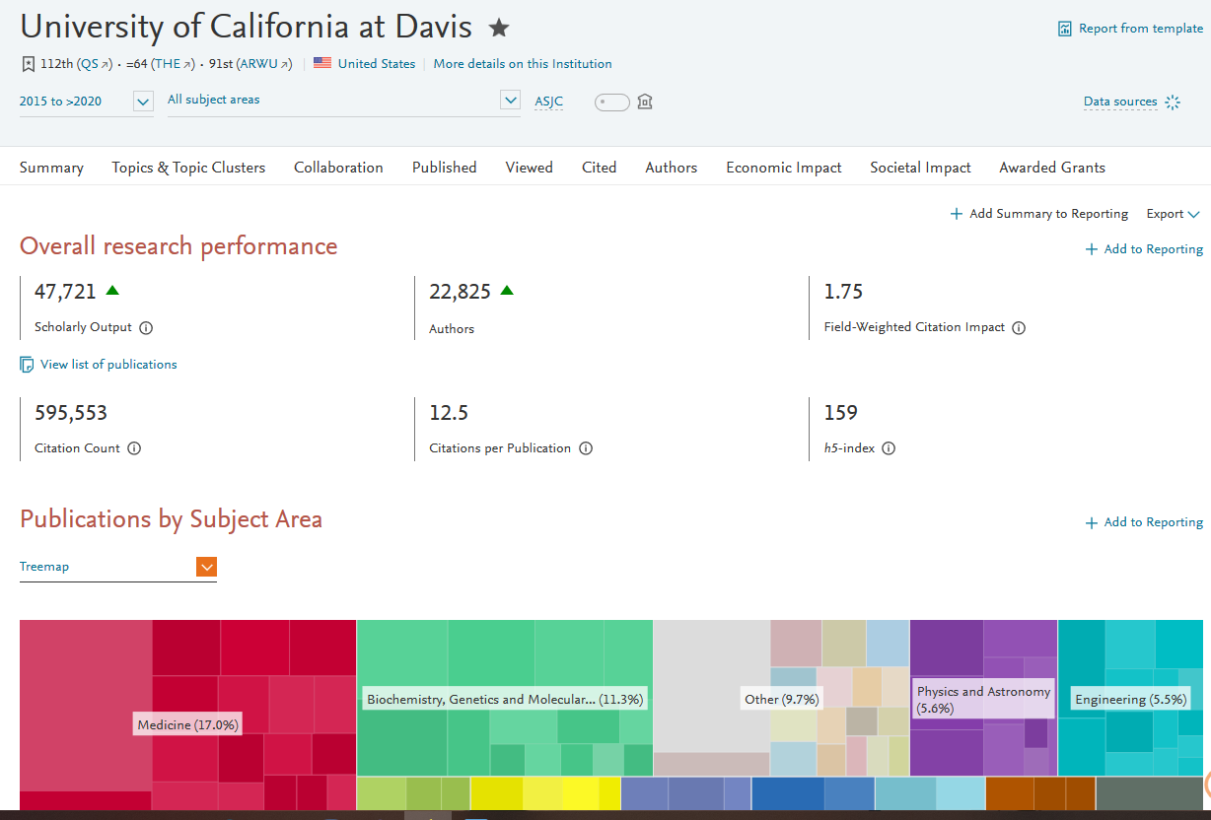
Metrics Highlights

Slide 9
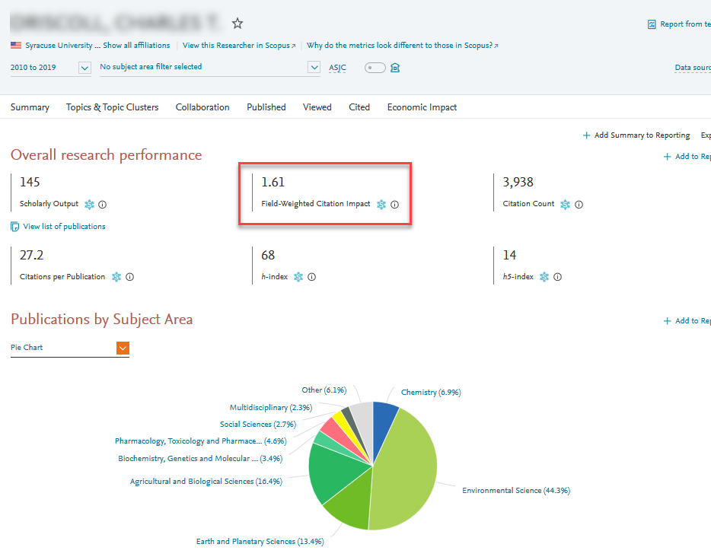
Field-Weighted Citation Impact (FWCI)
Benchmark entities regardless of size, discipline, profile, age, and publication-type.
Prestige metric
Note that:
FWCI can be unstable for entities with few documents (outliers have large effect)
New documents – citations take time to accrue
Use complementary metrics such as Publications in Top Journal Percentiles or Collaborations
Date range 2010 to 2019

Slide 10
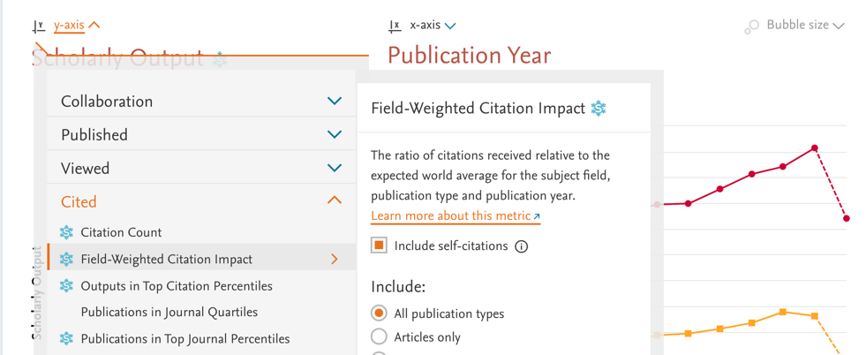
Design principles of SciVal
Accuracy
so customers trust the data and insights from all data sets
Everyone being assessed by metrics from SciVal should have access to those metrics
Users should have the ability to dissect the metrics to see the unerlying data
SciVal provides both transparency and metrics guidance to support the resposible use of metrics
Flexibility
so customers can customize their research entities and analyze them from all angles
Transparency
so customers can check the underlying data and understand the metrics

Slide 11
The array of metrics through SciVal
Metric theme | Metric sub-theme | Metrics in SciVal
A. Funding | Awards | Awards Volume
B. Outputs | Productivity of research outputs | Scholarly Output Number, Type and Growth Subject Area Count
 | Visibility of communication channels | Publications in Top Journal Percentiles
C. Research Impact | Research influence | Citations Count Field-Weighted Citation Impact Outputs in Top Citations Percentiles Citations per publication Cited publications h-indices |  | Number of citing countries Views Count Outputs in Top Views Percentiles Views per Publication Field-Weighted Views Impact
 | Knowledge transfer | Academic-Corporate Collaboration Citing-Patents Count Patent-Cited Count
D. Engagement | Academic network | Collaboration Collaboration Impact
 | Non-academic network | Academic-Corporate Collaboration Academic-Corporate Collaboration Impact
 | Expertise transfer | Academic-Corporate Collaboration Citing-Patents Count Patent-Cited Count
E. Societal Impact | Societal Impact | Academic-Corporate Collaboration Citing-Patents Count Patent-Cited Scholarly Output | Patent-Citations Count Mass Media Media Exposure Field-Weighted Mass Media
Qualitative input

Slide 12
Scholarly output 2000-2019
Scholarly output 2019
China | 694701
United States | 691052
United Kingdom | 214352
Germany | 185066
France | 120565
Canada | 115388
Australia | 110287
Notes:
Global scholarly output – all fields of research – start with something simple

Slide 13
Impact Rankings 2020: Good Health and Well-being
SDG 3 – Good Health and Well-being |  | Good Health | Overall
1 | RCSI University of Medicine and Health Sciences | 90.8 | 75.4–83.3
2 | La Trobe University | 90.6 | 96.6
3 | China Medical University, Taiwan | 89.8 | 68.2–75.3
4 | University of Auckland | 89.1 | 98.5
5 | University of Otago | 88.8 | 92.6
6 | McMaster University | 87.9 | 93.6
7 | University of Alabama at Birmingham | 87.8 | -
8 | Australian Catholic University | 87.7 | 75.4–83.3
9 | University of Dundee | 87.6 | 88.9
10 | Chang Gung University | 87.3 | -
Notes:
Impact rankings more than scholarly output

Slide 14
Impact Rankings 2020: Good Health and Well-being
SDG 3 – Good Health and Well-being |  | Good Health | Overall
11 | King’s College London | 86.4 | 95.4
12 | University of Saskatchewan | 86.2 | 83.9
13 | University of Newcastle | 85.9 | 88.7
14 | Kaohsiung Medical University | 85.7 | 68.2–75.3
14 | University of Sydney | 85.7 | 98.1
16 | Nagoya City University | 84.7 | 68.2–75.3
17 | University of Coimbra | 84.3 | 86.5
18 | Taipei Medical University | 84.2 | 61.5–68.0
19 | Deakin University | 84.1 | 88
20 | JSS Academy of Higher Education and Research | 83.9 | 68.2–75.3
Notes:
Impact rankings more than scholarly output

Slide 15
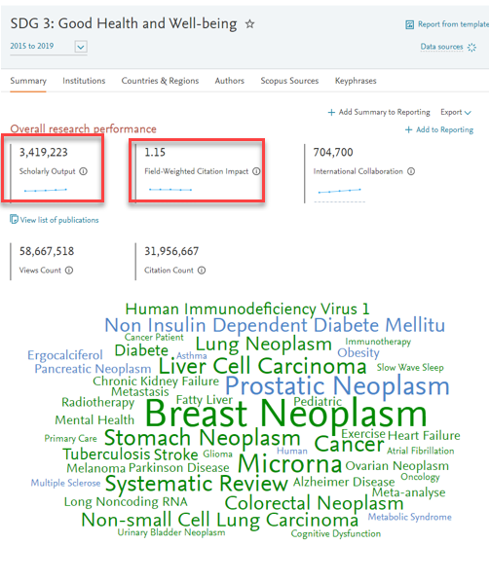
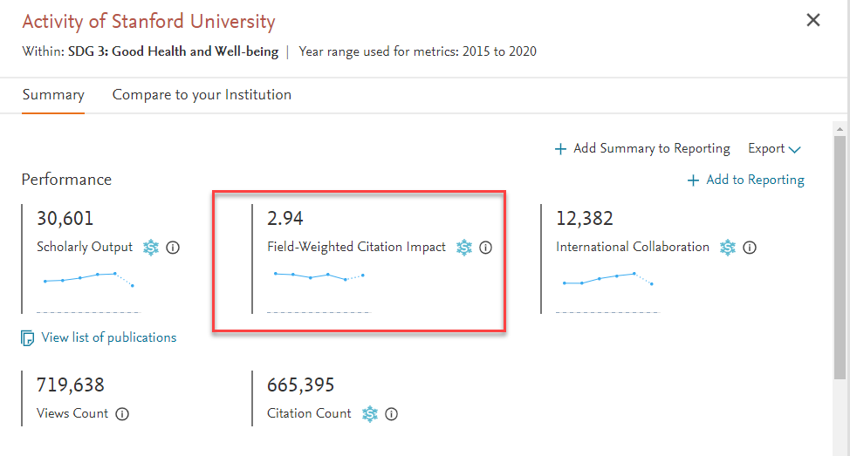
SDG 3: Good Health and Well-being
Notes:
#15 globally

Slide 16
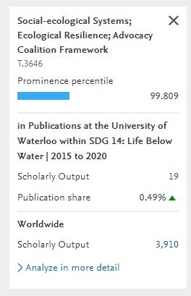
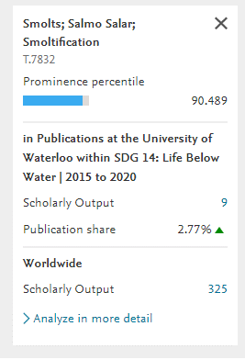
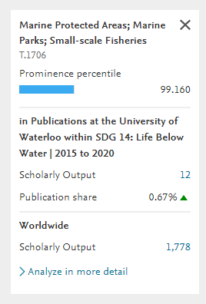
Stanford University Research in SDG 3
Notes:
Need to update slide

Slide 17
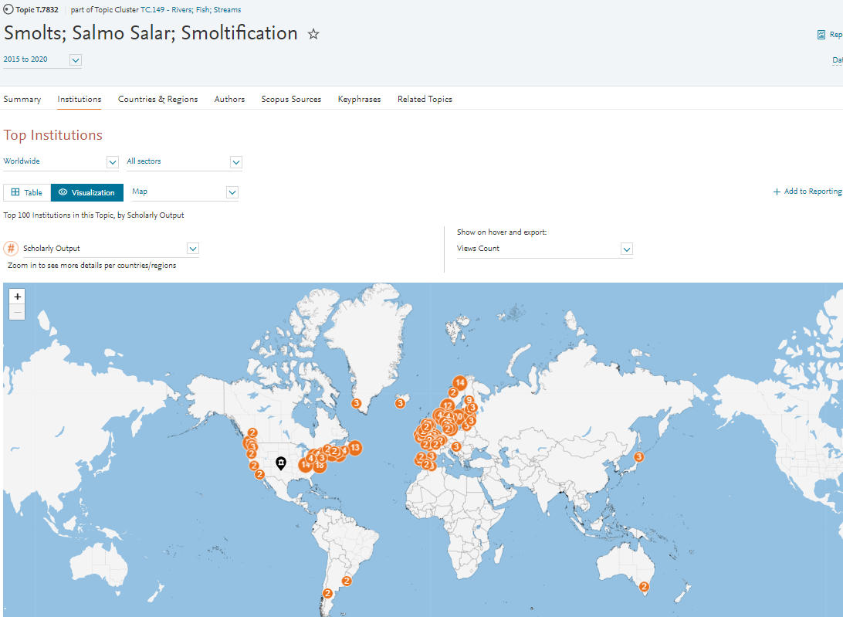
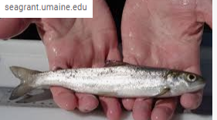
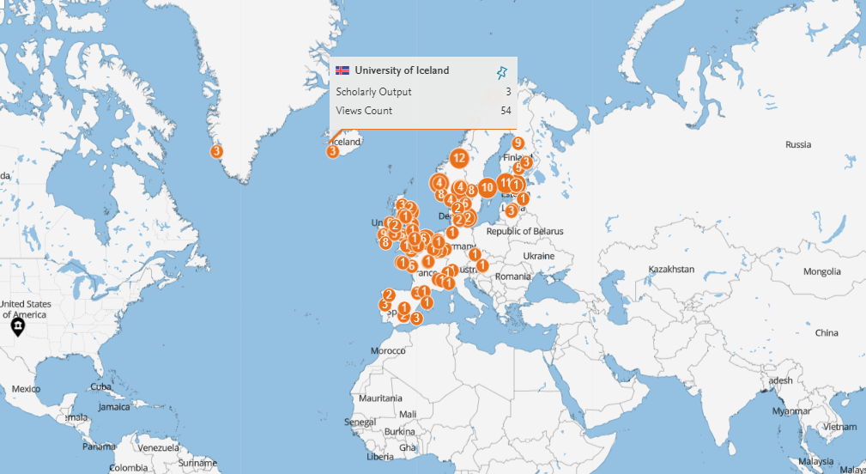
Find Global Collaborators

Slide 18
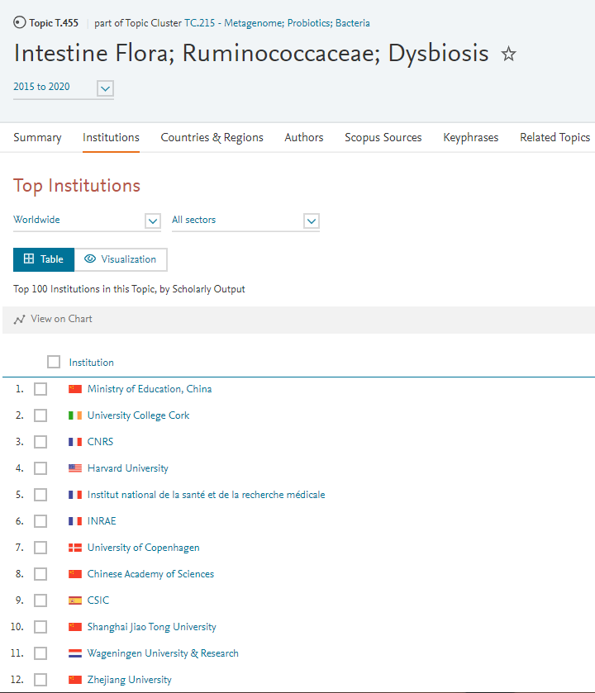
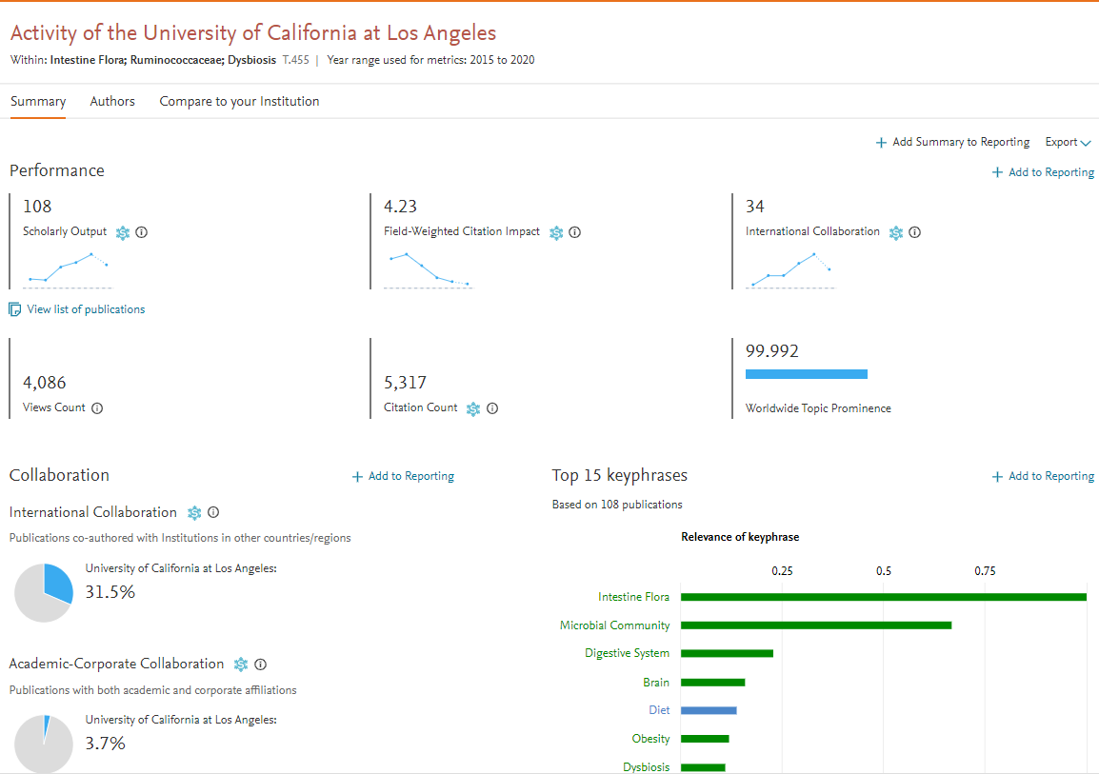
Explore Impact and Potential Collaborations
Potential
Notes:
From Topic, take a look at top institutions in this research area.
Explore activity of the highly productive research institution

Slide 19
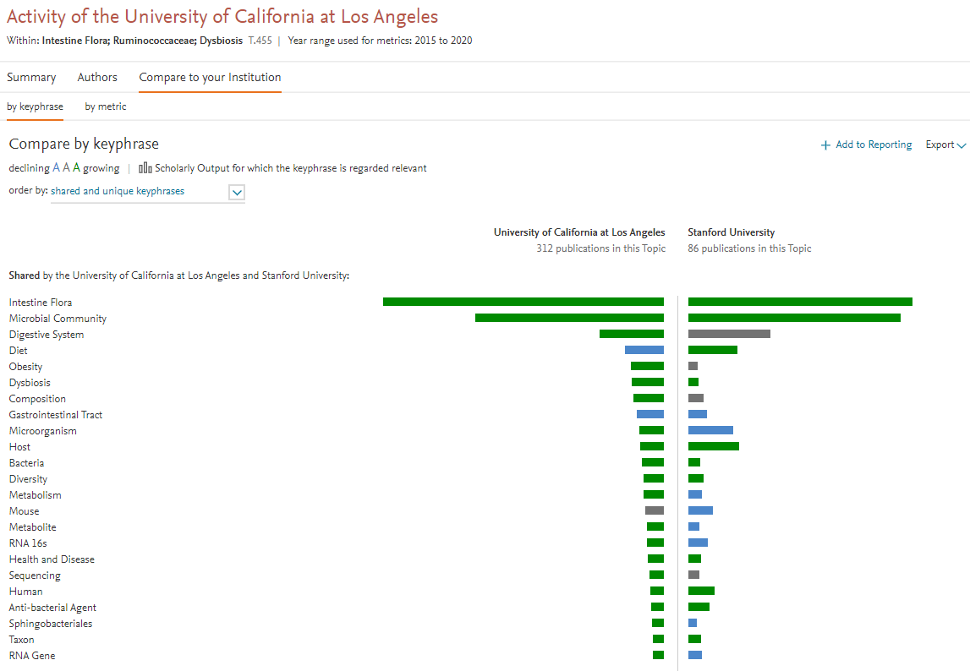
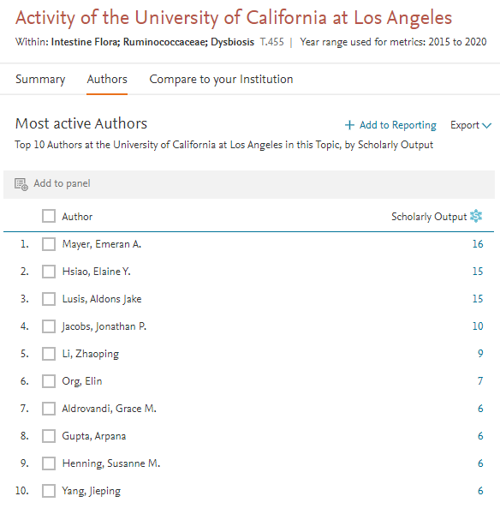
Notes:
Compare to your institution and identify authors – with whom you are not currently collaborating with, in this particular research area.
Within: Intestine Flora; Ruminococcaceae; DysbiosisT.455 Year range used for metrics: 2015 to 2020

Slide 20
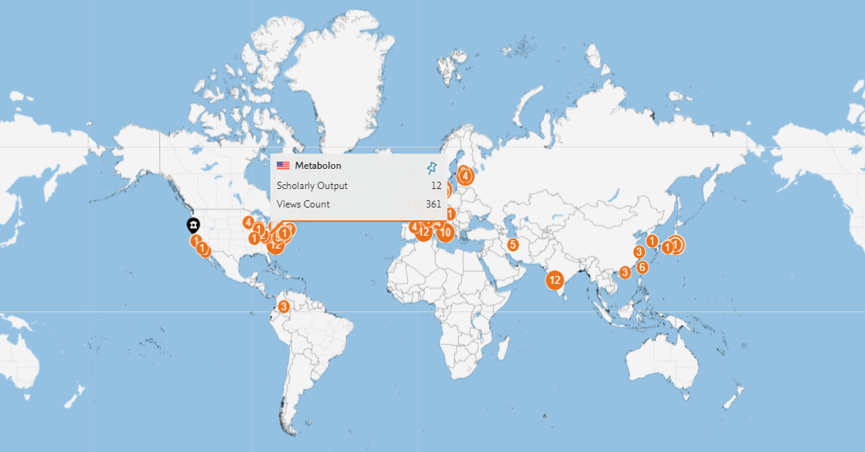
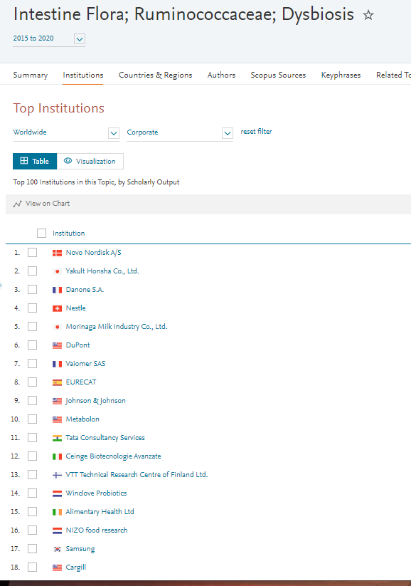
Find Corporations working in this research area

Slide 21
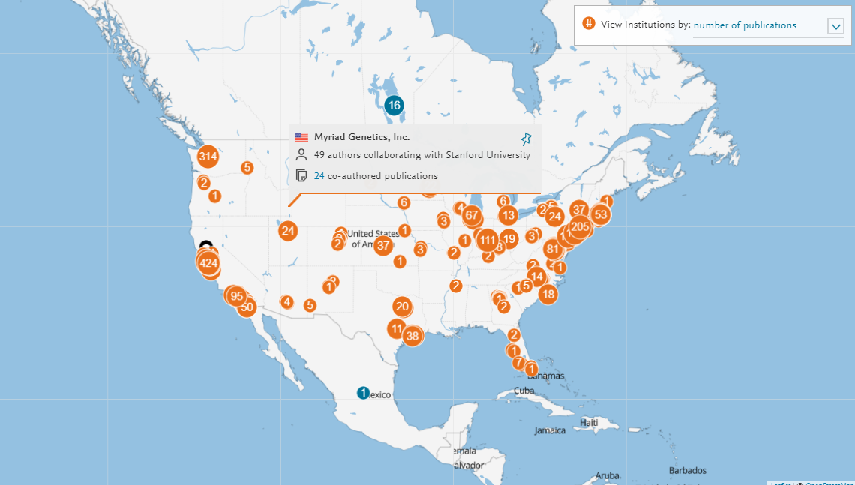
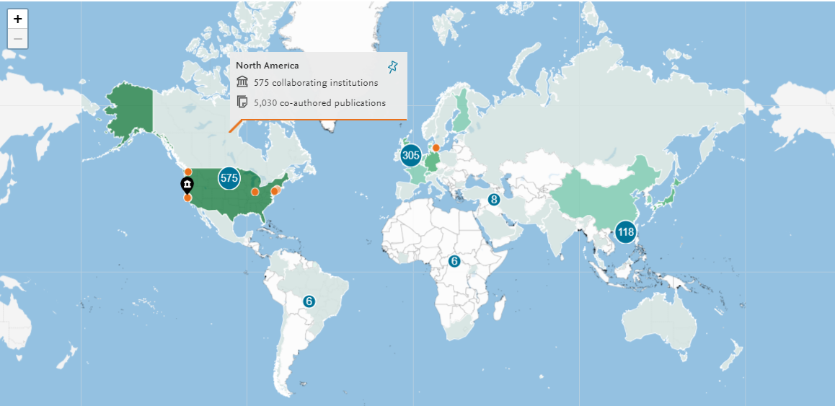
Academic-Corporate Collaborations
Notes:
Can look within a particular subject area for collaborators, or look in general

Slide 22
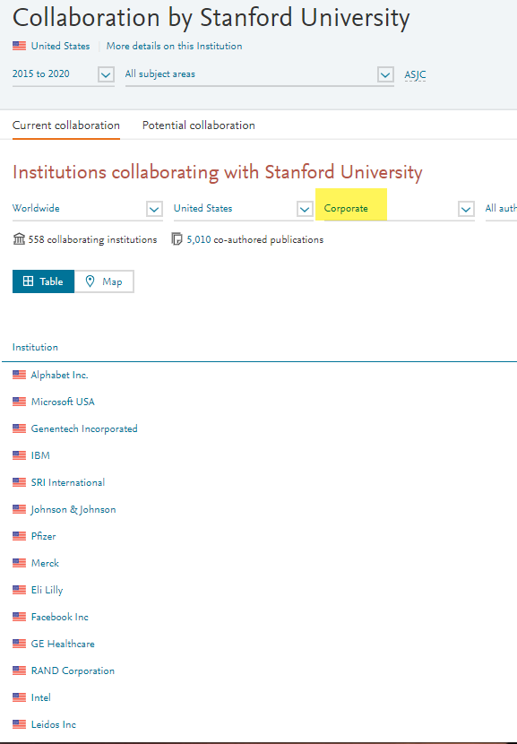
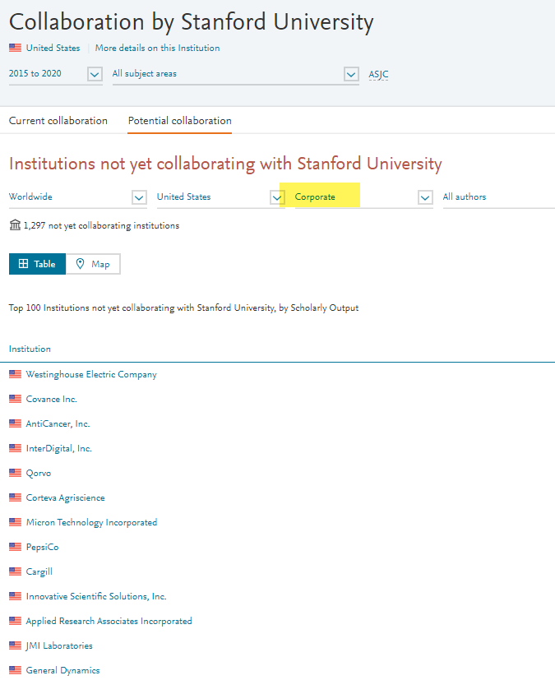
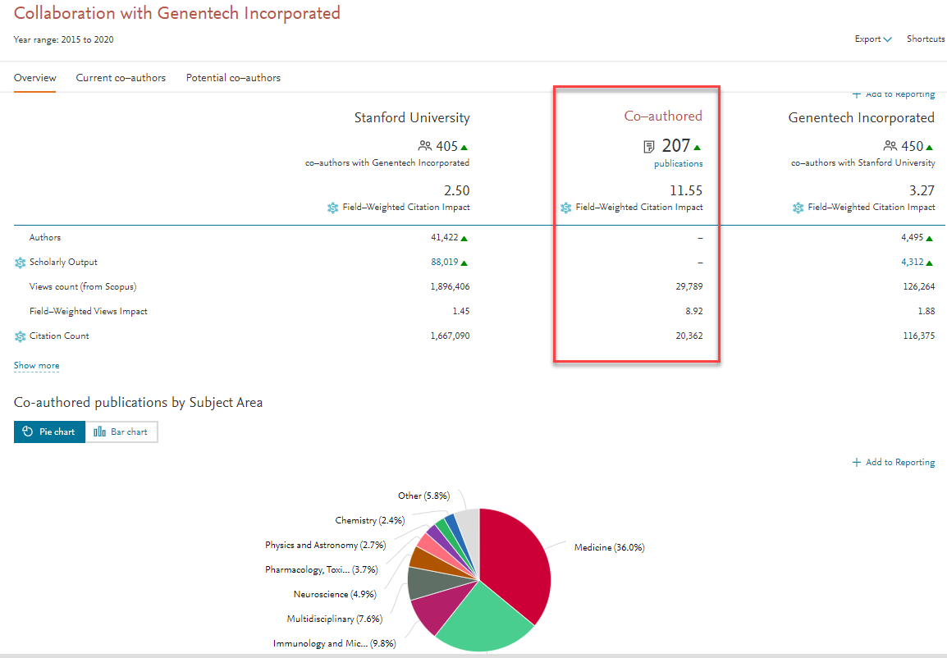
Existing and Potential Academic-Corporate Collaborations
Potential
Notes:
Need to redo slide

Slide 23
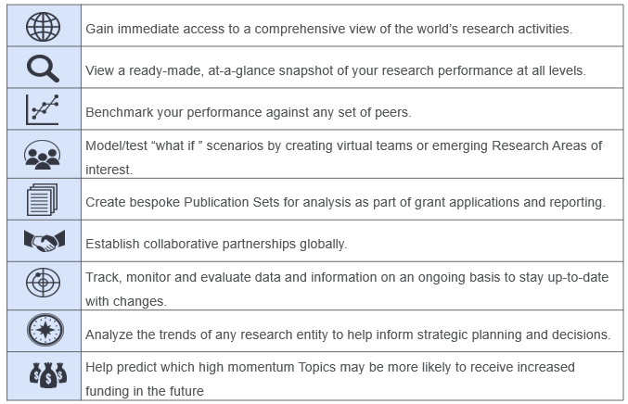
SciVal – out-of-the-box analytical solution
https://www.elsevier.com/solutions/scival

Slide 24
Find out more
Elsevier Research Intelligence https://www.elsevier.com/research-intelligence
Scopus https://www.brighttalk.com/channel/13703/scopus
SciVal https://www.brighttalk.com/channel/13819/elseviers-research-intelligence
Contact:
l.galloway@elsevier.com
949-280-6029

