Slide 1
Extramural Research in the Era of COVID-19: an NIH Perspective
Michael Lauer, MD
Deputy Director for Extramural Research; Director, Office of Extramural Research
National Institutes of Health
Pacific Regional Meeting of the National Organization of
Research Development Professionals (NORDP)
Wednesday, November 18, 2020
Virtual Meeting
Disclosures: None

Slide 2
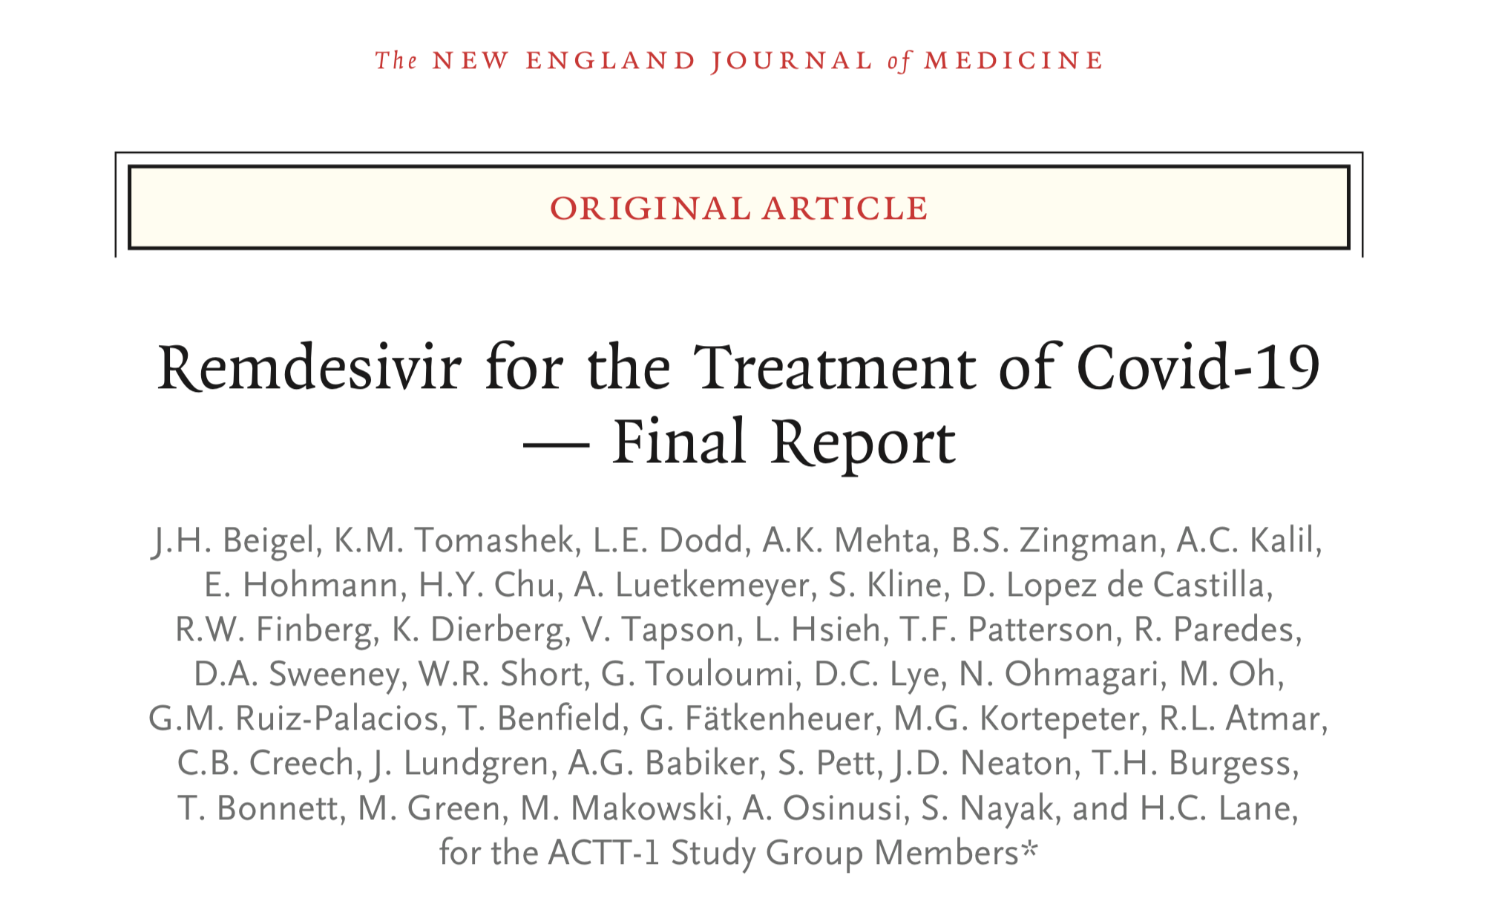
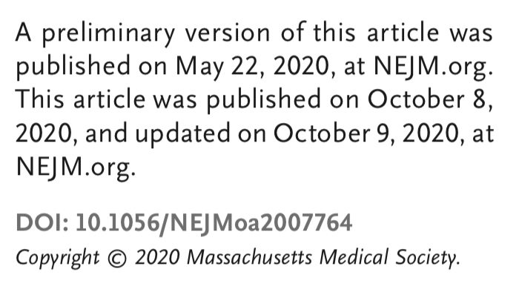
COVID-19: Acceleration!
https://www.nejm.org/doi/pdf/10.1056/NEJMoa2007764?articleTools=true
https://www.fda.gov/news-events/press-announcements/fda-approves-first-treatment-covid-19

Slide 3
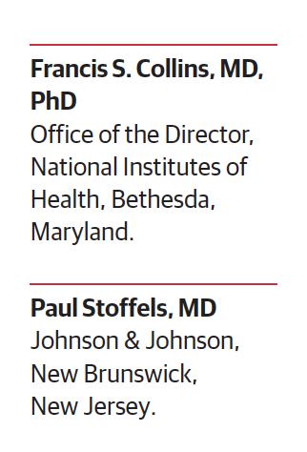
Accelerated Path to Therapeutics and Vaccines
Working Groups:
Preclinical: animal models, assays
Therapeutics clinical: prioritize agents, master protocol
Clinical trial capacity
Vaccines: evaluation, biomarkers, safety
https://jamanetwork.com/journals/jama/fullarticle/2766371

Slide 4
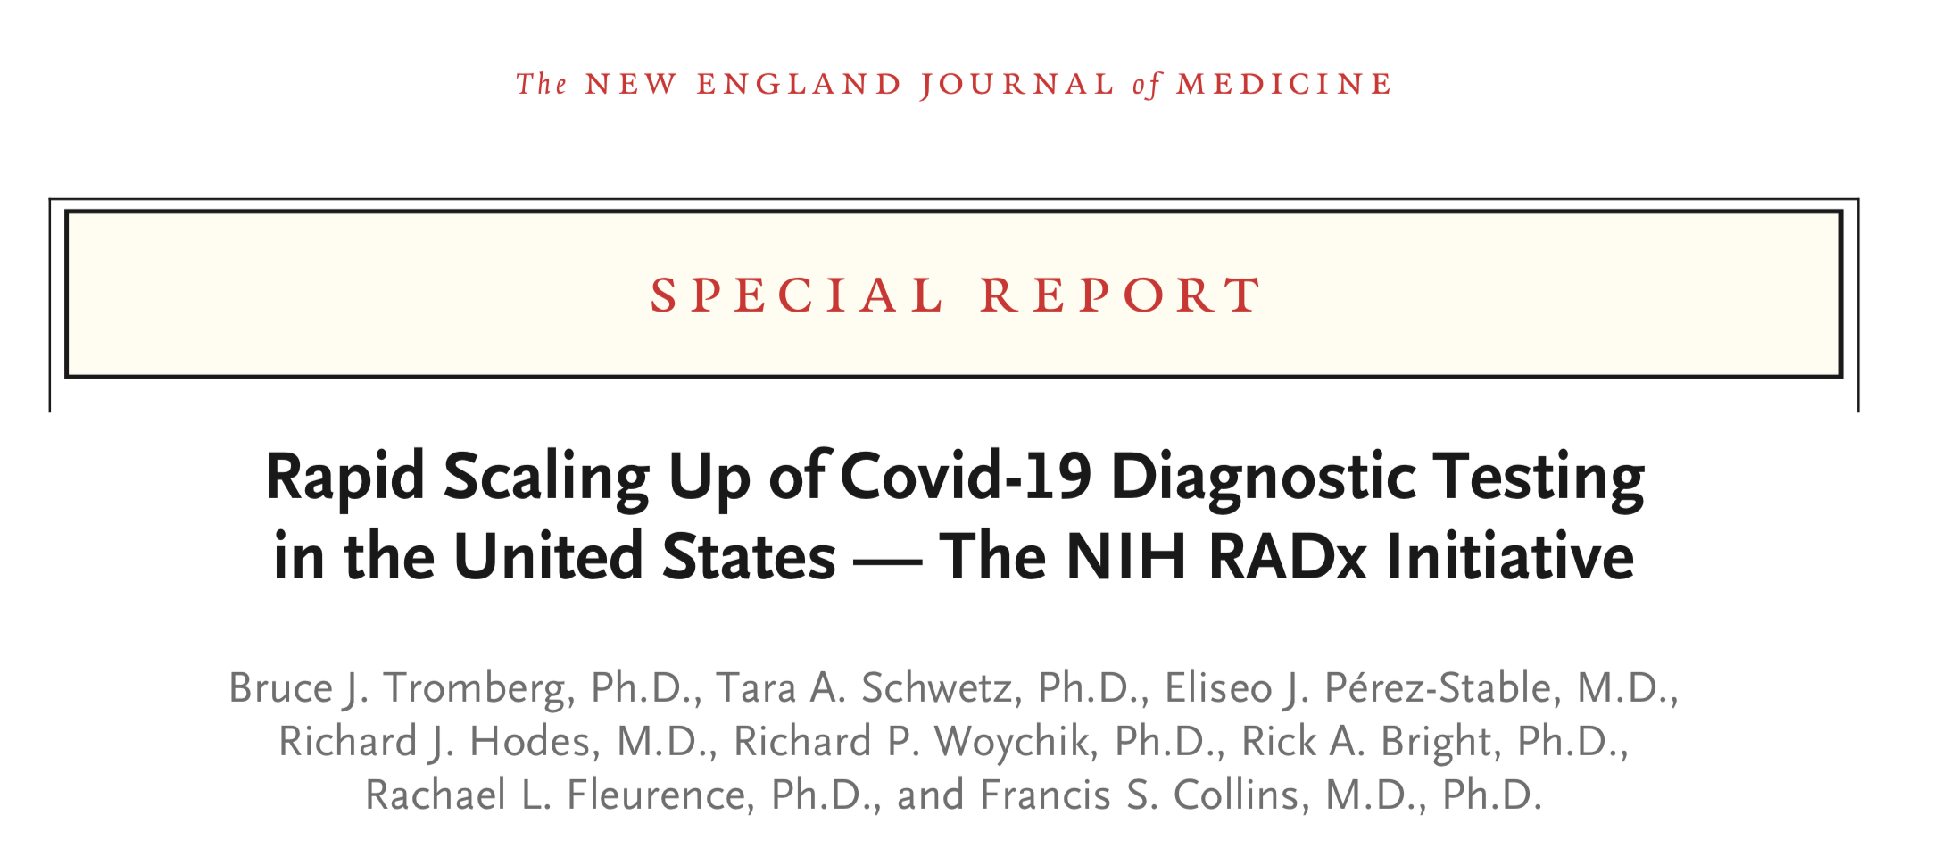
And Diagnostics …
https://www.nejm.org/doi/pdf/10.1056/NEJMsr2022263?articleTools=true

Slide 5
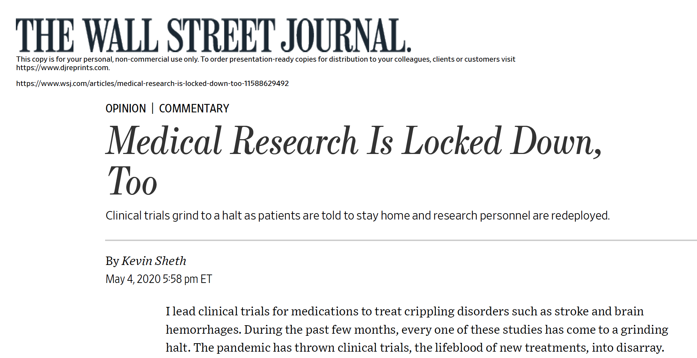
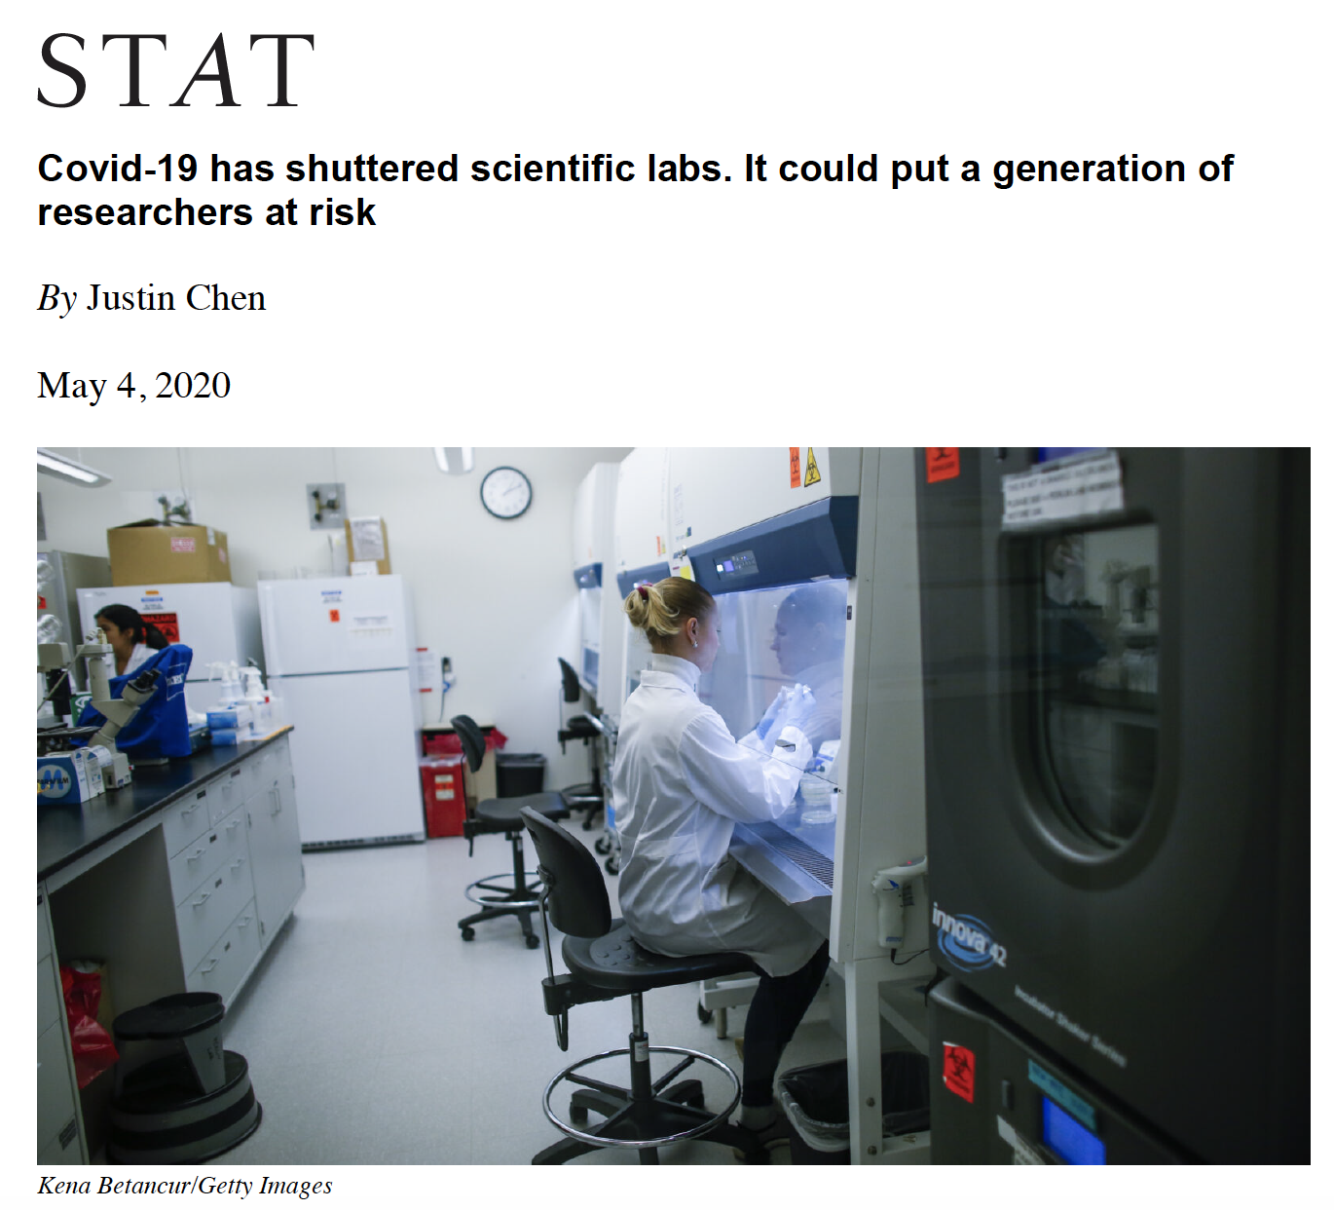
On the Other Hand …

Slide 6
Remarkably Prescient …

Slide 7
Extensive Disruption
Laboratories closed or nearly so
Communications suboptimal
Conferences and meetings cancelled or disrupted
Supply chains interrupted; resources lost
Widespread financial losses
Required telework has disparate effects (e.g. childcare)
Anxiety high, especially for early career investigators
https://crsreports.congress.gov/product/pdf/R/R46309

Slide 8
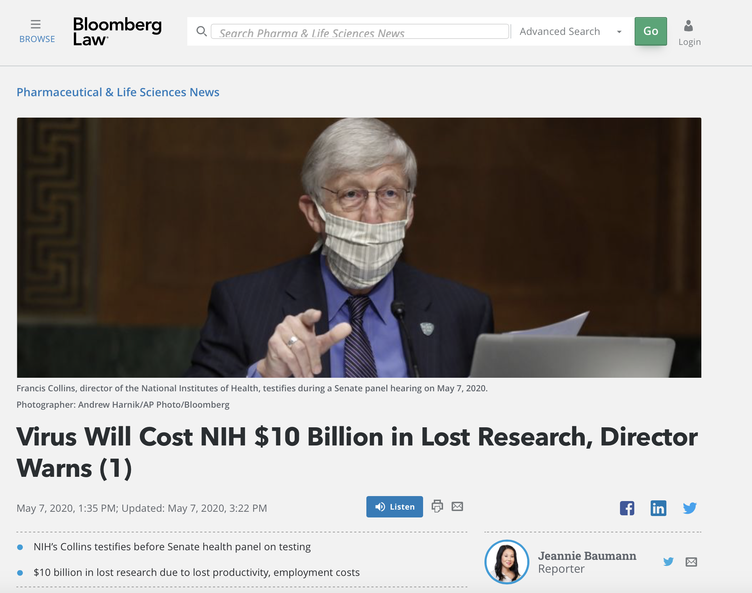
Real Losses
https://news.bloomberglaw.com/pharma-and-life-sciences/virus-will-cost-nih-10-billion-in-lost-research-director-warns

Slide 9
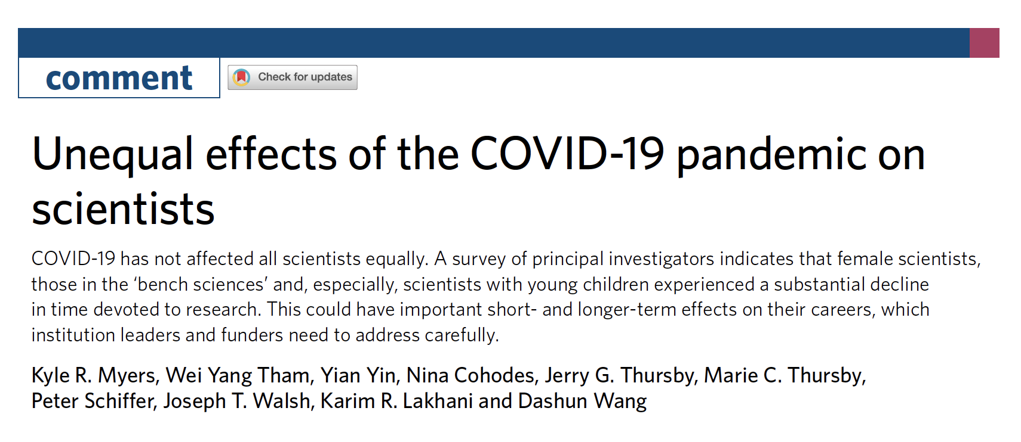
Disproportionate Effects
Nature Human Behavior, July 15, 2020
https://www.nature.com/articles/s41562-020-0921-y

Slide 10
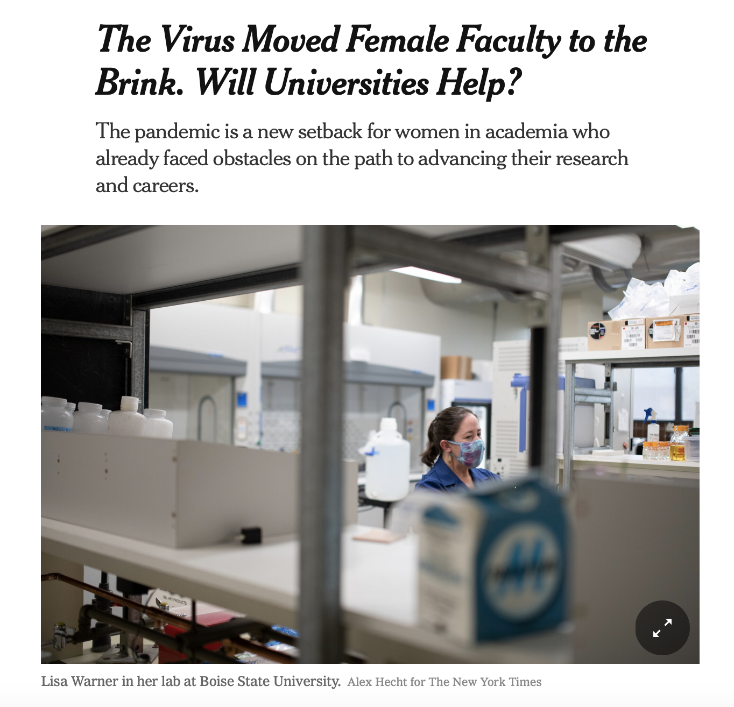
Impact on Productivity
Nature, May 28, 2020
https://media.nature.com/original/magazine-assets/d41586-020-01294-9/d41586-020-01294-9.pdf
https://www.nytimes.com/2020/10/06/science/covid-universities-women.html

Slide 11
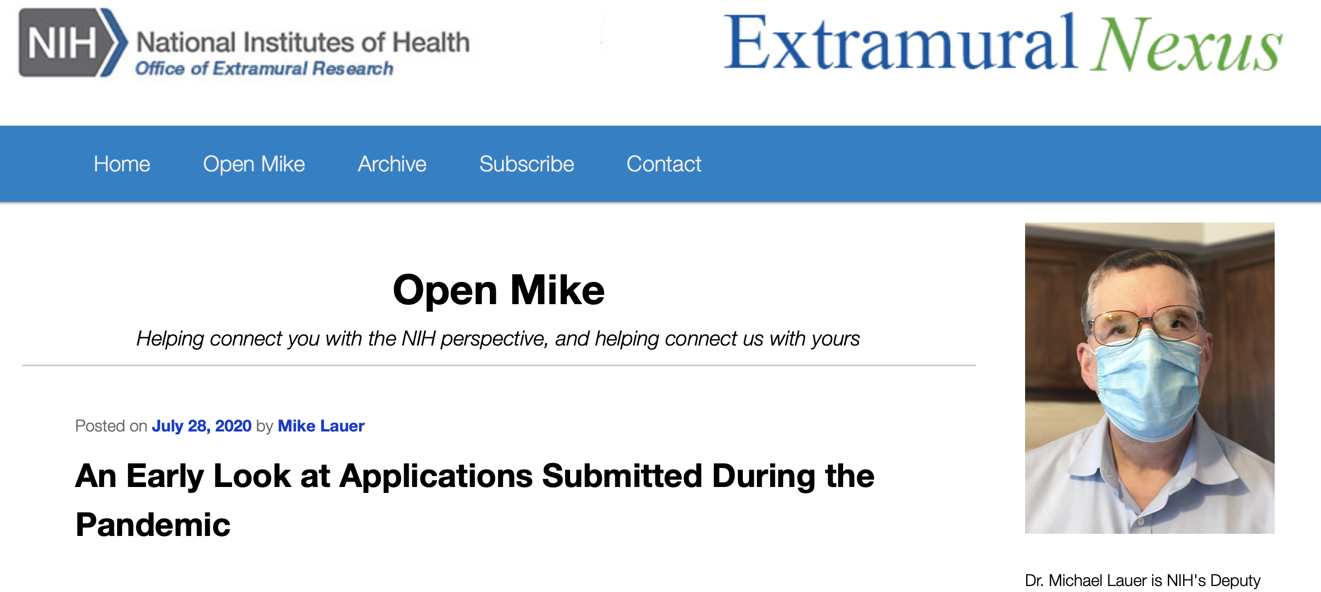
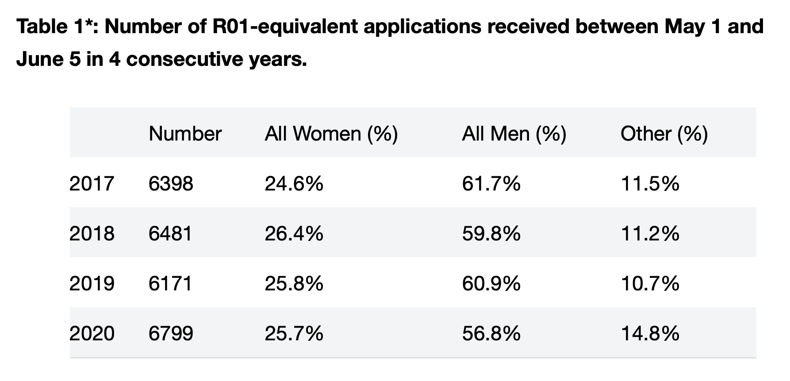
Monitoring Trends
https://nexus.od.nih.gov/all/2020/07/28/an-early-look-at-applications-submitted-during-the-pandemic/

Slide 12
Accommodations and Flexibilities
Application deadlines, post-submission data
All peer review remote – through Spring 2021
Salaries and stipends – until September 30, 2020
Human subject research, clinical trials
Animal research, guidance to IACUCs
Extensions on reporting; flexibility on expenditures
Accommodations for loss of time, ESI extension
https://grants.nih.gov/policy/natural-disasters/corona-virus.htm

Slide 13
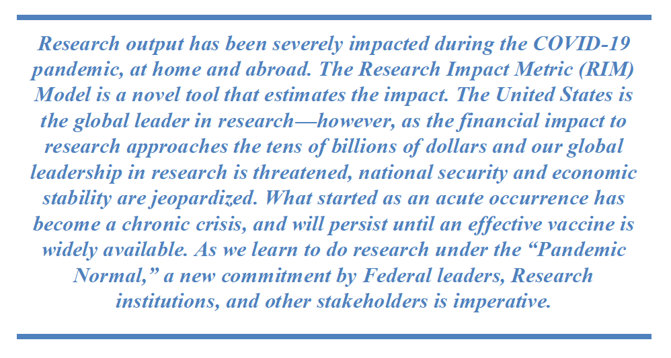
Intriguing Thought Exercise
https://www.cogr.edu/sites/default/files/Research_COVID_August2020_COGR_FINAL.pdf

Slide 14
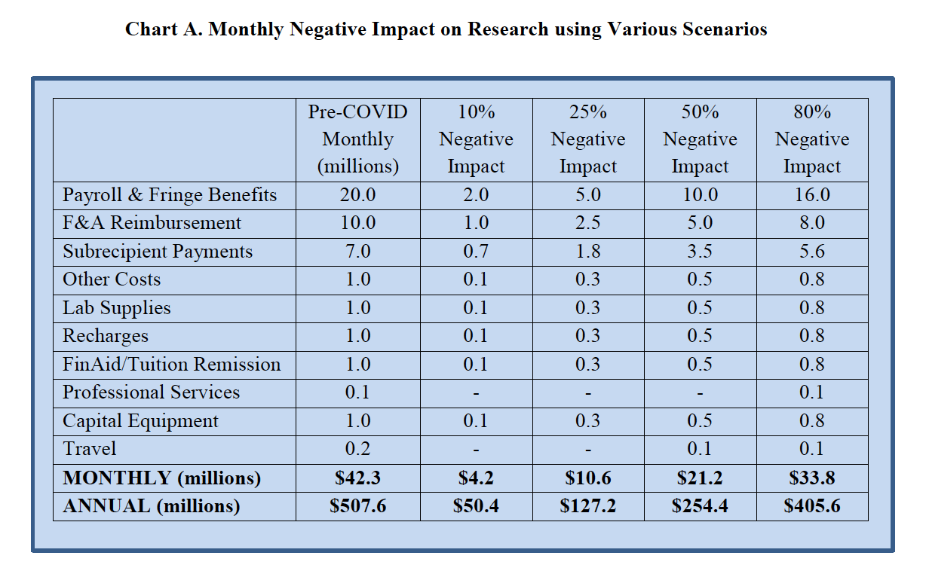
Hypothetical Example
https://www.cogr.edu/sites/default/files/Research_COVID_August2020_COGR_FINAL.pdf

Slide 15
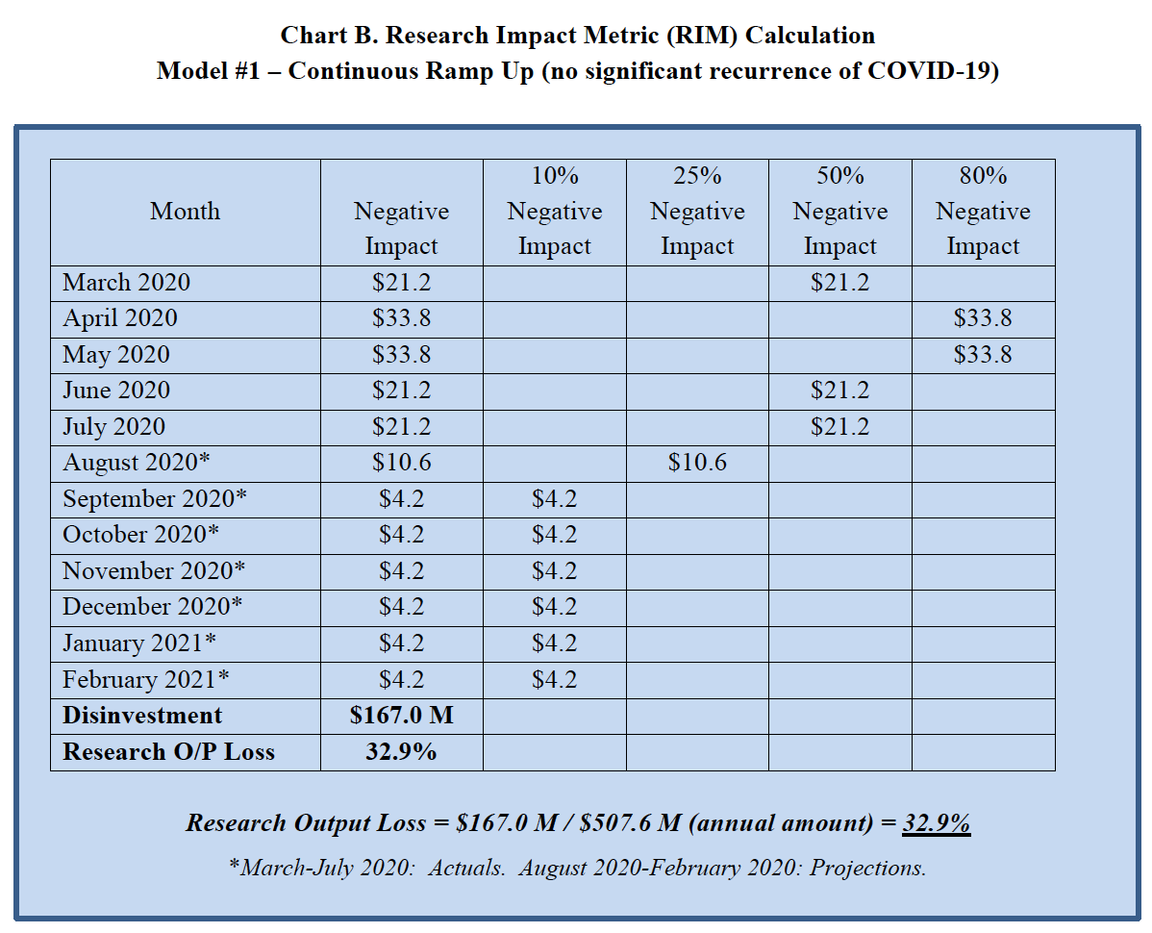
Continuous Ramp-Up
https://www.cogr.edu/sites/default/files/Research_COVID_August2020_COGR_FINAL.pdf

Slide 16
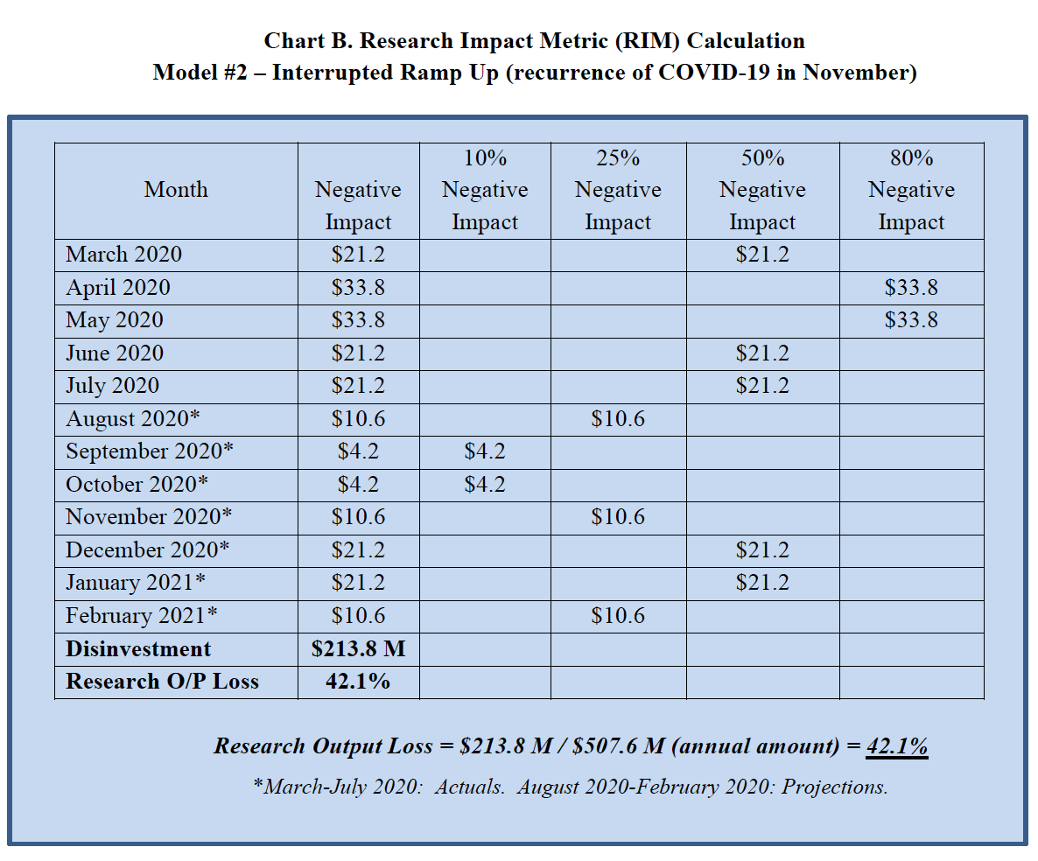
Interrupted Ramp-Up
https://www.cogr.edu/sites/default/files/Research_COVID_August2020_COGR_FINAL.pdf

Slide 17
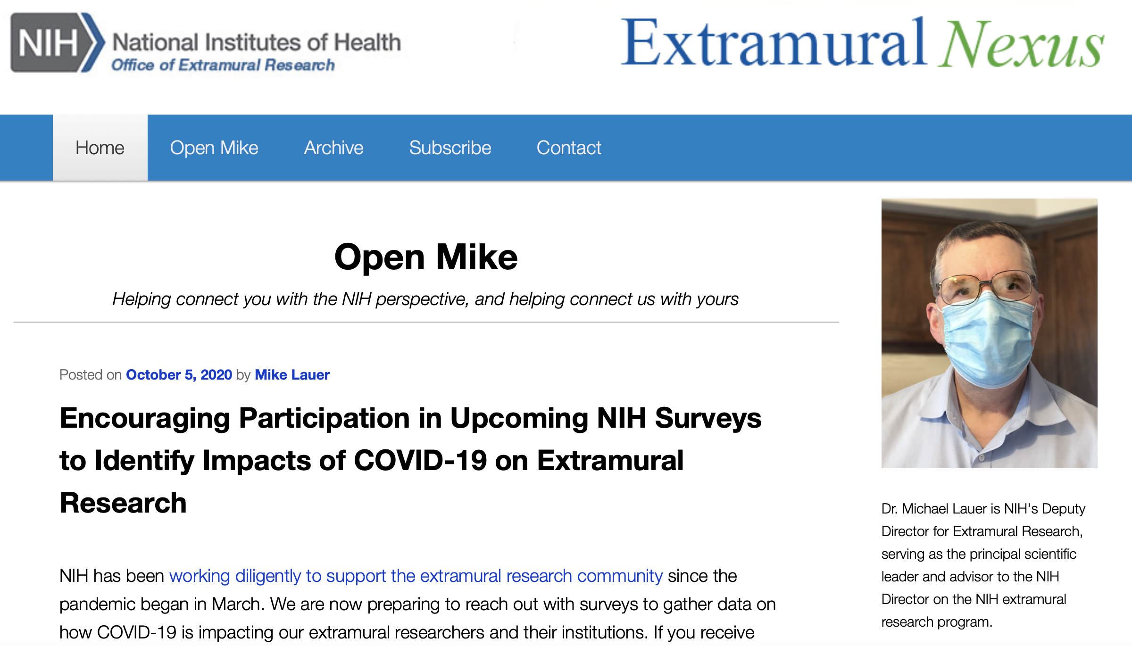
Learning From You!
https://nexus.od.nih.gov/all/2020/10/05/encouraging-participation-in-upcoming-nih-surveys-to-identify-impacts-of-covid-19-on-extramural-research/

Slide 18
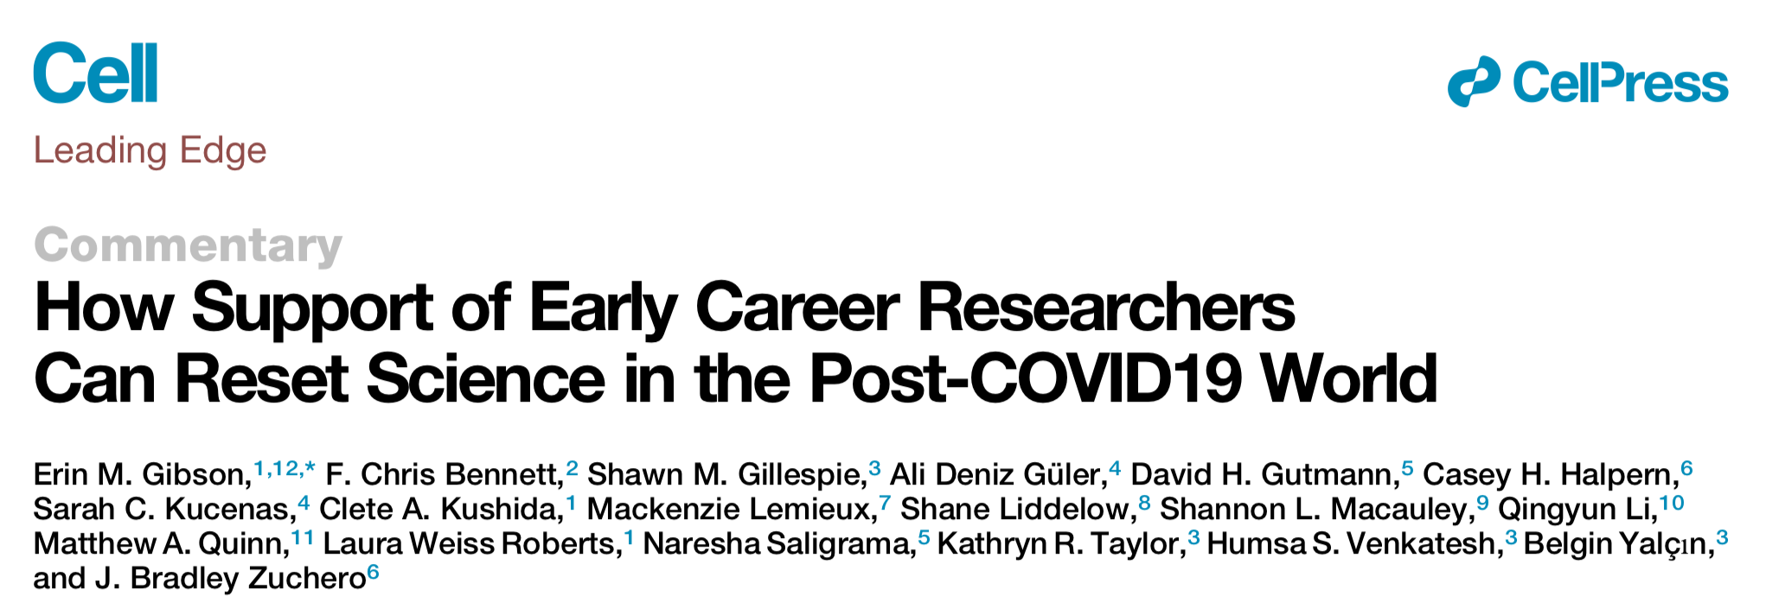
Perspectives For the Future
“The COVID19 crisis has magnified the systemic issues plaguing academic research … often-stifling excess requirements in publication, tenure, and grant processes; the reliance on funding from national agencies that is catered towards senior level researchers; and the lack of diversity in academic research due to the attrition of women and racial or ethnic minorities during early career stages … An unprecedented opportunity to reset … will require a concerted effort between funding agencies, universities, and the public to rethink how we support scientists, with a special emphasis on early career researchers.”
https://doi.org/10.1016/j.cell.2020.05.045

Slide 19
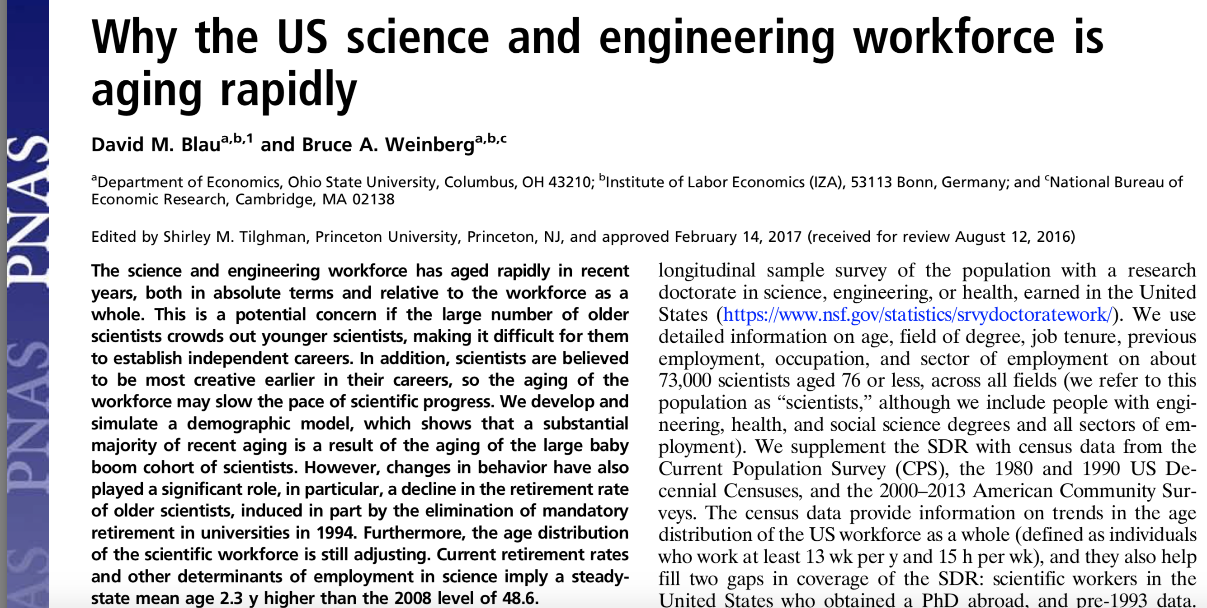
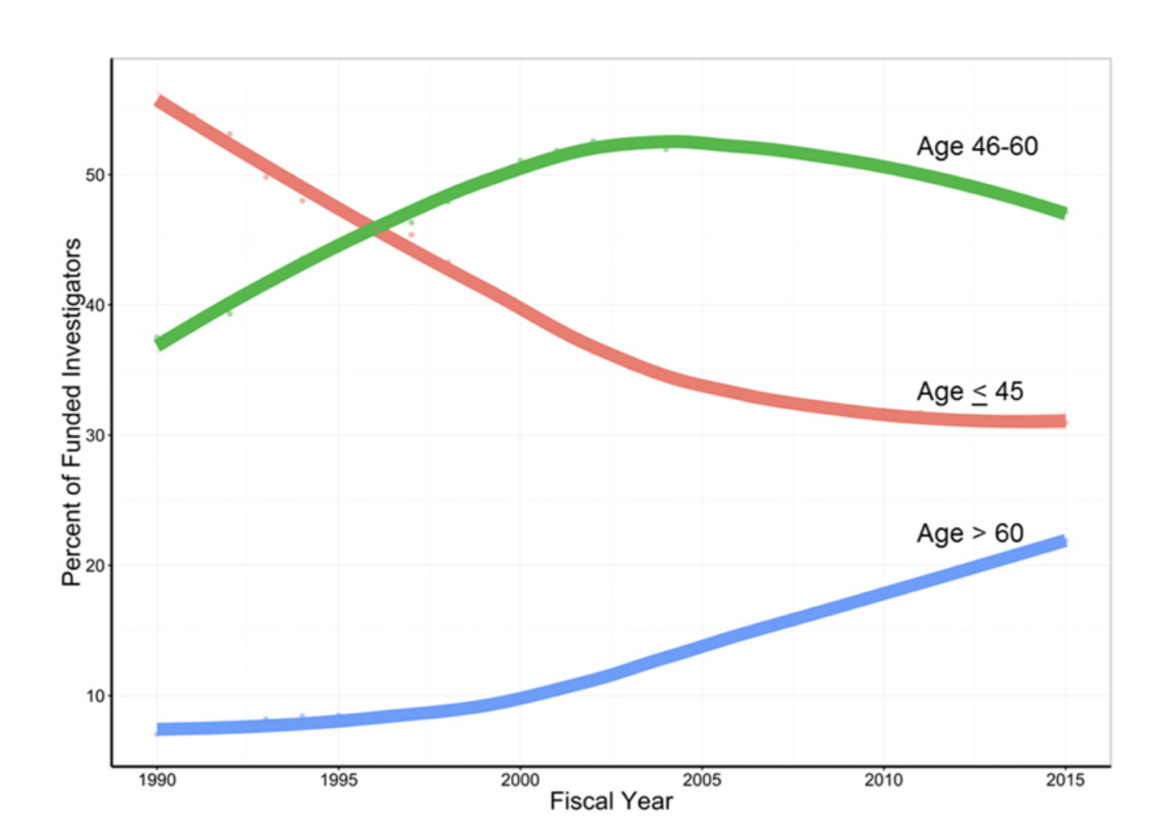
“Catered Towards Senior Level Researchers”
https://www.pnas.org/content/pnas/114/45/11801.full.pdf
https://www.pnas.org/content/pnas/early/2017/03/21/1611748114.full.pdf

Slide 20
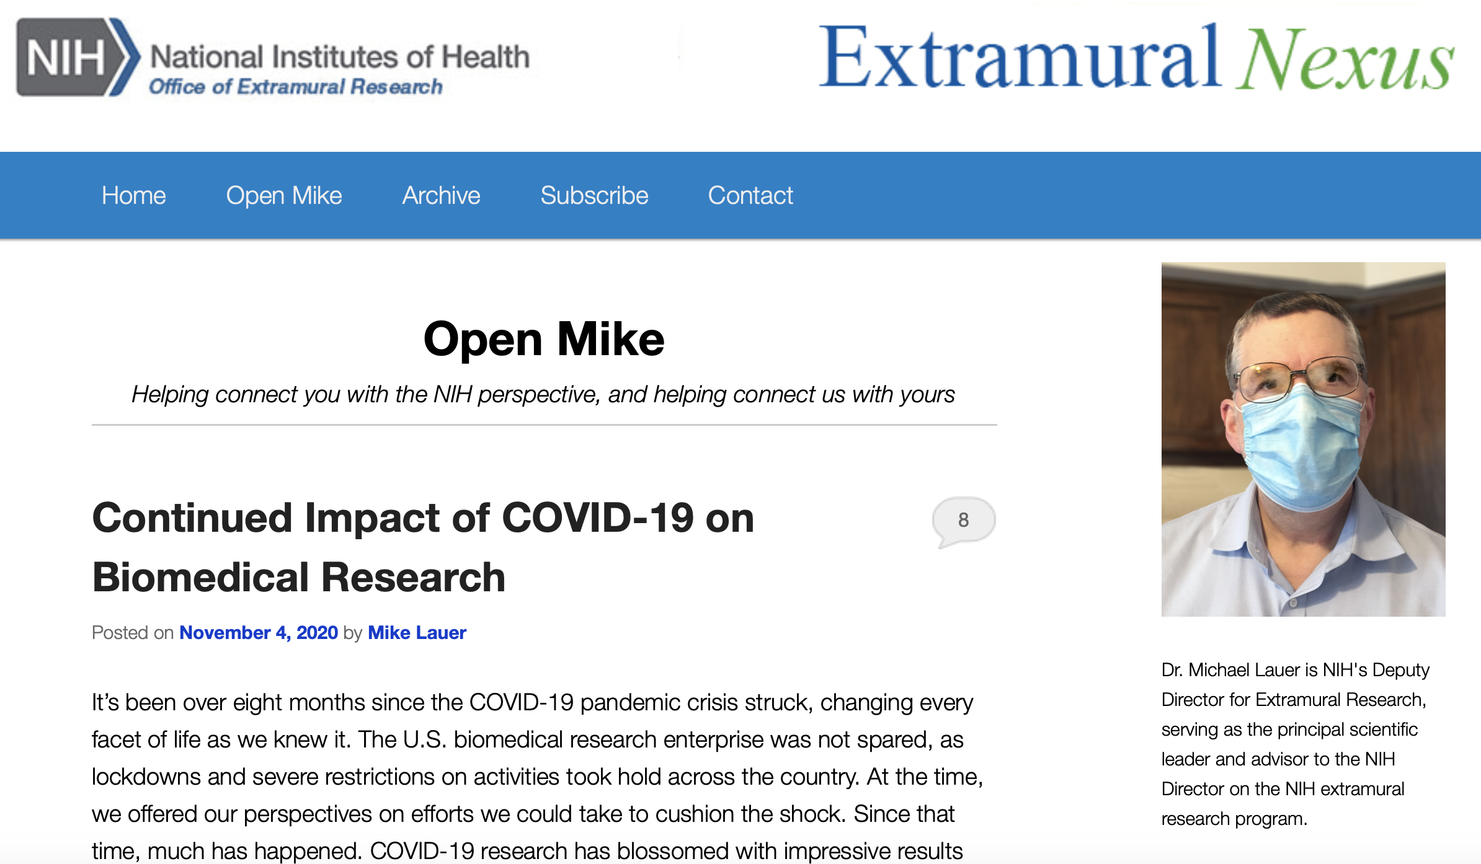
Current NIH Perspectives
https://nexus.od.nih.gov/all/category/blog/open-mike/

Slide 21
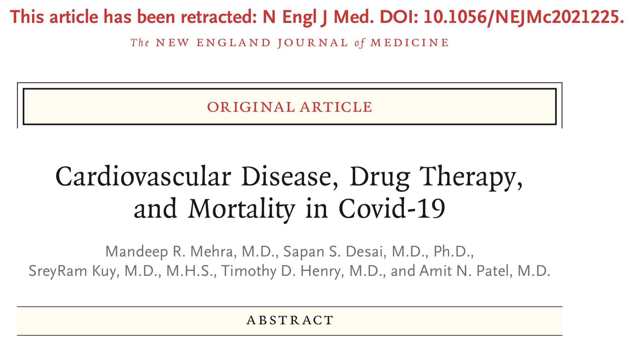
Ongoing Concerns About Integrity

Slide 22
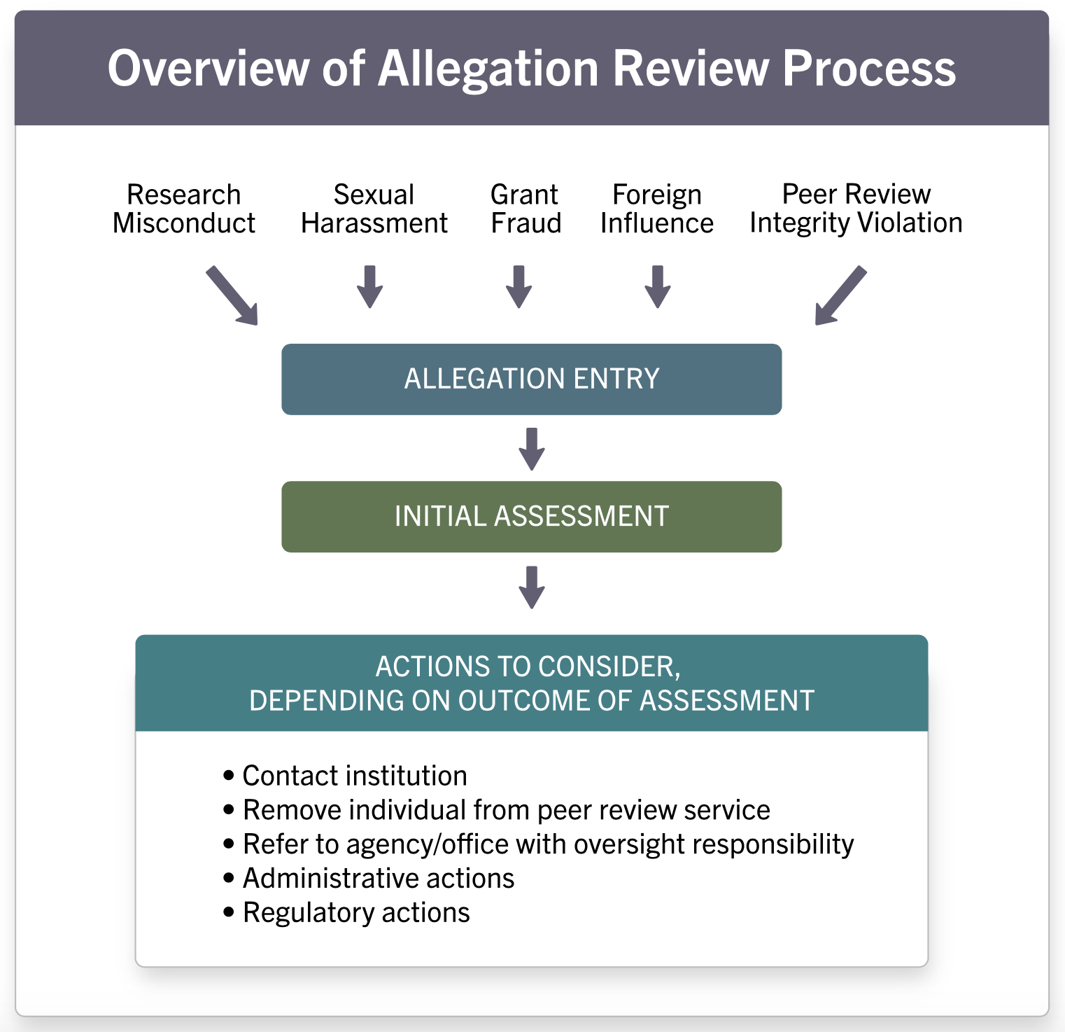
Our Integrity Concerns
https://grants.nih.gov/images/simplified.svg

Slide 23
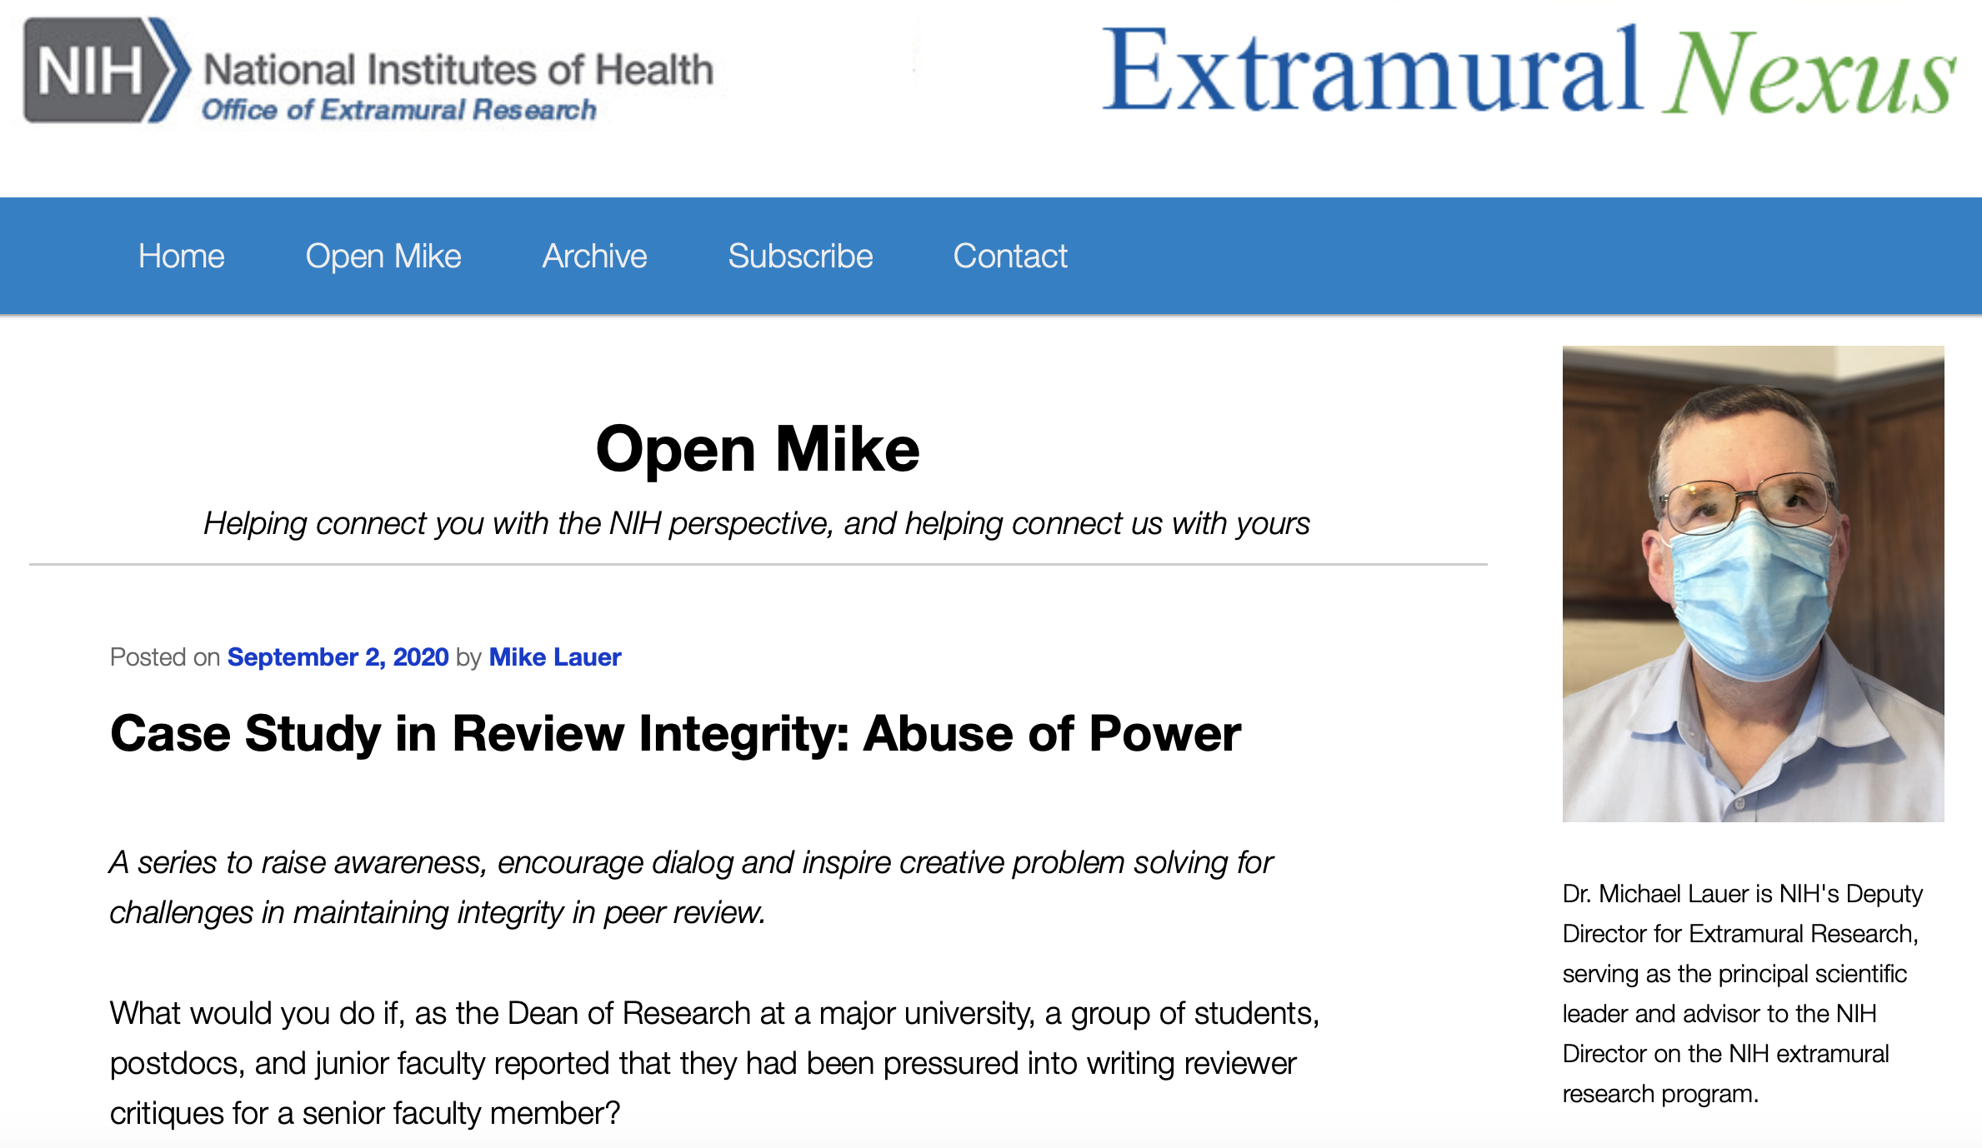
Peer Review Misconduct
https://nexus.od.nih.gov/all/2020/09/02/case-study-in-review-integrity-abuse-of-power/

Slide 24
Constructive Approaches to Peer Review
Seek lots of opinions (at your institution)
Read FOA’s and instructions carefully
Keep your ego in check
Mock study sections – my story
Low threshold to contact PO
Appeals: available, but …
Pay attention to review comments, some are …

Slide 25
Closing Thoughts
Impact on research “bipolar”
Extensive, and disproportionate, disruption
Long-term effects unclear
Opportunity for a future reset?
NIH priorities:
Early career / at-risk investigators, certain trials
Integrity above all (including peer review)

