Slide 1
Pivot: Identifying
November 8, 2012
INTERDISCIPLINARY RESEARCH SUPPORT
Kassie M. Obelleiro
Funding Opportunities Program Coordinator
Rainbow Vogt
Editorial Coordinator

Slide 2
Identifying Research Funding Opportunities
Tips for Finding Funding Opportunities
Check the Office of Research website
Search on funding resource websites
Subscription sites (paid and free): Grants.gov, Pivot, Grant Forward
Directly on the sponsoring agency’s website
Sign-up for regular email updates or RSS feeds from funding sources
Office Research: Funding Listserv

Slide 3
Office of Research Website http://research.ucdavis.edu/pgc/fo

Slide 4
Office of Research Website
View Program Announcements
Limited Submissions Programs
Funding Opportunities of Special Interest (not limited)
View UC Davis-sponsored Funding Programs
Find Forms, Instructions, and other Useful Information
Sign up for Funding Listserves
Find Resources for Preparing and Submitting Proposals

Slide 5
Office of Research Website

Slide 6
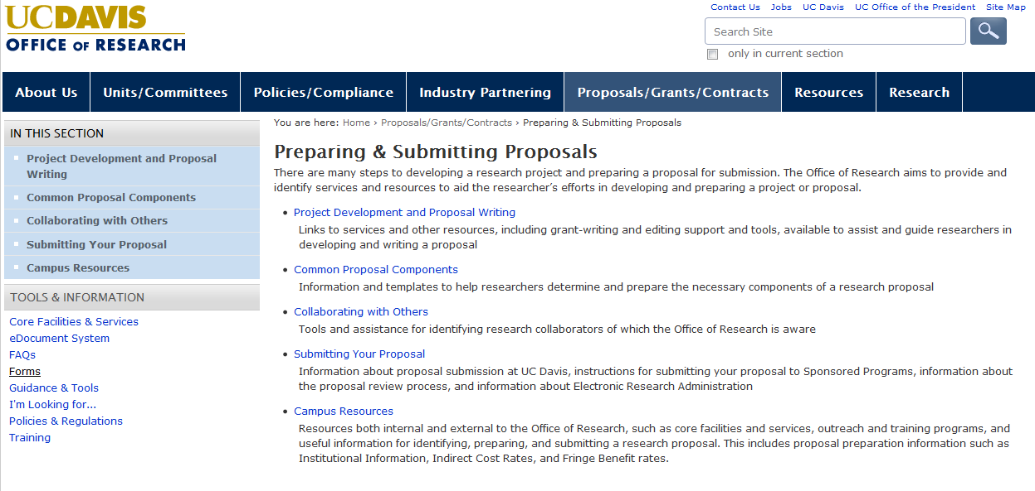
Office of Research Website
Preparing & Submitting Proposals

Slide 7
Pivot http://pivot.cos.com

Slide 8
Pivot
Search Funding Opportunities
Create Unique Searches and Receive Weekly Email Updates
See Associated Internal Deadlines or Notes
Track Individual Funding Opportunities
Claim Your Profile and View Funding Search Results
Find Collaborators

Slide 9
Grant Forward http://www.grantforward.com

Slide 10
Grant Forward
Search Funding Opportunities
Create Unique Searches and Receive Daily, Weekly or Monthly Email Updates
Track Individual Funding Opportunities
Mark as a Favorite

Slide 11
Grants.gov

Slide 12
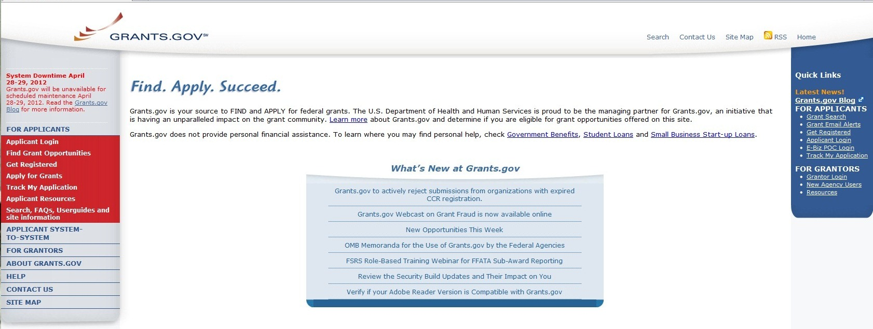
Grants.gov Funding Search

Slide 13
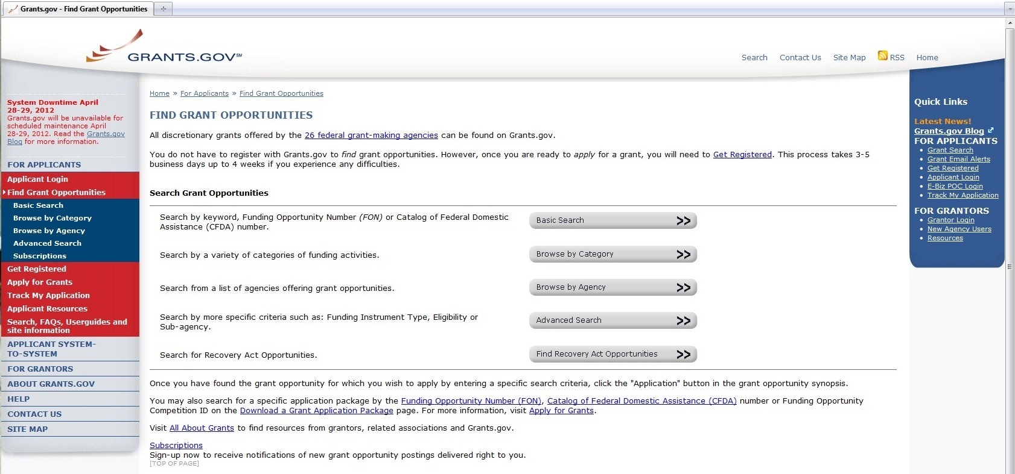
Grants.gov Funding Search

Slide 14
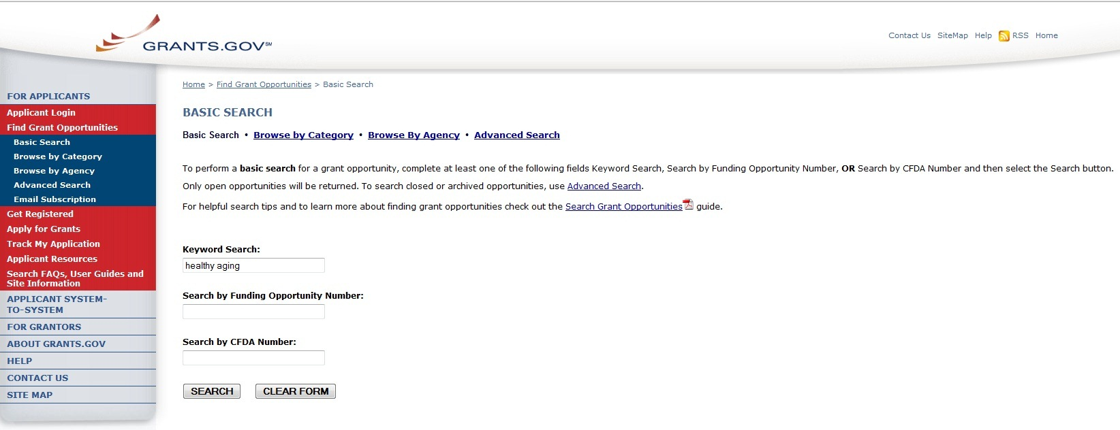
Grants.gov: Basic Search

Slide 15
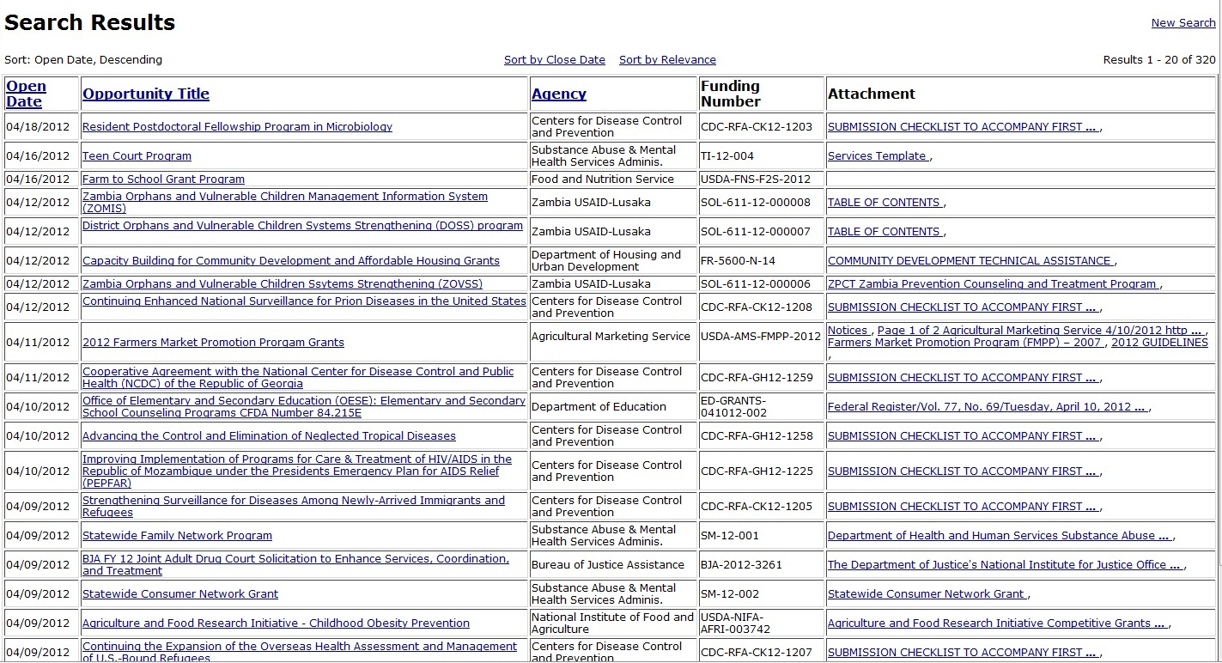
Grants.gov: Basic Search Results

Slide 16
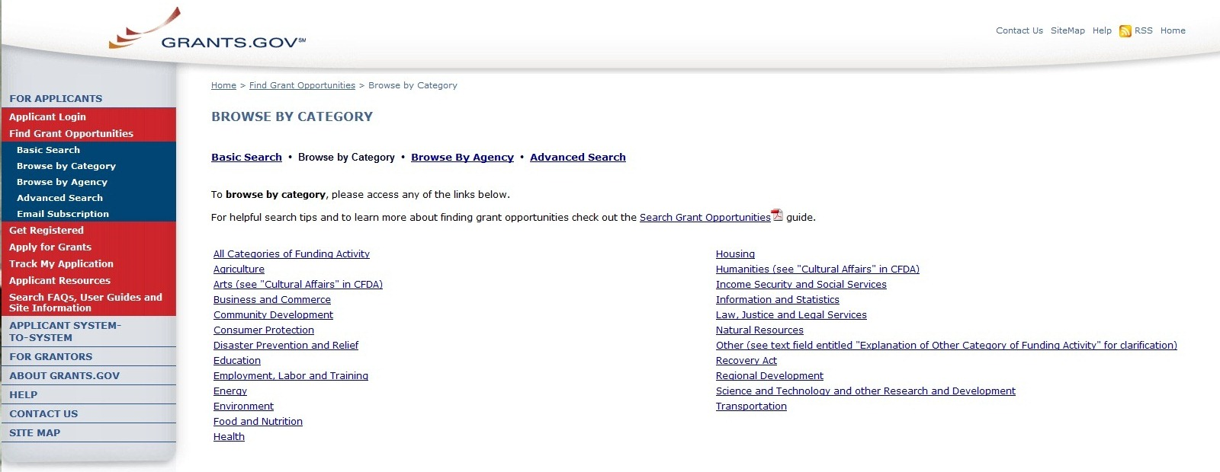
Grants.gov: Browse by Category

Slide 17
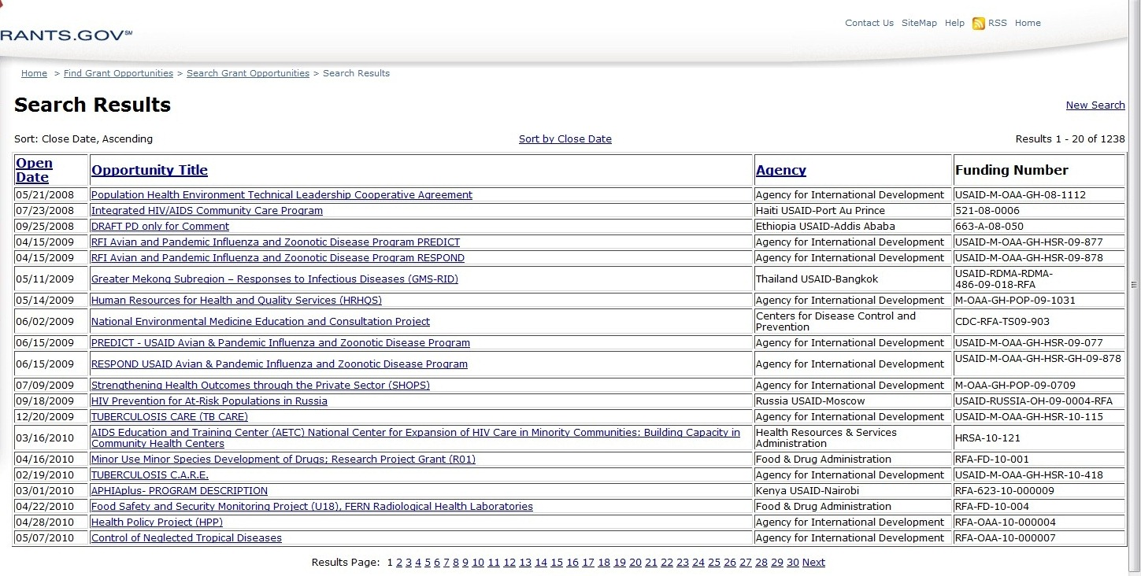
Grants.gov: Browse by Category - Health

Slide 18
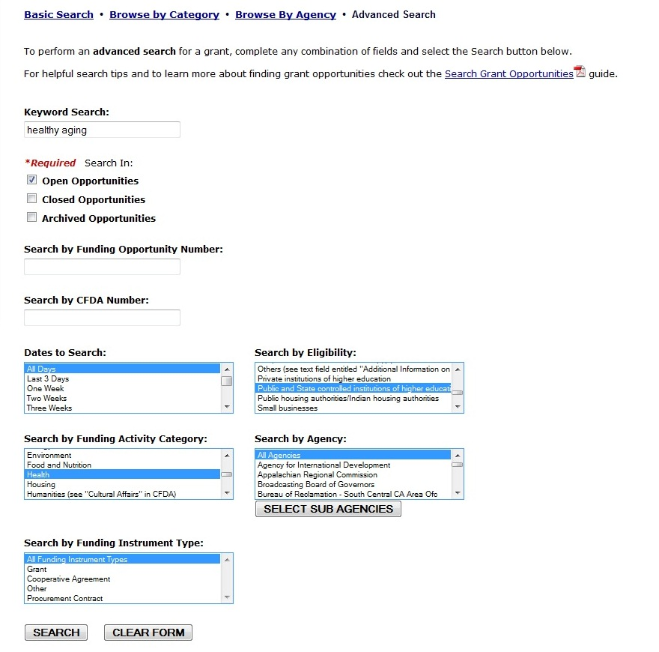
Grants.gov: Advanced Search

Slide 19
Grants.gov: Advanced Search Results

Slide 20
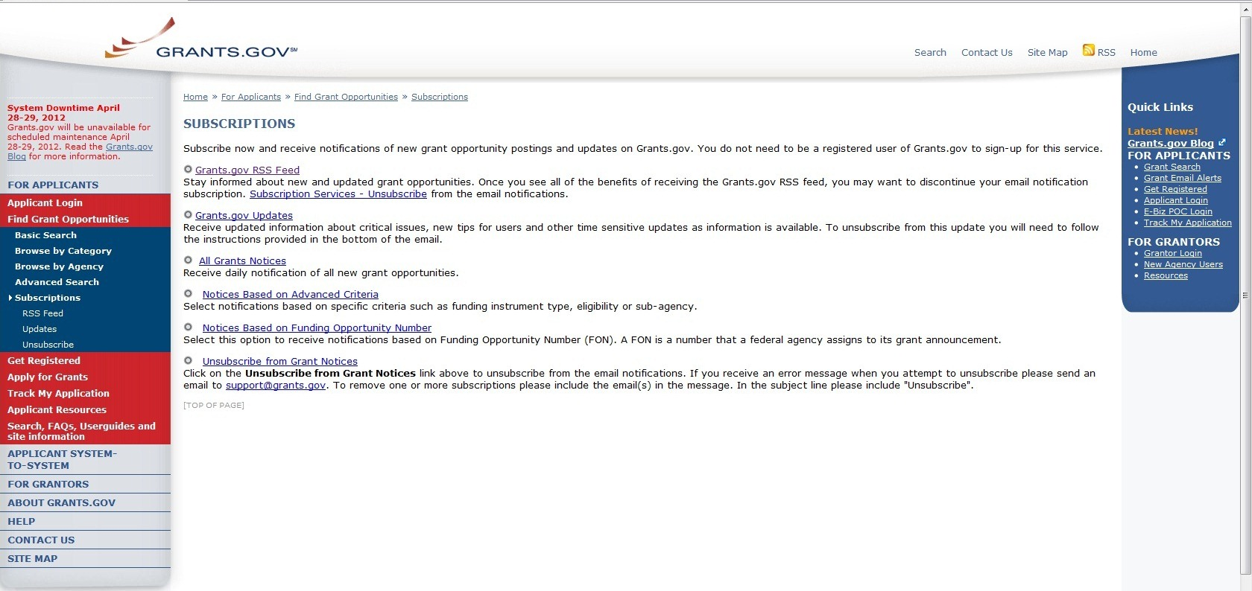
Grants.gov: Funding Updates

Slide 21
National Institutes of Health

Slide 22
National Institutes of Health (NIH)
Types of Funding Opportunity Announcements
Parent Announcements fund investigator initiated projects and have no specific solicitations.
Program Announcements (PA, PAR, or PAS) are relatively general and fund investigator initiated projects.
Request for Applications (RFAs, RFPs) solicit specific types of research and have set deadlines.

Slide 23
National Institutes of Health (NIH)
Types of Funding Opportunity Announcements
Parent Announcements fund investigator initiated projects and have no specific solicitations.
Program Announcements (PA, PAR, or PAS) are relatively general and fund investigator initiated projects.
Request for Applications (RFAs, RFPs) solicit specific types of research and have set deadlines.

Slide 24
NIH
Types of Funding Opportunity Announcements
FOA |  | Purpose
PA | Program Announcement | Requests applications in the stated scientific areas.
PAR | PA Reviewed in an Institute | PA with a special receipt, referral and/or review consideration. Special review section to ensure fair review.
PAS | PA with Set-Aside Funds | PA funded with money taken out of the budget for specific purpose.

Slide 25
NIH
Types of Funding Opportunity Announcements
FOA |  | Purpose
RFA | Request for Application | Solicits grant applications for specific (narrow) program purpose.
RFP | Request for Proposals | Solicits contract applications for a specific need (e.g. developing an animal model).

Slide 26
NIH
RFAs vs. PAs
 | RFA | PA
Represent | Urgent need | Ongoing area of interest
Effective period | Limited | Can be years
Funds | Set-aside | No strict budget
Due | Single date | Rolling
Review | Special panel | Regular study sections
Awards | Until funds are depleted | As decided by review committee

Slide 27
NIH: Program Announcements
Funding Mechanisms
Two Ways to Find Program Announcements
Search from the relevant Institute’s Page

Slide 28
National Institutes of Health (NIH)
Submitting to a Parent Announcement
Determine the Institute(s) that may be appropriate for your idea
Identify the relevant Institute(s)’ priority areas
Each Institute has identified priority areas that can be found on their website.
Identify the corresponding/relevant Parent Announcements

Slide 29
NIH: Identifying Institutes

Slide 30
NIH: Identifying Institutes

Slide 31
NIH: Determining Relevant Priority Areas

Slide 32
NIH: Determining Relevant Priority Areas
NINR Research Priorities
Health Promotion/Disease Prevention
Eliminating Health Disparities
Caregiving, Symptom management, and Self-management
Quality of Life
NINR is the lead Institute at NIH on research on care at the end of life—an important emerging field.

Slide 33
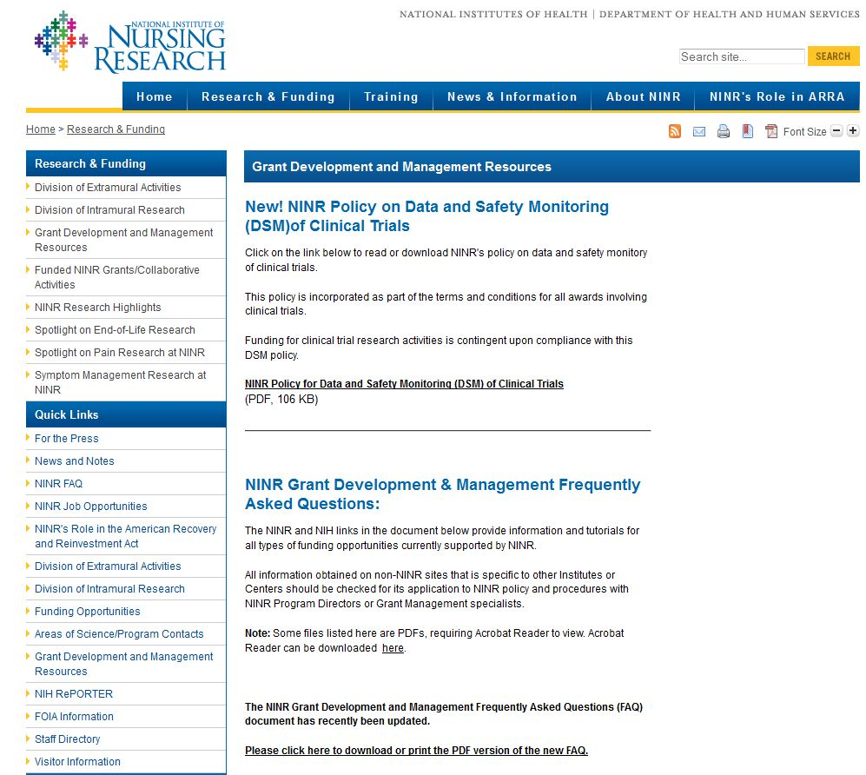
NINR: Finding Parent Announcements

Slide 34
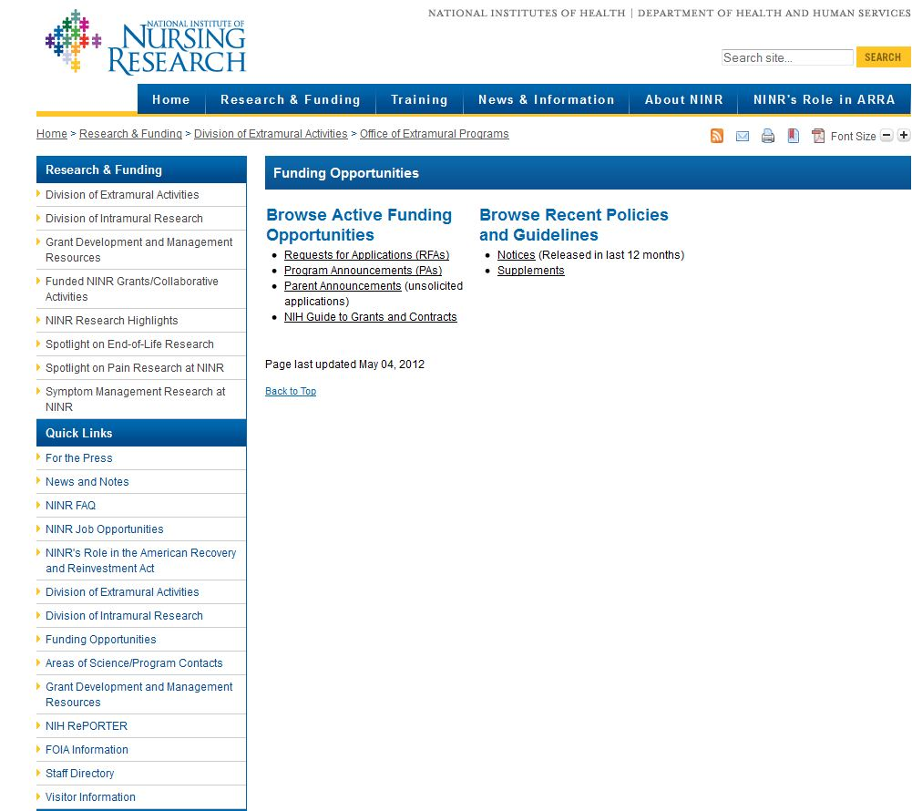
NINR: Finding Parent Announcements

Slide 35
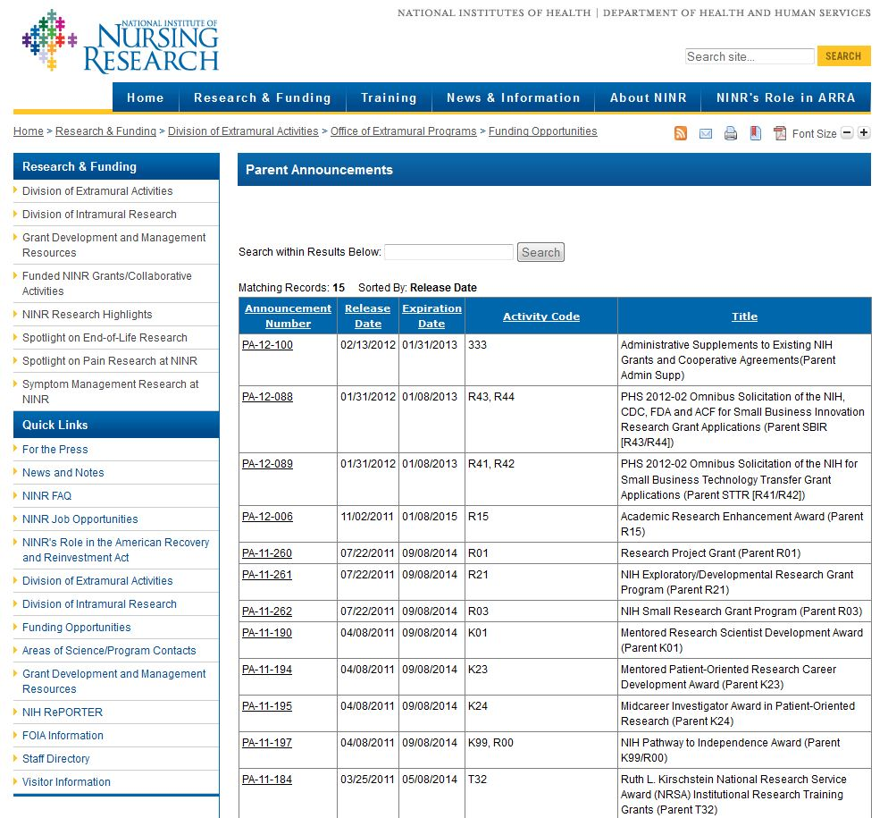
NINR: Finding Parent Announcements

Slide 36
NIH
Funding Mechanisms: R Series
FOA
R03 | NIH Small Grant Program (2 years, $50K/year)
R21 | NIH Exploratory/Developmental Research Award ($275K total)
R01 | NIH Research Project Grant Program (5 years, $250K/year)

Slide 37
NIH
Funding Mechanisms: T Series – Training and Fellowship
FOA
T32, T90 | Institutional Research Training Grants
K12 | Mentored Clinical Scientist Development Program Awards
F Series | Individual award series for students, post-docs, and fellows

Slide 38
NIH
Funding Mechanisms: K Series – Early Career
FOA
K01, K08, K23 | Transition Career Development Awards (3-5 years, salary and research-related support)
K22, K99/R00 | Transition Career Development Awards (2-5 years, salary, and research funds)

Slide 39
NIH: Program Announcements
Funding Mechanisms
Two Ways to Find Program Announcements
Search from the relevant Institute’s Page
Search all Funding Opportunities and Notices
http://grants.nih.gov/grants/guide/

Slide 40
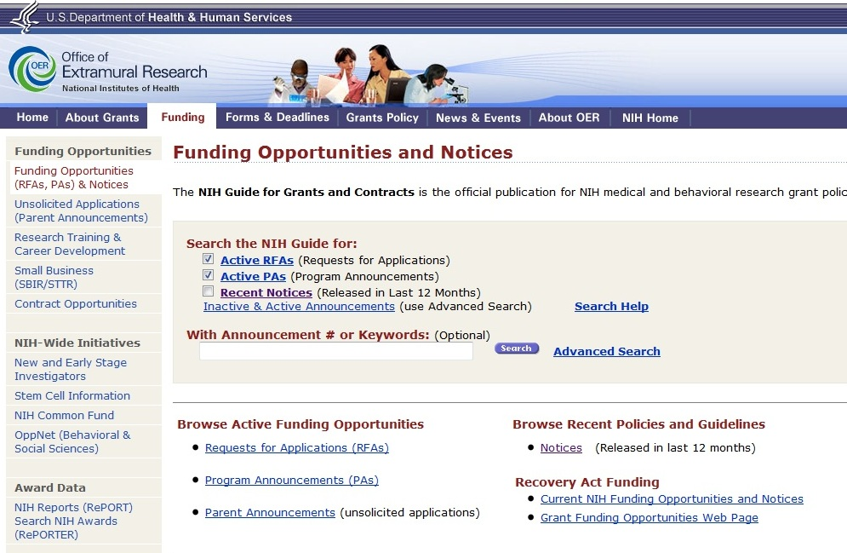
NIH: Funding Opportunities and Notices
http://grants.nih.gov/grants/guide/

Slide 41
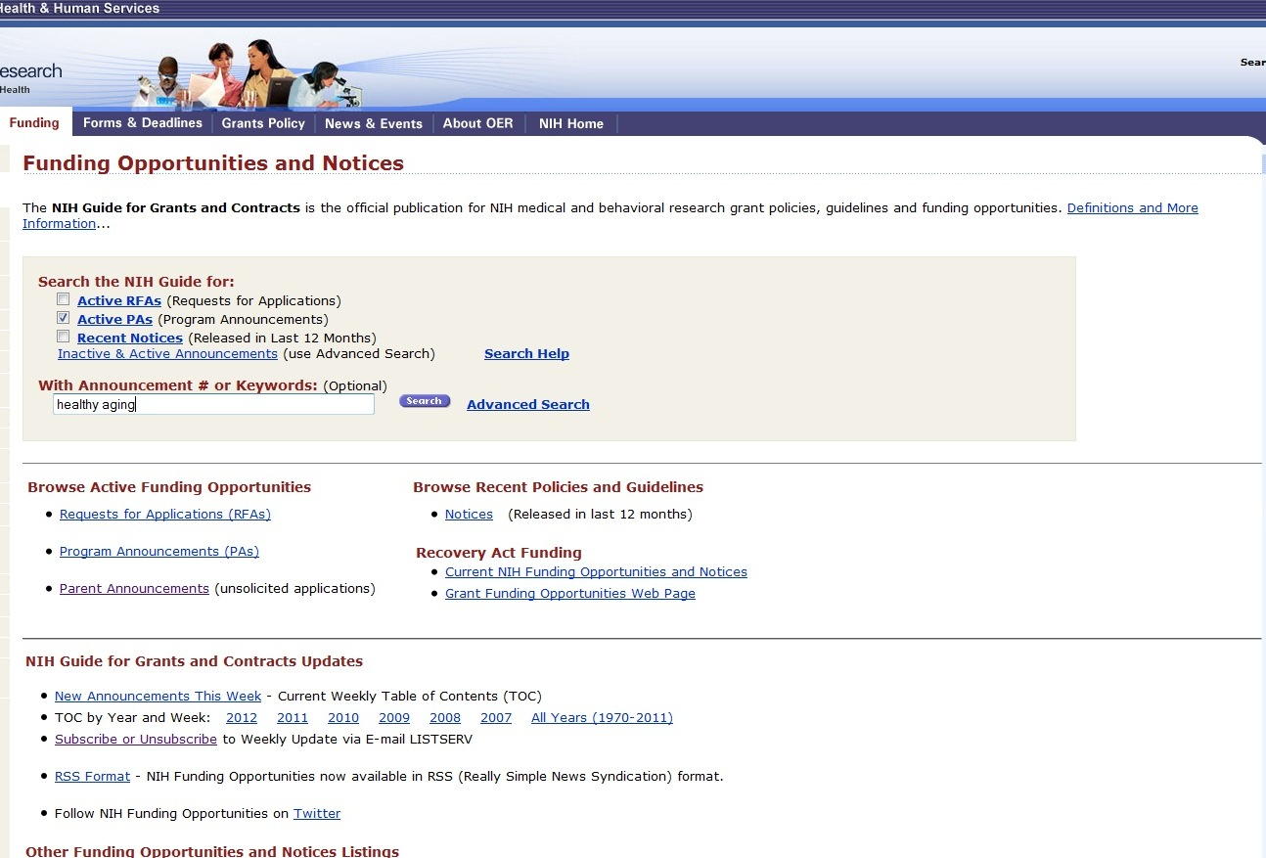
NIH: All Program Announcements

Slide 42
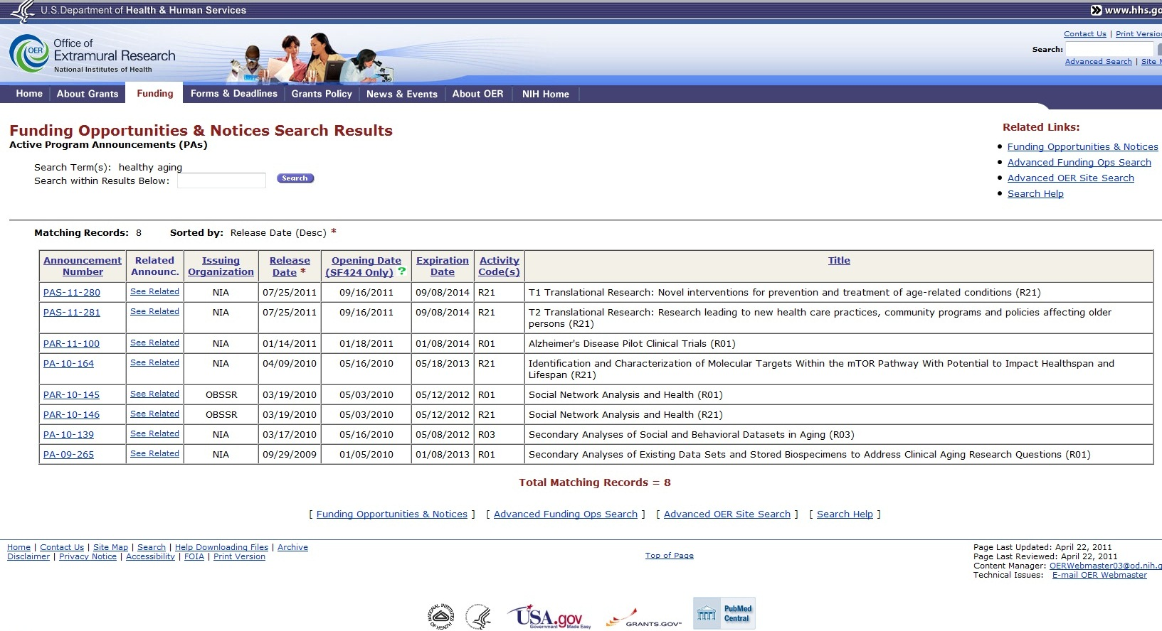
NIH: Program Announcement Search Results

Slide 43
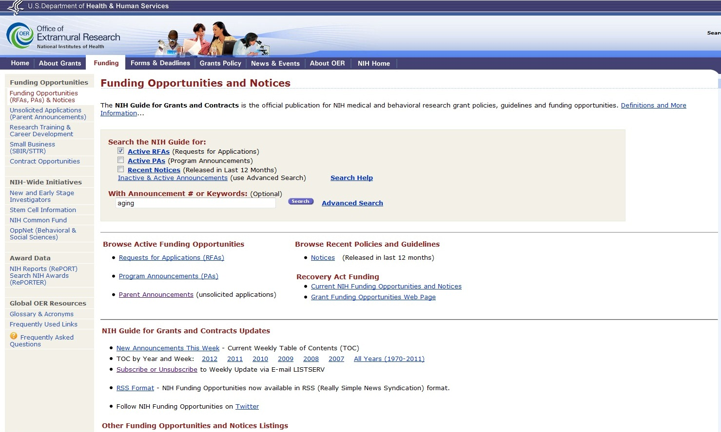
NIH: Request for Applications (RFAs)

Slide 44
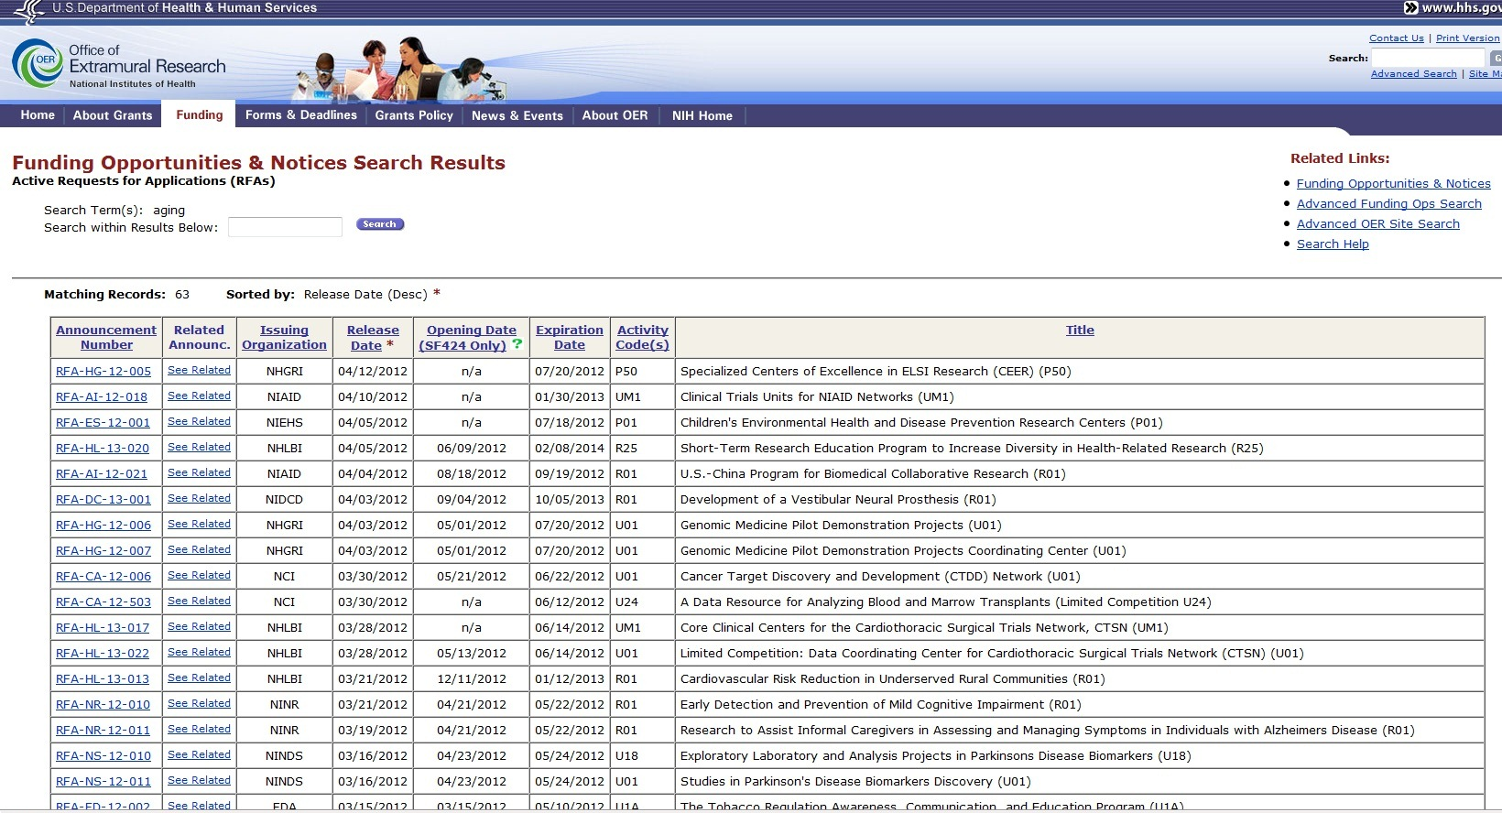
NIH: RFA Search Results

Slide 45
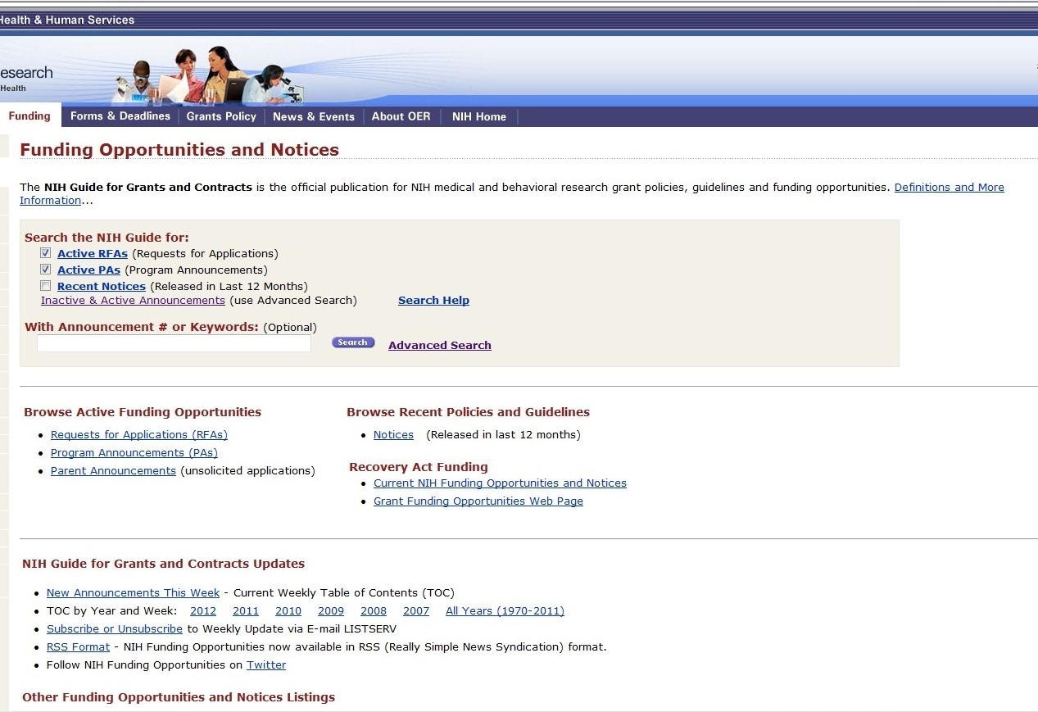
NIH: Advanced Search

Slide 46
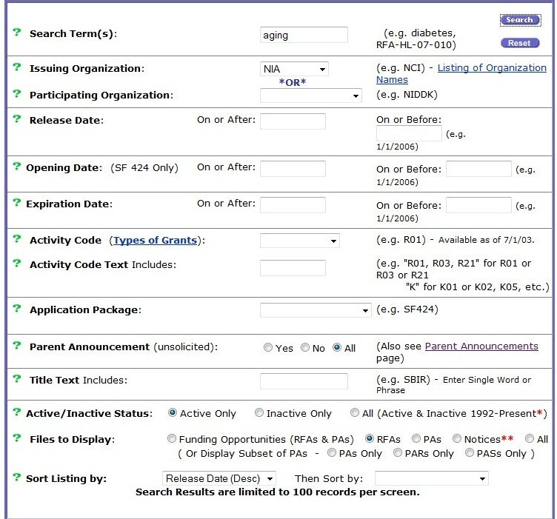
NIH: Advanced Search

Slide 47
NIH: Advanced Search Results

Slide 48
National Institutes of Health (NIH)
Email Subscriptions and RSS Feeds

Slide 49
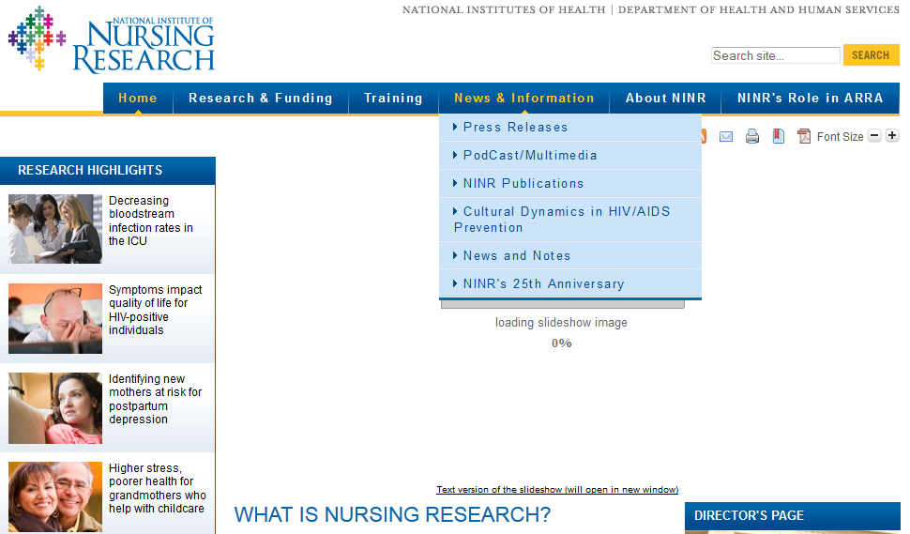
National Institutes of Health (NIH)
Email Subscriptions and RSS Feeds

Slide 50
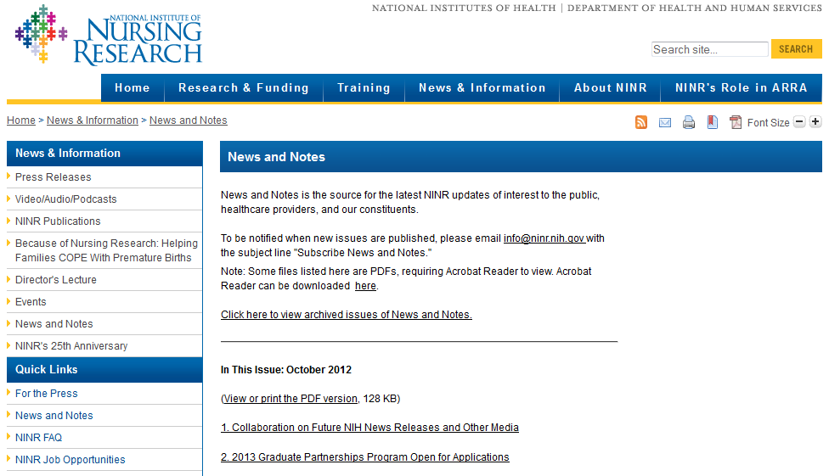
National Institutes of Health (NIH)
Email Subscriptions and RSS Feeds

Slide 51
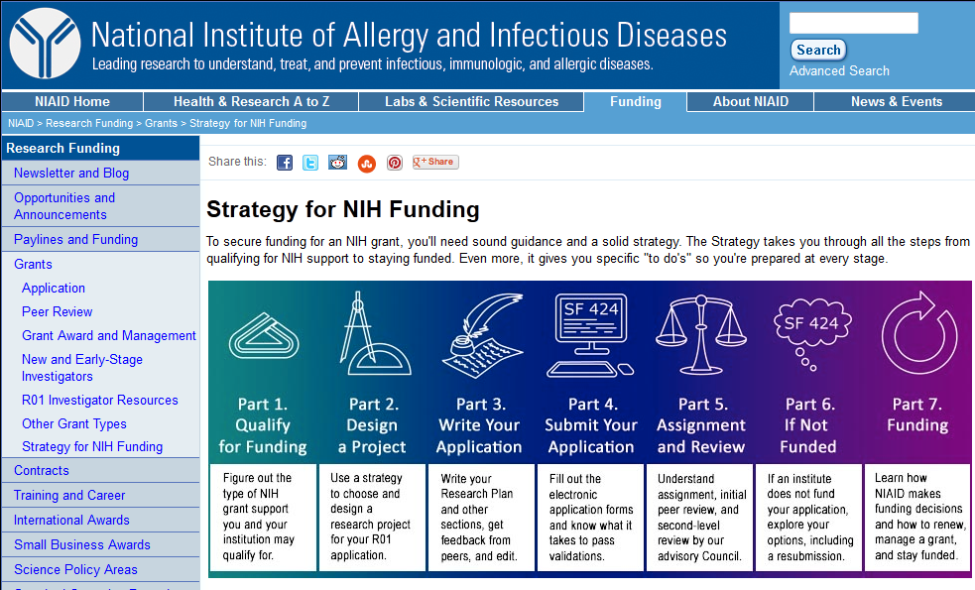
NIH: NIAID Grant Strategy Guide
http://www.niaid.nih.gov/researchfunding/grant/strategy/pages/default.aspx

Slide 52
Resources and Other Helpful Links
Identifying Research Funding Opportunities

Slide 53
Resources and Helpful Links
Publically Available Sites
National Institutes of Health (NIH)
Grants Guide: http://grants.nih.gov/grants/guide/index.html
Parent Announcements:
http://grants.nih.gov/grants/guide/parent_announcements.htm
Activity Code Definitions:
http://grants.nih.gov/grants/funding/funding_program.htm
National Science Foundation (NSF)
http://nsf.gov/funding
Grants.gov
http://www.grants.gov
Foundation Center
http://foundationcenter.org/findfunders/fundingsources/rfp.html

Slide 54
Resources and Helpful Links
Paid Subscription Sites
Pivot
http://pivot.cos.com
Grant Forward
http://www.grantforward.com
SciVal Funding
http://www.info.scival.com/
Foundation Directory Online
http://fconline.foundationcenter.org/
infoEd SPIN Funding Opportunities
http://infoedglobal.com/solutions/grants-contracts/spin-funding-
opportunities/

Slide 55
Identifying Research Funding Opportunities
Contact Information
Kassie M. Obelleiro
Funding Opportunities Program Coordinator
Interdisciplinary Research Support
Phone: (530) 754-7738
E-mail: kobelleiro@ucdavis.edu / limsubmissions@ucdavis.edu
Rainbow Vogt
Editorial Coordinator
Interdisciplinary Research Support
Phone: (530) 754-7788
E-mail: ravogt@ucdavis.edu

