Slide 1
Call for Abstracts: Sharing Your Expertise
Notes:
Estimated time on slide: 0.5 minute
Presenter: Kari
Thank you all for joining today! I’m excited to get started on this presentation.
The purpose of this webinar is to encourage you to consider submitting an abstract for a 2019 conference presentation. We want to make it less overwhelming or intimidating.
Next, we’ll be introducing the call for abstracts, highlighting some of the expectations for each of the format options.
Finally, we will walk you through the abstract components, review criteria, and how to submit your abstract.

Slide 2
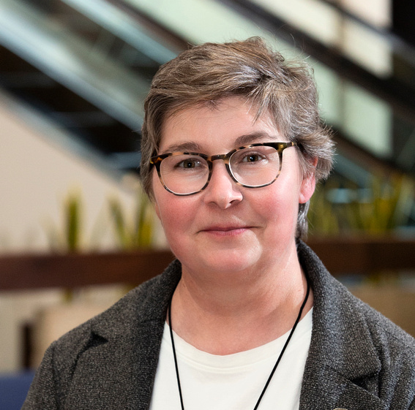
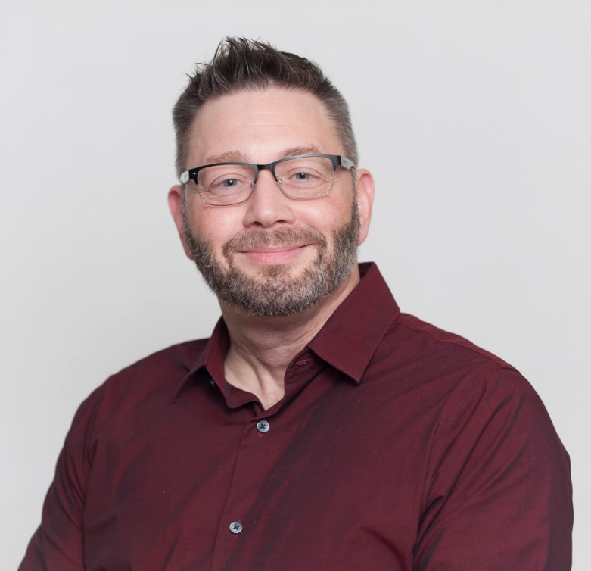
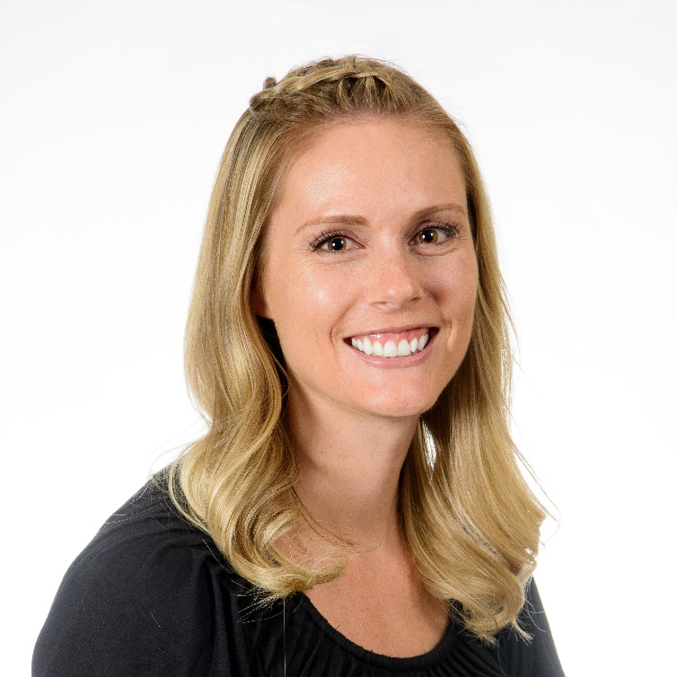
Presenters
Kari Whittenberger-Keith, Ph.D. University of Wisconsin-Milwaukee
David Widmer, Ph.D. Memorial Sloan Kettering
Jeannie Wilson, MA Arizona State University
Notes:
Today’s presenters are:
Each person introduces themselves

Slide 3
Why Present
Support the professionalization of research development positions
Share and learn best practices
Support networking and the open exchange of ideas
Contribute to NORDP’s diversity and inclusive excellence goals
Notes:
Why consider a presentation at the 2019 NORDP Conference? Here are just a few reasons:any
Our conference is intended to support the professionalization of research development positions, a field unique from other academic administrative roles and very different from research administration. This conference is intended to support the distinct field of research development and recognize its role in all types of institutions.
We have a great community of professionals in NORDP, and the annual conference is our opportunity to share best practices that we have developed and to learn from others. Nobody has all the answers—but other NORDP members do!
The annual conference serves as a great opportunity to network with others and foster the open exchange of ideas. You can use your conference presentation to meet others exploring similar topics or issues at their institutions. Use a conference presentation to co-present with someone you’ve been looking to collaborate with.
The purpose of this webinar, and the annual conference, is to support the mentoring and development of NORDP professionals at all career stages. A large part of this initiative is to encourage those who have not presented at NORDP before to consider submitting an abstract. Topics or issues related to NORDP’s diversity and inclusive excellence goals are always of high importance.

Slide 4
Why Present
I find that NORDP is an assembly of colleagues that are all-in for advancing research in our institutions, which is exactly how I see my professional life. I feel supported and encouraged by the membership. Presenting at NORDP is a bit like presenting in front of friends, everyone wants you to succeed and grow, and is curious to learn from you. Our colleagues are eager and ambitious in their thinking and I love learning how the content I am presenting might be applicable as well as learning from the feedback I get on my presentation skills. I look forward to it every year.
Donnalyn Roxey, NORDP member
Notes:
Why consider a presentation at the 2019 NORDP Conference? Here are just a few reasons:any
Our conference is intended to support the professionalization of research development positions, a field unique from other academic administrative roles and very different from research administration. This conference is intended to support the distinct field of research development and recognize its role in all types of institutions.
We have a great community of professionals in NORDP, and the annual conference is our opportunity to share best practices that we have developed and to learn from others. Nobody has all the answers—but other NORDP members do!
The annual conference serves as a great opportunity to network with others and foster the open exchange of ideas. You can use your conference presentation to meet others exploring similar topics or issues at their institutions. Use a conference presentation to co-present with someone you’ve been looking to collaborate with.
The purpose of this webinar, and the annual conference, is to support the mentoring and development of NORDP professionals at all career stages. A large part of this initiative is to encourage those who have not presented at NORDP before to consider submitting an abstract. Topics or issues related to NORDP’s diversity and inclusive excellence goals are always of high importance.

Slide 5
Pick a Presentation
Two-Hour Individual Oral or Panel Presentation
One-Hour Individual Oral or Panel Presentation
Lightning Talks
Idea Showcase
Roundtables
Conference Workshops
(and, yes, you can submit more than one abstract)
Notes:
The Annual Conference will have six presentation types:
Two-Hour Individual Oral or Panel Presentation
One-Hour Individual Oral or Panel Presentation
Lightning Talks
Idea Showcase
Roundtables
The sixth type, conference workshops, are not a part of today’s discussion because those applications are solicited via a separate call. Today’s discussion will provide an overview of the first five presentation types listed here.

Slide 6
Two-Hour Sessions
New this Year
Oral Individual or Panel Presentation Characteristics:
Individuals OR panels of no more than four persons
Should be relevant to the NORDP mission and/or professional development
Justify the extra hour over a one-hour session
The Logistics:
Audience size: 40-75
Audio visual equipment will be provided
Scheduled for Monday, April 29th
Notes:
What are the key characteristics of a two-hour Oral Individual or Panel Presentation?
It may be a single person oral presentation or a panel presentation of no more than four individuals.
These sessions should focus on an issue or opportunity related to the NORDP mission and/or be important to developing the skills or professional development of conference participants.
If you propose a two-hour session, you need to develop a compelling case as to why your session should receive an extra hour. This includes providing a justification for a more in-depth discussion, allowing for more interactive activities, and/or involving the participants more fully in the session.
And now for the fine print:
Audience size at these sessions is anticipated to be between 40 and 75. Carefully consider what you may be able to cover with an audience of this size.
Audio-visual equipment for slide presentations will be provided.
All two hour sessions will be scheduled on Monday, April 29.

Slide 7
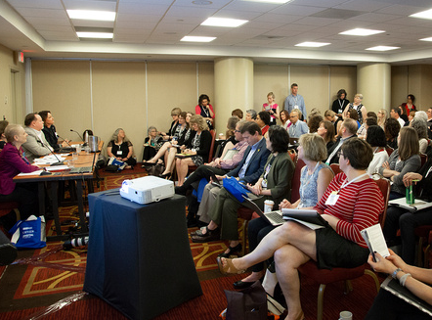
One-Hour Sessions
Oral Individual or Panel Presentation Characteristics:
Individuals OR panels of no more than four persons
Should be relevant to the NORDP mission and/or professional development
The Logistics:
Audience size: 25-75
Audio visual equipment will be provided
Scheduled for Tuesday, April 30 and Wednesday, May 1
For both:
Avoid single case studies!
Notes:
The one hour oral individual or panel presentations are somewhat similar to the two hour sessions:
It may be a single person oral presentation or a panel presentation of no more than four individuals.
These sessions should focus on an issue or opportunity related to the NORDP mission and/or be important to developing the skills or professional development of conference participants.
Audience size at these sessions is anticipated to be between 25 and 75. Carefully consider what you may be able to cover with an audience of this size.
Audio-visual equipment for slide presentations will be provided.
All one-hour sessions will be scheduled for Tuesday, April 30 or Wednesday, May 1. (do we know if applicants will be able to submit a preference for the presentation date/time?)
For both the one and two hour sessions, avoid presenting case studies from a single institution or program. Case studies are most appropriate for a poster in the Idea Showcase, whereas the one- and two-hour sessions are most appropriate for tackling complex or over-arching issues, challenges, opportunities, and topics in research development that impact a diverse array of institutions and perspectives.

Slide 8
Lightning Talks
New this Year
Lightning Talks Characteristics:
Share new and creative ideas for fostering research development
Based on Ignite (http://www.ignitetalks.io/)
How to develop a good Ignite Talk? See http://scottberkun.com/2009/how-to-give-a-great-ignite-talk/
The Logistics:
You have five minutes and 20 slides for your presentation
Slides advance automatically every 15 seconds
Presenters will be grouped into 60 minute sessions
Scheduled for Tuesday, April 30 and Wednesday, May 1
Notes:
New to NORDP for this year’s conference, Lightning Talks will be an opportunity for individuals to share new and creative ideas for fostering research development. This new conference session is based on Ignite, and interested applicants are encouraged to visit the ignitetalks website listed here for more information about the format, background, and samples. Additionally, Scott Berkun has also developed a blog post with key strategies to develop an Ignite Talk session. Applicants are also encouraged to review the link posted to this slide.
In a Lightning Talk, you have five minutes and 20 slides for your presentation; slides advance automatically every 15 seconds. Presenters will be grouped into 60-minute sessions, to be delivered on Tuesday, April 30 and Wednesday, May 1.

Slide 9
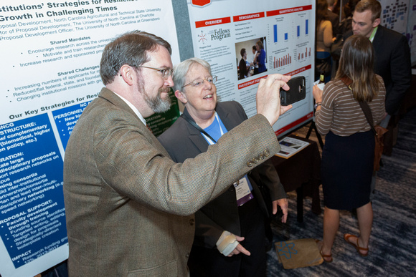
Idea Showcase
Idea Showcase Characteristics:
Designed for individuals or small teams to present posters
Supports presentation of case studies, best practices, and/or innovative or experimental ideas
The Logistics:
Presenters must provide their own posters at
their own cost
Posters will be presented for discussion during
the Tuesday Idea Showcase and Reception
Notes:
The Idea Showcase is designed for individuals or small teams to present posters illustrating their own approaches to problems and solutions in research development, to showcase best practices and case studies, and to introduce innovative and/or experimental ideas.
Presenters chosen to participate in the Idea Showcase will provide their own posters at their own cost. Posters will be presented for discussion during the Tuesday Idea Showcase and Reception.

Slide 10
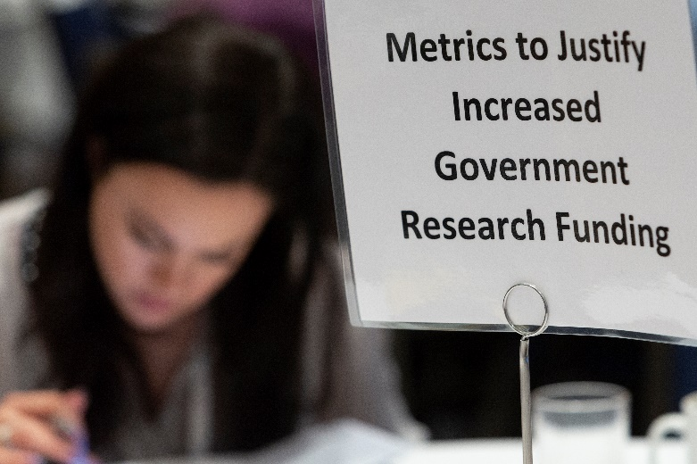
Round Tables
Roundtable Characteristics:
One-Hour Session
Discussion focused on a specific issue related to research development
Share individual experiences in an open setting
The Logistics:
Provide a description of the topic
Applicant must affirm their willingness to lead the discussion
Scheduled for Tuesday, April 30 and Wednesday, May 1
Notes:
Roundtable sessions are scheduled for one hour and will allow conference attendees to participate in a discussion focused on a specific issue related to Research Development. Roundtables encourage networking and sharing of individual experiences in an open setting.
Applicants should provide a description of the topic and its relevance to NORDP members, as well as be willing to commit to leading the roundtable discussion. Applicant will serve as “host.” Roundtables are scheduled for Tuesday, April 30 and Wednesday, May 1.

Slide 11
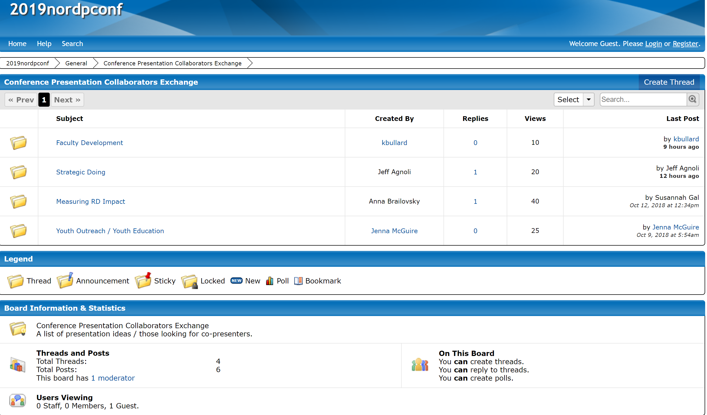
Finding a Co-Presenter
New this Year
http://2019nordpconf.proboards.com/
Notes:
New for this year, the NORDP ProBoard is available to support collaboration and networking opportunities between NORDP members. Need a co-presenter because you are considering a panel session? Looking to be a co-presenter because you are proposing a two-hour session and need assistance with implementing interactive activities? New to presenting and are interested in collaborating with a NORDP veteran? Check out the NORDP ProBoard for your various collaboration needs.

Slide 12
Abstract Components
Application Components:
Session Type
Intended Audience
Brief Author Bio
Title
Full Abstract
Program Abstract
Notes:
Let’s talk briefly about the various application components and some considerations for each section. We’ve already covered the different session types. Let’s talk next about the Intended Audience.

Slide 13
Who is NORDP?
Narrow Definitions
Broadly Appealing
Specific Characteristics
Notes:
Within the NORDP community, we all have very different roles, expertise, and skill sets. Along with that, we have different career aspirations.
When designing your session, you’ll want to keep in mind our evolving demographics as an organization (check out our website for more information).
Ask yourself key questions, including: is this purposefully narrow, or appropriate to a wider audience?
Remember, you’ll want to clearly define your target audience for your session, as that’s who we’ll advertise it to.

Slide 14
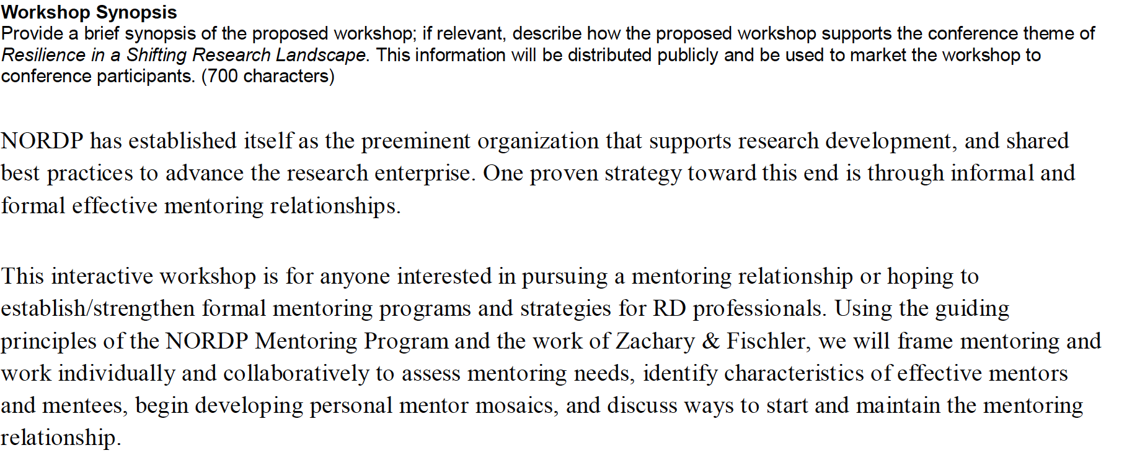
Relevance to NORDP
Notes:
At the get go, you should clearly state why your abstract is relevant to NORDP. If you aren’t able to answer how you’re relevant, then you need to continue to work on the concept!
NORDP is a growing, evolving, and diverse group of individuals committed to the concept of research development. A broad understanding of what NORDP is trying to achieve will help you contextualize your session into our work as RD professionals.
It might be useful to consider the following questions:
What would the NORDP community find useful about your presentation?
Can you articulate overarching learning objectives?
Are there ways to describe a benefit for attending your presentation?

Slide 15
Target Audience
Essential
Fundamental to Research Development
Intended for members interested in RD, new to the field, those that have new duties connected to the topic, and/or those interested a refresher
Essential ≠ Easy
Intermediate
Fundamental to RD, but relevant to those with one or more years of experience in RD
Also may be relevant to those considering “next steps” in terms of career progression
Advanced
For those with significant skills in the topic or working in or towards leadership roles in RD
Also may be relevant to those considering “next steps” in terms of career progression
All Members
Notes:
You will need to identify a target audience for your session. You have four options during the abstract submission process:
Essential: This is content designed to provide knowledge and content fundamental to research development. Content may be appropriate for individuals interested in research development, new to RD, individuals already in RD but whose job responsibilities do not currently include the indicated topic, or those who want a refresher. Just remember that “essential” doesn’t mean “easy.”
Intermediate: This is content that is fundamental to RD, but indicative of or relevant to individuals who have been involved in RD (or the given topic) for more than one year. This information can also be useful to individuals thinking about the next steps in their career or about skills and responsibilities they want to gain.
Advanced: Content is relevant to and aimed at individuals who already have significant skills in the given topic; who have or are working toward leadership roles in RD (including those who are “offices of one”); and/or who have an institutional leadership role or advise institutional leaders. This information can also be useful to experienced individuals thinking about their next career steps or about skills or responsibilities they want to gain.
All members: This session is relevant to those at all stages in their research development careers.
Just a reminder… NORDP membership is growing every day. A session that is narrowly, but appropriately focused, stands a better chance of selection versus an abstract that is too broad and misidentifies the intended audience for its content.

Slide 16
Authors
Bios must be provided for each author
Limited to 500 characters
Opportunity to highlight the author’s
expertise, education, background and
how it directly relates to the session
Notes:
Abstract authors will need to submit brief bios of 500 characters. Carefully consider developing your bio so that the reviewers will be able to determine how your expertise, education, and background are directly related to the proposed session. Remember, the reviewers probably don’t know you or anything about you—they have no idea how or why you are qualified to present. This is your chance to tell the reviewers about your experience and background and why you are awesome!
When providing information about yourself, it’s always good to convince the reader that you have what it takes to present on the topic.
However, you do not need to be top of your game! We’re looking for diversity in workshops and presenters. So, keep it accurate and reflect why you’re not only passionate about the topic, but also bring your expertise to the table for this workshop topic.
Questions to think about as you define your expertise:
Do you bring institutional expertise, for example a primarily undergraduate institution or an historically black college or university?
Do you bring hands-on experience, like working on a significant number or type of projects?
As a member of your team, do you close the knowledge gap? For example, do you have a deep understanding of some particular aspect of research development?

Slide 17
Title and Abstract
Title
Be certain to select something meaningful!
How do I develop a compelling abstract? Consider:
What are your goals?
What will participants learn?
What new concepts will you introduce?
How you will your session advance research development?
Remember—you will submit two abstracts: The Full Abstract and the Program Abstract
Notes:
Let’s talk briefly about the most important aspects of your abstract submission: the title and the abstracts themselves. First, let’s talk about the title of your session. Be certain to give your session a title that’s meaningful. Let’s be honest—there are certain NORDP members that skim the program materials looking solely at the titles. A meaningful title will likely help members quickly identify the session relevance (and may increase your attendance).
You next need to develop your program abstract, which is limited to 2,000 characters. That may seem like a lot of space, but to give you context—2,000 characters in Times New Roman font is about half a page. Thus, brevity and clarity is important. Your abstract must answer these four questions:
What are the goals of your session?
What will participants learn by attending your session?
Will you be introducing new concepts, skills development, or theories?
How will your session support the concept of advancing the field of research development?
And, as a reminder, NORDP is particularly interested a topic that:
Demonstrates ways in which research development professionals support, encourage, and empower researchers to try new things – to create and mobilize knowledge, to try new funding mechanisms or multi-disciplinary grants, to participate in campus think-tanks or networking events
Explores new approaches used in research development programs
Explores creative resources for personal and career development
Emphasizes innovative roles and the value of research development in the broader research enterprise
Introduces and explores essential topics and issues in research development
Finally, remember that you will be submitting two abstracts: the full abstract, which is 2,000 characters, but also the Program Abstract, which is 100 words. This is what will be used to market your session in the program. You need to emphasize what participants will learn or gain by attending your session. Please note that your Program Abstract cannot be changed UNLESS REQUESTED by the Conference Program Committee.

Slide 18
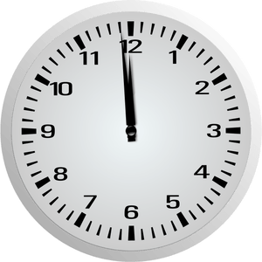
Submission Deadline
Sunday
November 25, 2018
11:59 pm Pacific Time
The deadline will not be extended!
Notes:
Once you have completed all of the abstract application requirements, it’s time to submit! As a reminder, proposals are due Sunday, November 25, 2018 at 11:59 PM Pacific Time. There will be NO extensions to the deadline—this is the latest date and time in which the Committee can accept abstract submissions and still be able to meet all other conference development milestones.

Slide 19
Review Criteria
Quality of the abstract
Likelihood that the abstract will engage participants and promote discussion
Clarity in describing the session’s objectives, outcomes, and intended audience
Relevance of the topic in providing key content to RD professionals
Suitability of the topic to the presentation format proposed
Notes:
So you’ve submitted your abstract by the deadline—now what? It’s the Conference Program Committee’s time to work. Abstracts will be reviewed by the Committee based on the criteria these four criteria (which are also available in the Call for Abstracts). This information is intended to assist applicants with developing a compelling abstract that aligns with the Committee’s review criteria. What you see here is what the Committee will use to score and rank the abstracts. If you address the review criteria in your abstract in a clear, meaningful, and compelling manner, your abstract will stand a good chance in being selected.

Slide 20
The Review Process: Fine Print
Abstracts selected by:
Reviews and rankings of all abstracts
Available time slots
Diversity of topics, expertise/audience levels, and institutions
Sessions from previous conferences may be re-presented, but the author should communicate why it should occur again in 2019.
Presenters from NORDP webinars are encouraged to present at the annual conference.
If you submit an abstract, you’re expected to attend the conference (and pay for the registration, including co-presenters)
Notes:
Too many words – needs to be edited – it’s all pretty useful info; adding some sort of visual to the slide will help.
The Program Committee will select presentations based upon the reviews and ratings of all abstracts submitted, available time slots for presentations, and diversity of presentation topics and levels, including diversity of represented institutions.
Sessions from previous conferences may be re-presented in 2019. If you presented previously, and your session was re-received (well received?) or experienced a large turnout, consider resubmitting your abstract. You, as the author, must communicate in the abstract why your session deserves another presentation.
Individuals who have presented NORDP webinars are encouraged to propose the same or a similar topic for a conference presentation, where they can reach a broader audience.
If your abstract is selected for a One or Two-hour Oral Panel Presentation, the corresponding presenter and up to three other presenters are expected to register and attend the meeting and make the presentation (no more than four presenters in a panel). If your abstract is selected for the Idea Showcase, at least the corresponding presenter is expected to attend the NORDP annual meeting and present the poster.
Please do NOT submit an abstract as a corresponding presenter if you do not plan to attend the NORDP annual meeting.

Slide 21
Closing the Deal
You (and your co-presenters) must register for the conference
You must submit the online presenter’s agreement
Review your speaker’s packet
Consider attending a presentation skills webinar in Winter 2019
Notes:
Your abstract’s been submitted, it’s been selected for presentation at NORDP 2019, and you (and your presenters) have decided to present! Now what?
First, All presenters and group panelist co-presenters must register for the conference and submit the online presenter’s agreement. All final instructions and information will be sent to you in a speaker’s packet. Carefully review your speaker’s packet for final details regarding your session.
The NORDP Professional Development (PD) Committee will be offering a presentation skills webinar in winter 2019 to provide additional training on making effective presentations; presenters are encouraged to attend the webinar. Additional details will be available after the abstracts have been selected for NORDP 2019.

Slide 22
Who Gets Selected
65 oral presentation opportunities
425 estimated attendance
Notes:
Could Jan or Kari complete this section? I don’t know if my “notes” from a conference call count as the “official data” for this section.

Slide 23
How to Submit an Abstract
Tips:
Start the process early
Get someone to proofread
Think about what you tell your faculty about developing proposals
Don’t be afraid to stretch yourself
Notes:
What are some final tips to develop and submit your abstract? Here are a few thoughts:
Start the process early. It gives you a chance to ensure you give the maximum amount of planning and thought into your abstract. For those proposing a co-presenter model, it gives you a chance to show a meaningful, intentional collaboration among the presenters versus an abstract slapped together at the last minute.
Get someone to proofread your application, perhaps even someone without experience in RD. Do they understand what you are proposing to do? Having a second set of eyes is always helpful.
Remember what we tell our faculty when they are developing their proposals. Read the directions. Be thoughtful in your session design. Don’t wait until the last minute to submit your abstract. Write to the review criteria. Look at past abstracts to see what’s been presented in the past.
Ultimately, the annual conference is all about professional development. Don’t be afraid to stretch yourself in terms of a new area of knowledge to present on, or to stretch yourself to a new group of co-presenters. The conference is designed to benefit both the attendees AND the presenters.

Slide 24
Notes:
Wrap up questions

Slide 25
For More Information
NORDP Conference Co-Chair
Kari Whittenberger-Keith
kariwk@uwm.edu
See you at
#NORDP2019
Providence, Rhode Island
April 29, 30 & May 1

